Slide 1
KUT - NexBill
Duration: 2 Hours
Audience: LOT | F&A

Slide 2
Agenda
Login & Setting 5 - Joy Jiang
Home 25 - Joy Jiang | Xuezhi Ding
Master Data 10 - Joy Jiang
Entitled Price Record 10 - Joy Jiang
Order Management 40 - Joy Jiang
Invoice Management 40 - Xuezhi Ding
Finance & Accounting 30 - Sterling Zeng | Yongcan Li
Device List 5 - Joy Jiang
Usage Metering 10 - Joy Jiang
Report 40 - Joy Jiang | Xuezhi Ding | Yongcan Li
Approval Center 10 - Joy Jiang

Slide 3
NexBill Program Overview
Transform invoicing from fragmented manual execution to a controlled, automated process
BUSINESS OBJECTIVE
Decommission BRIM and establish NexBill as the invoicing platform, meeting U.S. data-regulatory requirements while improving invoice timeliness, completeness, and accuracy.
CURRENT TIMELINESS
CURRENT ACCURACY
BUSINESS GOAL
WHY CHANGE NOW
57%
45%
On-time & accurate invoicing
Manual entry
& fragmented data
Errors, delays
& disputes
Cash flow &
customer impact
Delivery Scope
Capabilities included in NexBill
Scope Boundaries
Explicit exclusions and dependencies
↗
Data Volumes
◎
Geographical Coverage
OUT OF SCOPE
Designing the solution to handle high transaction volumes
efficiently, including peak periods and batch processing.​
Supporting invoicing across multiple regions with
localized tax, currency, and language requirements.​
Dependent programs: Lithium onboarding and Trailblazer manual orders
Pricing or discount-policy changes
⇄
Geographical Coverage
✓
Data Validation and Exception Handling
Customer payment-processing systems
Connecting order management, finance, and invoicing
platforms for seamless data flow.​
Ensuring completeness and accuracy
of invoice data before issuance.​
External audit or compliance reviews
▥
Compliance Requirements
◇
Reporting and Monitoring
Incorporating tax rules, audit trails, and regulatory
standards (e.g., VAT, GST etc.) into the invoicing process
Dashboards for invoice status, timeliness, and
accuracy metrics.​
EXPECTED BUSINESS VALUE
Financial Accuracy: Reduced revenue leakage and billing disputes.​
Operational Efficiency: Less manual intervention and faster processing.​
Customer Satisfaction: Timely and correct invoices improve trust.​
Compliance: Better audit trails and regulatory adherence.​

Slide 4
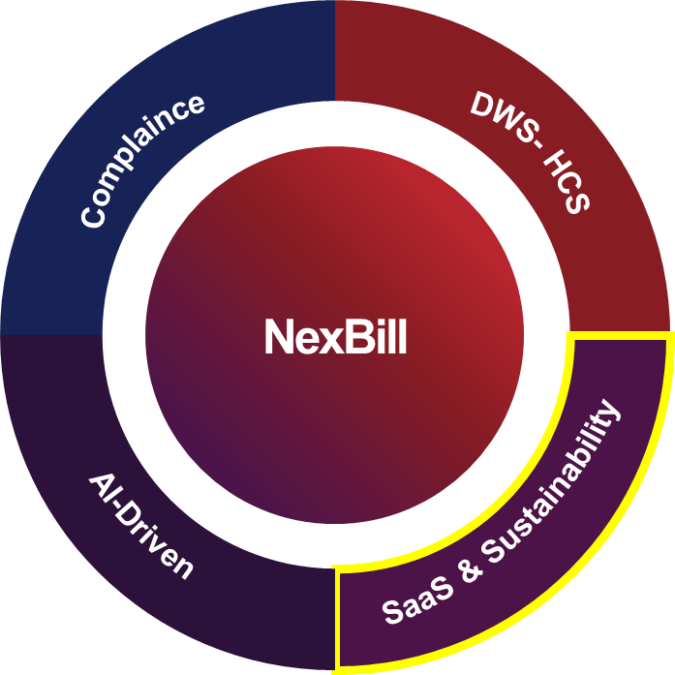
NexBill Project Wave I & II Roadmap
Q4 FY2627
Wave II (AP & EMEA)
Q3 FY2627
Implement an enhanced invoicing solution encompassing 88 functionalities, migrate data from the BRIM system to NexBill, and establish readiness to meet future data compliance requirements for EMEA and AP by Apr ’27
Decommission BRIM tool (May 27)
Wave I (NA)
FY2526
Implement a holistic invoicing solution encompassing 88 functionalities and migrate NA data from the BRIM system to NexBill to meet NA compliance requirements by Dec ’26, with ROW migration to follow.
Cease the use of BRIM as an invoicing tool for NA
NexBill Program Kick-Off
Program Scope Definition
Biz Benefit Case Alignment
FY2728
FY2627
FY2526

Slide 5
NexBill - Overall Introduction
Billing Platform
Current Situation
Key Change
Key Impact
Billing System: S4/ECC
Billing Method: Manual Billing
Key Business Scenarios:
  DaaS MLA (Migrated to EaaS)
  DaaS MSA / MLA – Early Order
  IaaS
  Special Charge
LOT team directly raises billing requests in NexBill system and generates the invoices. Invoice process will follow EaaS flow with invoice preview, invoice email to the customer.
Manual Billing
S4/ECC → NexBill
Billing System: LSP + S4/ECC
Billing Method: Auto Billing
Key Business Scenarios:
  DaaS MSA (*)
  SaaS
Running DaaS
No Impact
N/A
* Only for existing deals / original Hub (NL10) / LA
* After deal migration, run on EaaS platform
Billing System: BRIM
Billing Method: Auto Billing
Key Business Scenarios:
  DaaS MSA / MLA
  IaaS
  ISG Lease
LOT team generate invoice in advance and issue CMR & DMR easily
New dashboard for data visibility to all NexBill users
New reports for daily operation like invoice detail report (header & item), invoice payment tracking, projected cash flow (WIP), F&A related reports.
EaaS
BRIM → NexBill
* BRIM will sunset after NexBill rollout

Slide 6
NexBill - System Function
1. Billing Model
Mgmt.
2. Contract
Mgmt.
3. Subscription
Mgmt.
4. Usage & Billing
5. Invoicing
6. F & A
Offering Model Definition
Contract Lifecycle Mgmt.
Subscription Contract Mgmt.
Billing Schedule
Convergent Invoicing
Reconciliation
* Refer to IaaS Model
Usage Pricing Metrics
Revenue Sharing Model
Subscription Contract Change Mgmt.
Consumption billing engine
Taxation.
Accounting Entry
* Refer to IaaS Consumption
Generalized Price Calculation Model
Subscription Lifecycle Mgmt.
Recurring billing engine
Statement
GL Posting
Early Termination
Structure Payment billing engine
Invoice & Statement Approval
Deferral
Flex Options
One-Off Billing
Invoice Delivery (LIC)
Revenue Split
End of Term
Invoice Adjustment
End of Term Extension
Revenue Sharing
Mid Term Rewrite
7. Common Functions
Product Master Data
Customer Master Data
Exchange Rate Mgmt.
Vendor/funder
Master Data
Common Config
8. Reports
Business Operation reporting
Tax Reports
Invoice Reports
Other Reports

Slide 7
NexBill Business Process
Customer
Interaction
Subscription & Billing – NexBill
AR/AP Handling
…
SPS Sign Off / FGLA
Subscription
Initiation
Payment Schedule
Generation
Billable Item
Invoice Preview & Approval
Customer Invoice Generation
F&A Posting
AR Generation
Taxation
Damage Charge
Customer Collection
Invoice delivery
On Demand Charge
One-off
Subscription
ICO Billing Generation
Flex Pause/Down
Taxation
Early Termination
Subscription
Change
Payment Schedule
Updating
Partner Settlement
Taxation
AP Generation
Termination/
Extension
One-off
Subscription
Invoice Adjustment
Payment
Customer Usage
Metering Data Acquisition
Data Processing

Slide 8
1. Login & Setting
Login - Joy Jiang
Setting - Joy Jiang
Duration: 5 Minutes

Slide 9
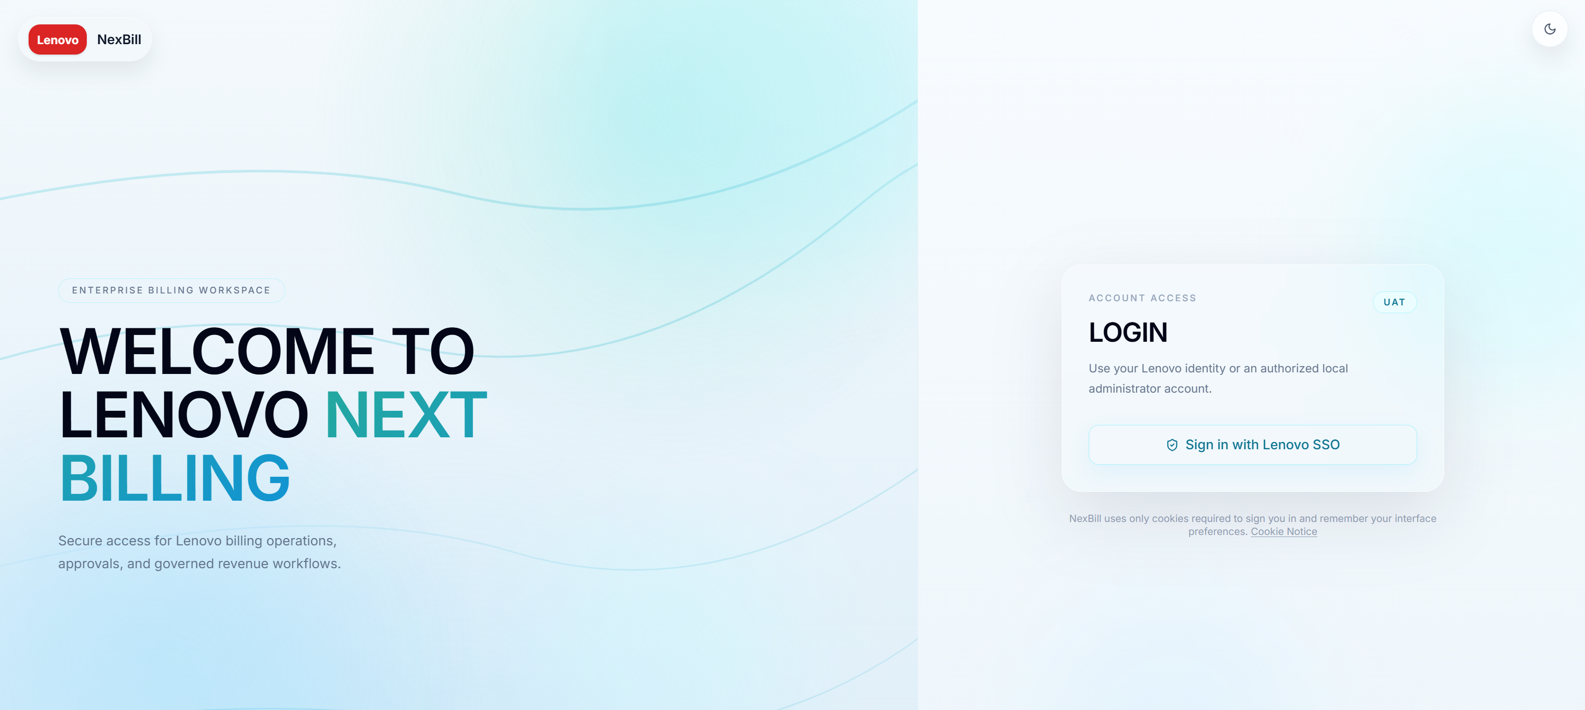
Login
The NexBill Login page provides secure access to the Lenovo Next Billing platform through Lenovo Single Sign-On (SSO). All users must be authenticated and authorized before accessing system functions.
Login: SSO → Access request → Role assignment → Login
1
Sign in with Lenovo SSO
Click Sign in with Lenovo SSO to access NexBill using your Lenovo IT Code.
2
First-Time Login Process
1. Click Sign in with Lenovo SSO.
2. NexBill automatically sends an access request to the NexBill Administrator.
3. The administrator assigns the required roles and permissions.
4. After approval, the user receives a notification email and can access NexBill.
1
3
Subsequent Logins
Authorized users can directly click Sign in with Lenovo SSO to access NexBill.
4
Access Control
Access to menus, functions, and business operations is controlled based on assigned roles.
Note: If login access has not yet been approved, users will not be able to enter the NexBill system after SSO authentication. Please contact the NexBill administrator if access approval is required urgently.
Nexbill UAT: https://nbl-uat.lenovo.com/
Nexbill PRD: https://nbl.lenovo.com/

Slide 10
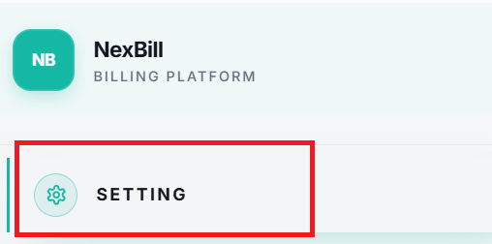
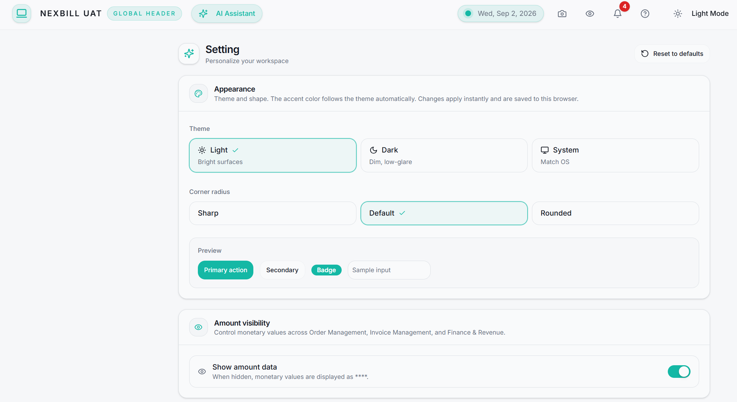
Setting
The Setting page allows users to personalize their NexBill workspace. Users can customize the visual appearance, font style, layout preferences, amount visibility, and animation settings to create a more comfortable and productive working environment.
All settings are applied immediately and are saved in the user's browser. Users can also restore the default configuration at any time by selecting Reset to Defaults.
1
Appearance
The Appearance section allows users to customize the overall look and feel of the NexBill interface.
Theme
Choose Light, Dark, or System mode.
Corner Radius
Choose Sharp, Default, or Rounded mode.
A preview area is provided to demonstrate how the selected theme and style will appear within the application.
1
2
Amount Visibility
Show or hide monetary amounts displayed in NexBill.
Show Amount Data
Enabled: Monetary values are displayed normally.
Disabled: Monetary values are masked and displayed as ****.
This setting applies across major business modules, including:
Order Management
Invoice Management
Finance & Revenue
This feature helps protect sensitive financial information when sharing screens or working in public environments.
2

Slide 11
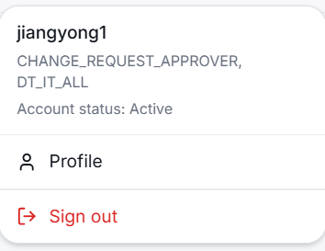
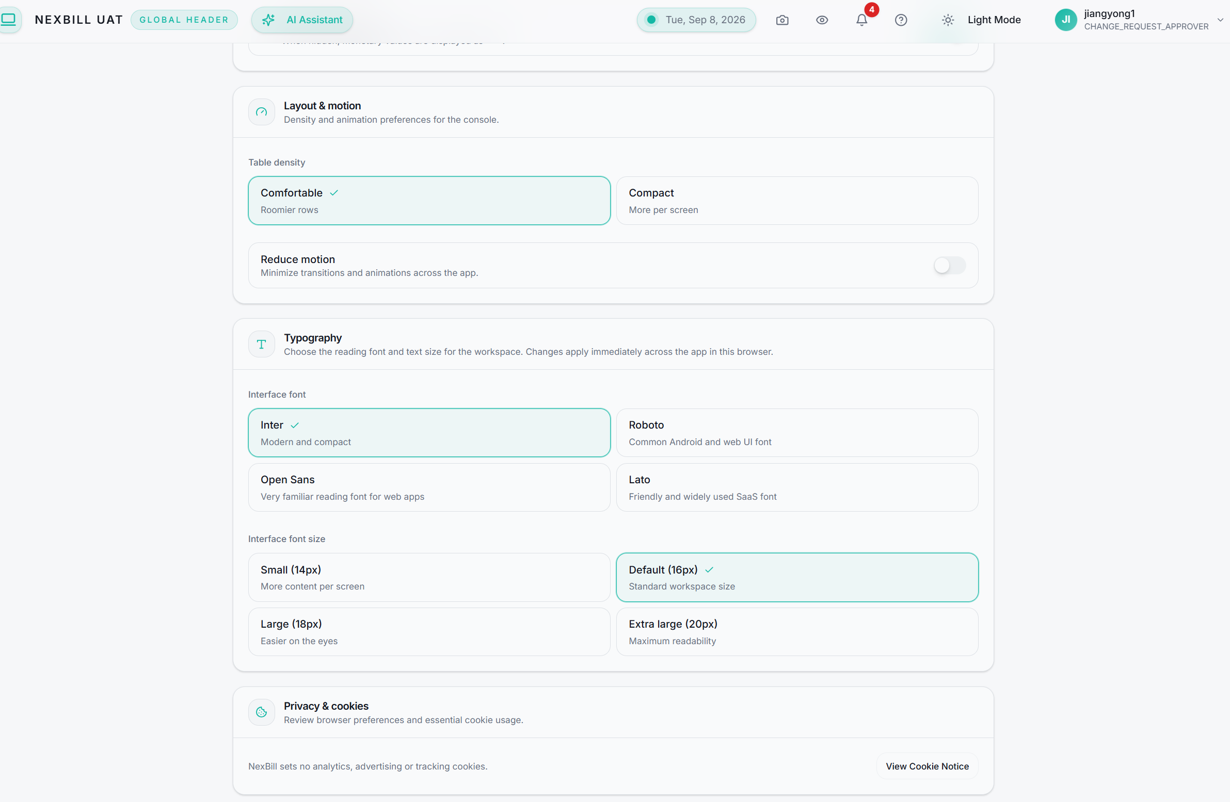
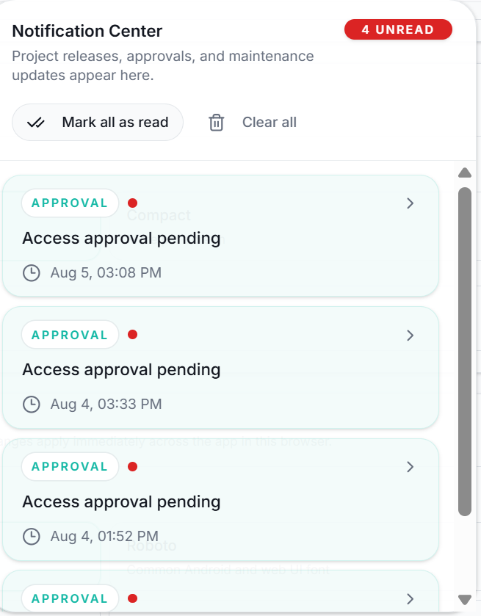
Setting
All settings are applied immediately and are saved in the user's browser. Users can also restore the default configuration at any time by selecting Reset to Defaults.
3
Table Density
6
Select Comfortable or Compact view to control how much information is displayed in tables.
Comfortable: Larger spacing between rows for better readability.
Compact: Displays more records within the available screen space.
Reduce Motion: When enabled, animations and transition effects throughout the application are minimized to improve accessibility and reduce visual distractions.
3
4
Layout & Motion
Available fonts:
Inter, Roboto, Open Sans, Lato
Available font size:
Small (14px), Default (16px), Large (18px), Extra Large (20px)
4
5
Privacy & Cookies
View NexBill's cookie and privacy information. User preferences are stored locally to improve the application experience.
6
Global Header Functions
Screenshot: Capture the current page.
Hide Amount Data: Mask monetary values.
Notification Center: View system notifications and approval updates.
Help: Access user guides and support resources.
Theme Mode: Switch between Light and Dark Mode.
User Profile: View account information and sign out.
5

Slide 12
2. Home
Timeliness & Accuracy - Xuezhi Ding
Delayed Invoice Aging - Xuezhi Ding
Invoice Volume Trend - Joy Jiang
Invoice Rejections - Joy Jiang
Volume & Billing - Joy Jiang
Focus Items - Joy Jiang
Customer Billing Status - Joy Jiang
Duration: 15 + 10 Minutes

Slide 13
Home — Your Billing Operations Launchpad
Your first page after entering NexBill: one view of billing health, workload, exceptions, and customer progress.
KEY MESSAGE
See what is on track, what is delayed, and what needs action — then drill directly into the underlying records.
1 MONITOR BILLING HEALTH
2 PRIORITIZE ACTION
3 UNDERSTAND BUSINESS PROGRESS
• Timeliness & Accuracy — preview/final timeliness, accuracy and issue rate
• Delayed Invoice Aging — overdue count and amount across six aging buckets
• Invoice Volume Trend — plan vs. actual vs. delay, by count or amount
• Invoice Rejections — identify affected customers, periods and rejection details
• Focus Items — see unposted finals, previews pending over 7 days and recent adjustments
• Direct links take users to the relevant invoice and search pages
• Volume & Billing — monthly subscription-order and invoice activity
• Customer Billing Status — invoice count plus preview and billed amounts by customer
• Drill down or export data for follow-up and offline analysis
A USER’S HOME WORKFLOW
LAND
Open Home
SCAN
Check health
FILTER
Narrow the view
PRIORITIZE
Review exceptions
DRILL DOWN
Open details
QUICK CONTROLS
Month • Service Model • Biz/System View • Count/Amount • Chart/Table • Export
KEY USER RULE | Start with Focus Items and exception indicators; apply filters, then drill into the relevant invoice or customer record.

Slide 14
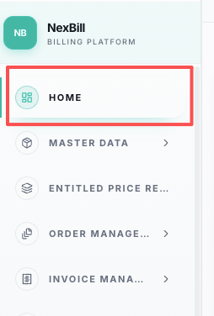
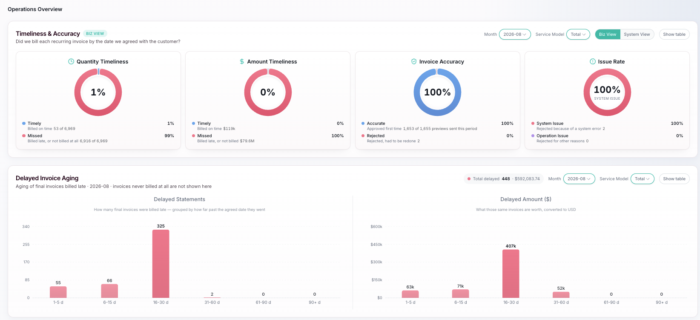
Invoice Dashboard
1. Timeliness & Accuracy
Tracks recurring invoice performance across timeliness (% preview/final missed target date) and accuracy (% preview rejected).
2. Delayed Invoice Aging
Final invoices missed target date grouped by aging bucket.

Slide 15
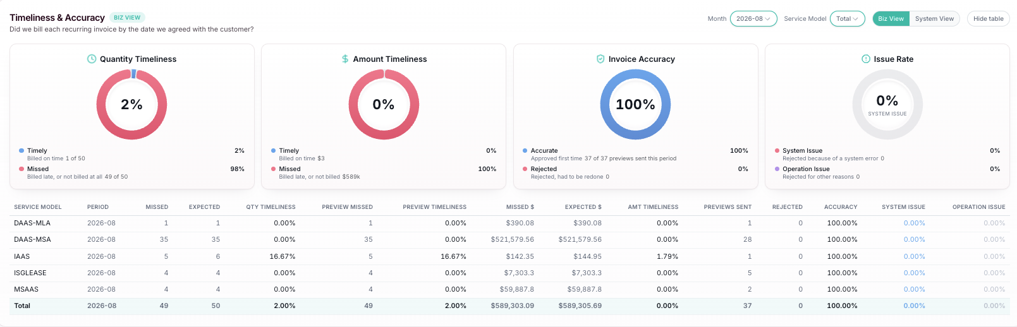
Timeliness & Accuracy
1. Quantity Timeliness(Business)
Monitoring the processing performance of invoices for different service models to identify bottlenecks and areas for improvement, ensuring efficiency and accuracy in billing. Only recurring invoices are calculated
Count of final statements not at Customer Final Invoice Date of current month / Count of total final statements should be created in current month
2. Amount Timeliness(Business)
Amount of final invoices not at Customer Final Invoice Date of current month / Amount of total final invoices should be created in current month in USD
3. Quantity Timeliness(System)
Count of preview statements not at Customer Preview Invoice Date of current month / Count of total preview statements should be created in current month
4. Amount Timeliness(System)
Amount of preview invoices not at Customer Preview Invoice Date of current month / Amount of total preview invoices should be created in current month) in USD
5. Invoice Accuracy
Count of rejected preview statements of current month / Count of total preview statements of current month
6. Issue Rate
Count of rejected preview statement with system error of current month / Count of rejected preview statements of current month

Slide 16
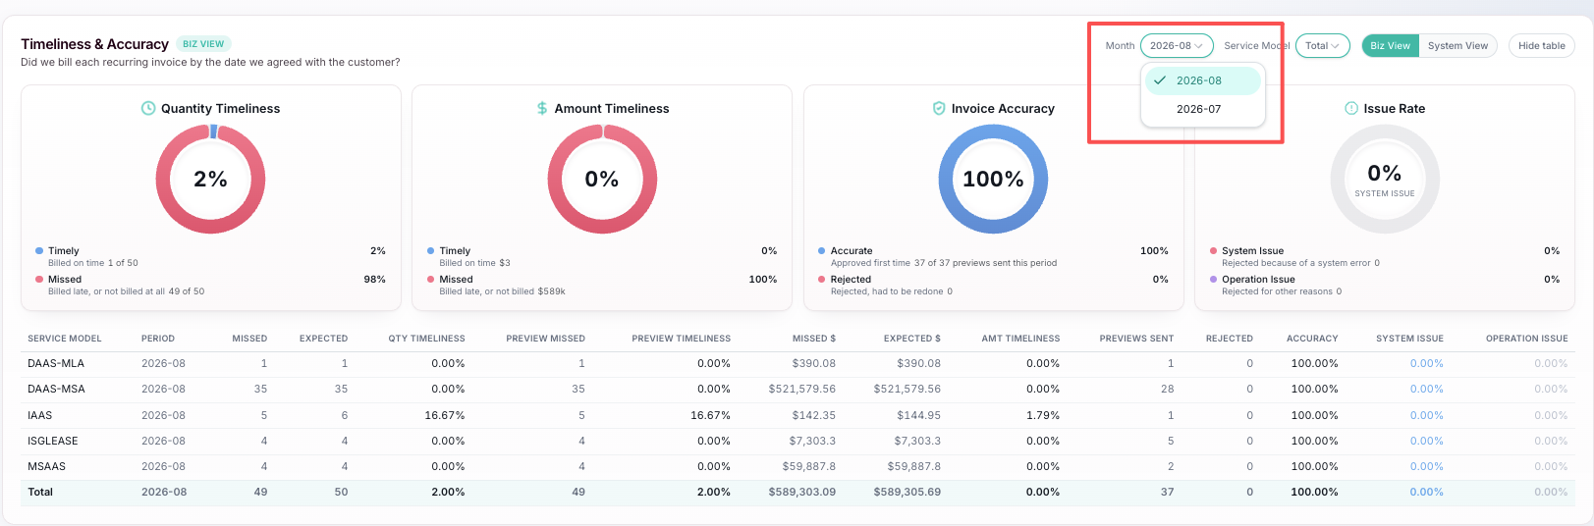
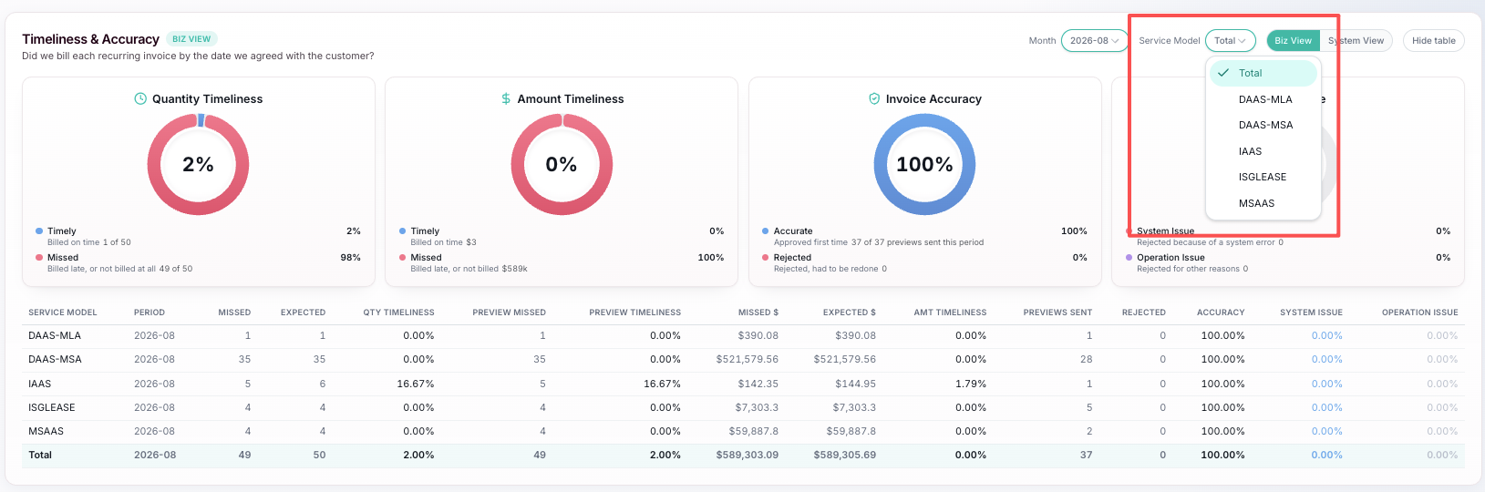
Timeliness & Accuracy
Monitoring the processing performance of invoices for different service models to identify bottlenecks and areas for improvement, ensuring efficiency and accuracy in billing. Only recurring invoices are calculated
1. Select Month & Service Model
Use the Month filter (e.g. 2027.01) and the Service Model filter (Total, DaaS-MLA, DaaS-MSA, IaaS, ISGLEASE, MSAAS). All gauges, tables and the timeline refresh with the selection.
2. Switch Biz View / System View
Biz View reads final-invoice timeliness (only net amount considered); System View reads preview-invoice timeliness.
3. Show Table/Hide Table
Use Show Table / Hide Table to toggle the detail table.

Slide 17
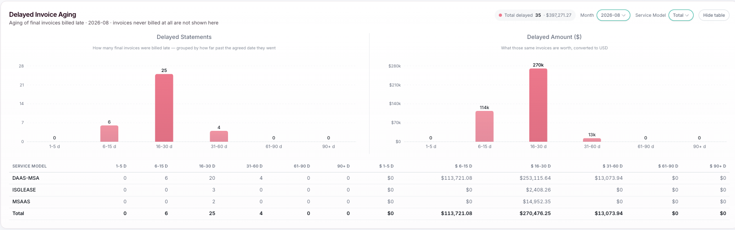
Delayed Invoice Aging
The aging table is grouped by service model and shows delayed statement count and delayed invoice amount for each bucket. For each service model, columns show delayed statement count and delayed invoice amount (USD with thousand separators) across six buckets: 1-5, 6-15, 16-30, 31-60, 61-90, 90+ days. Each delayed invoice falls into exactly one bucket by its overdue days.
1. Quantity Aging
Count of delayed final statements - 1-5 days, 6-15 days, 16-30 days, 31-60 days, 61-90 days, 90 days plus
2. Amount Aging
Amount of delayed final invoices – 1-5 days, 6-15 days, 16-30 days, 31-60 days, 61-90 days, 90 days plus

Slide 18
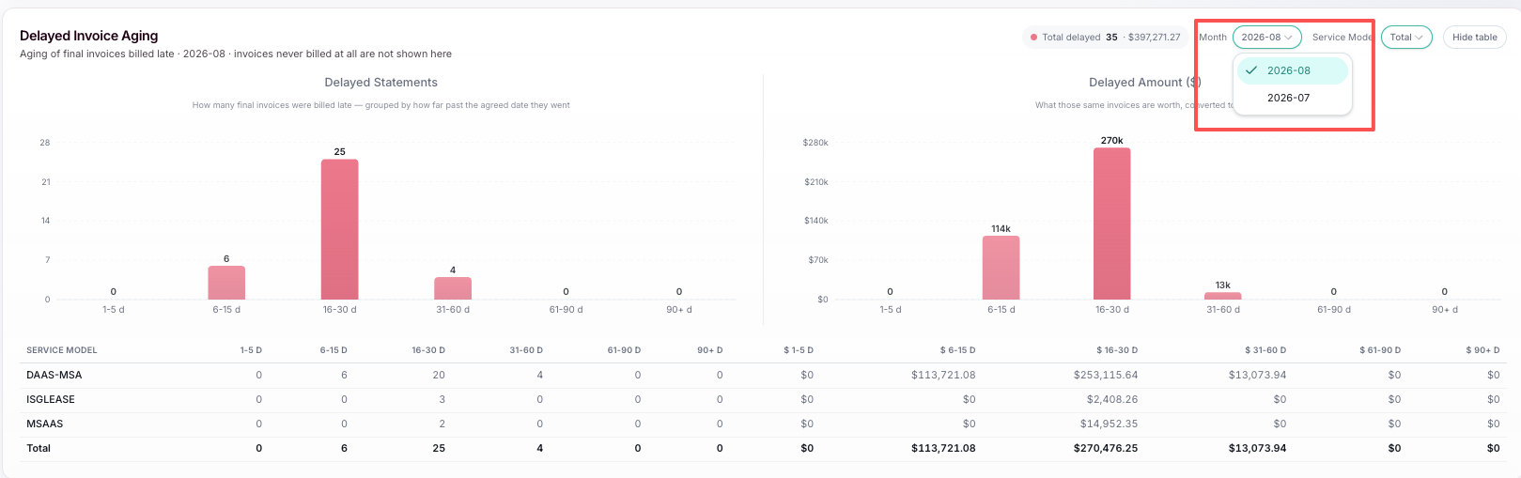
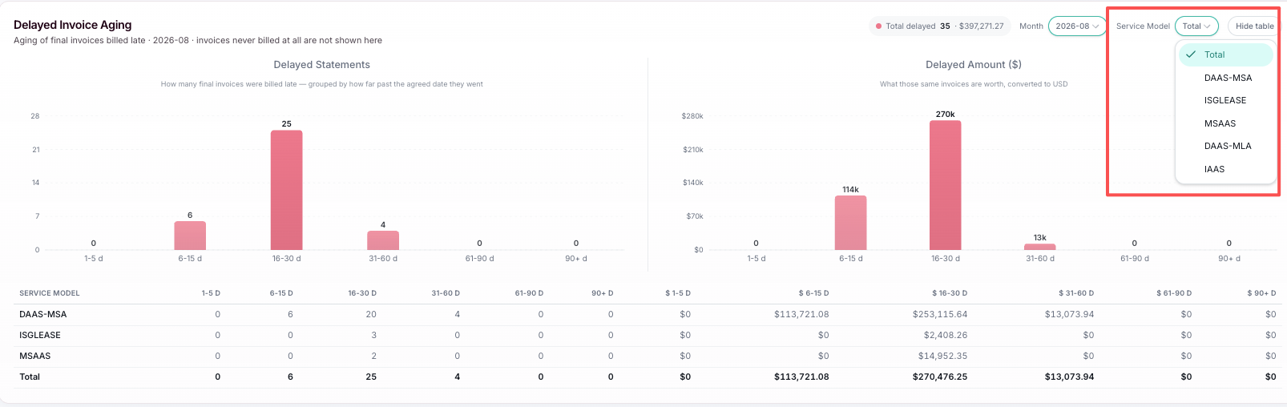
Delayed Invoice Aging
The aging table is grouped by service model and shows delayed statement count and delayed invoice amount for each bucket. For each service model, columns show delayed statement count and delayed invoice amount (USD with thousand separators) across six buckets: 1-5, 6-15, 16-30, 31-60, 61-90, 90+ days. Each delayed invoice falls into exactly one bucket by its overdue days.
1. Select Month & Service Model
Use the Month filter (e.g. 2027.01) and the Service Model filter (Total, DaaS-MLA, DaaS-MSA, IaaS, ISGLEASE, MSAAS). All gauges, tables and the timeline refresh with the selection.
2. Switch Biz View / System View
Biz View reads final-invoice timeliness (only net amount considered); System View reads preview-invoice timeliness.
3. Show Table/Hide Table
Use Show Table / Hide Table to toggle the detail table.

Slide 19
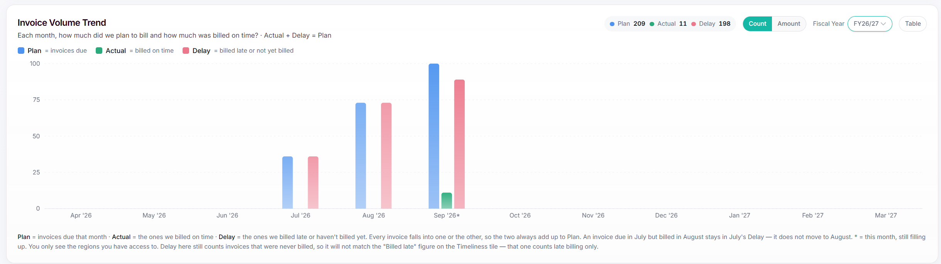
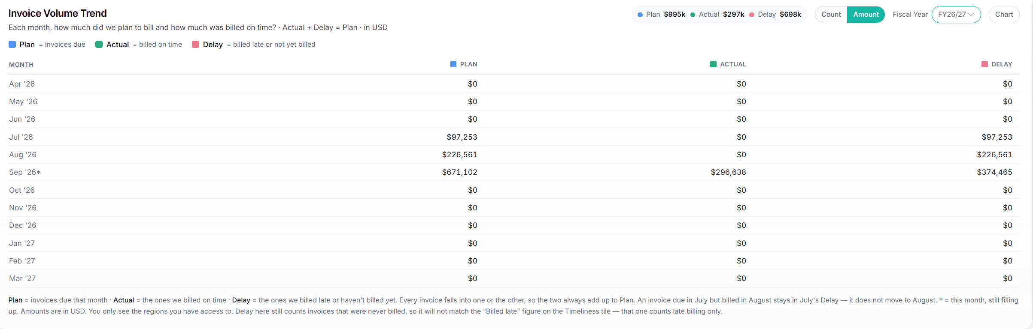
Invoice Volume Trend
The dashboard enables users to monitor planned invoices, actual billed invoices, and delayed invoices. It helps users quickly identify billing trends, monitor billing timeliness, and assess billing performance across the selected fiscal year. Users can analyze data by Count or Amount and switch between Chart and Table views for detailed review.
1
1
Invoice Volume Trend
2
3
4
Metrics
Plan: Invoices scheduled to be billed during the selected month.
Actual: Invoices billed on time.
Delay: Invoices billed late or not yet billed.
Actual + Delay = Plan
2
Count / Amount View
Users can switch between two measurement:
Count: Displays invoice volume based on the number of invoices.
Amount: Displays invoice volume based on invoice monetary values (USD).
3
Fiscal Year Selection
The Fiscal Year filter allows users to view dashboard data for a specific fiscal year.
4
Table View
Displays the same data in a tabular format for detailed review and comparison.
Users can switch between the two views at any time.

Slide 20
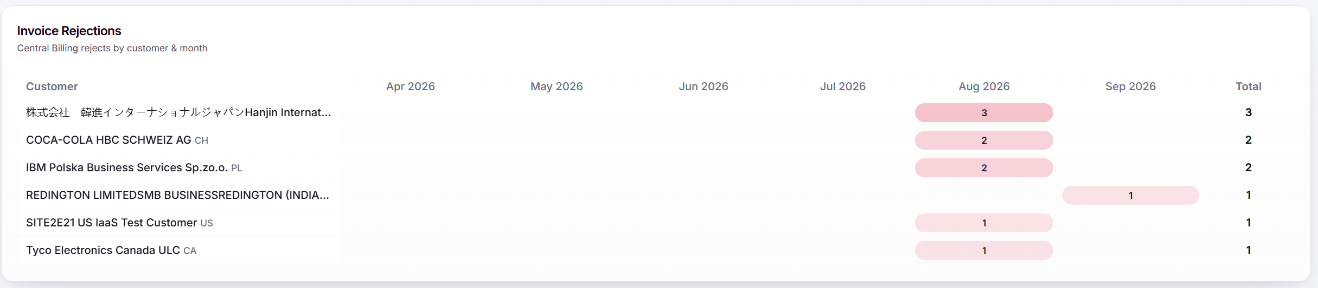
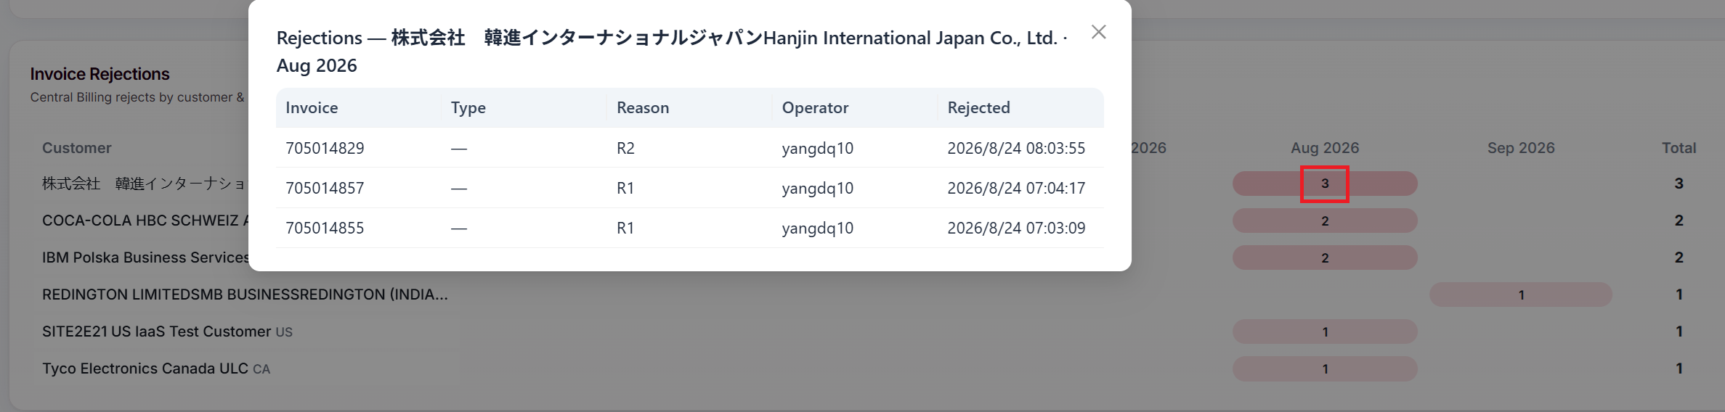
Invoice Rejections
The dashboard provides visibility into invoice rejection activities across customers and billing periods. It helps users identify customers with rejected invoices, monitor rejection trends over time, and prioritize follow-up actions to improve billing efficiency and invoice acceptance rates.
1
Invoice Rejections
1
The Invoice Rejections widget displays the number of rejected invoices by customer and billing month.
Customer Rejection View
Displays customers with invoice rejection counts by month and total rejections.
Highlights customers with the highest number of rejections.
Monthly Rejection Trend
Shows invoice rejection counts across monthly periods.
Total Rejections
Displays the cumulative number of rejected invoices for each customer.
2
2
Rejection Details Drill-Down
Users can select a rejection count displayed in the dashboard to view the underlying rejected invoices:
Invoice Number
Invoice Type
Rejection Reason
Operator
Rejected Date and Time

Slide 21
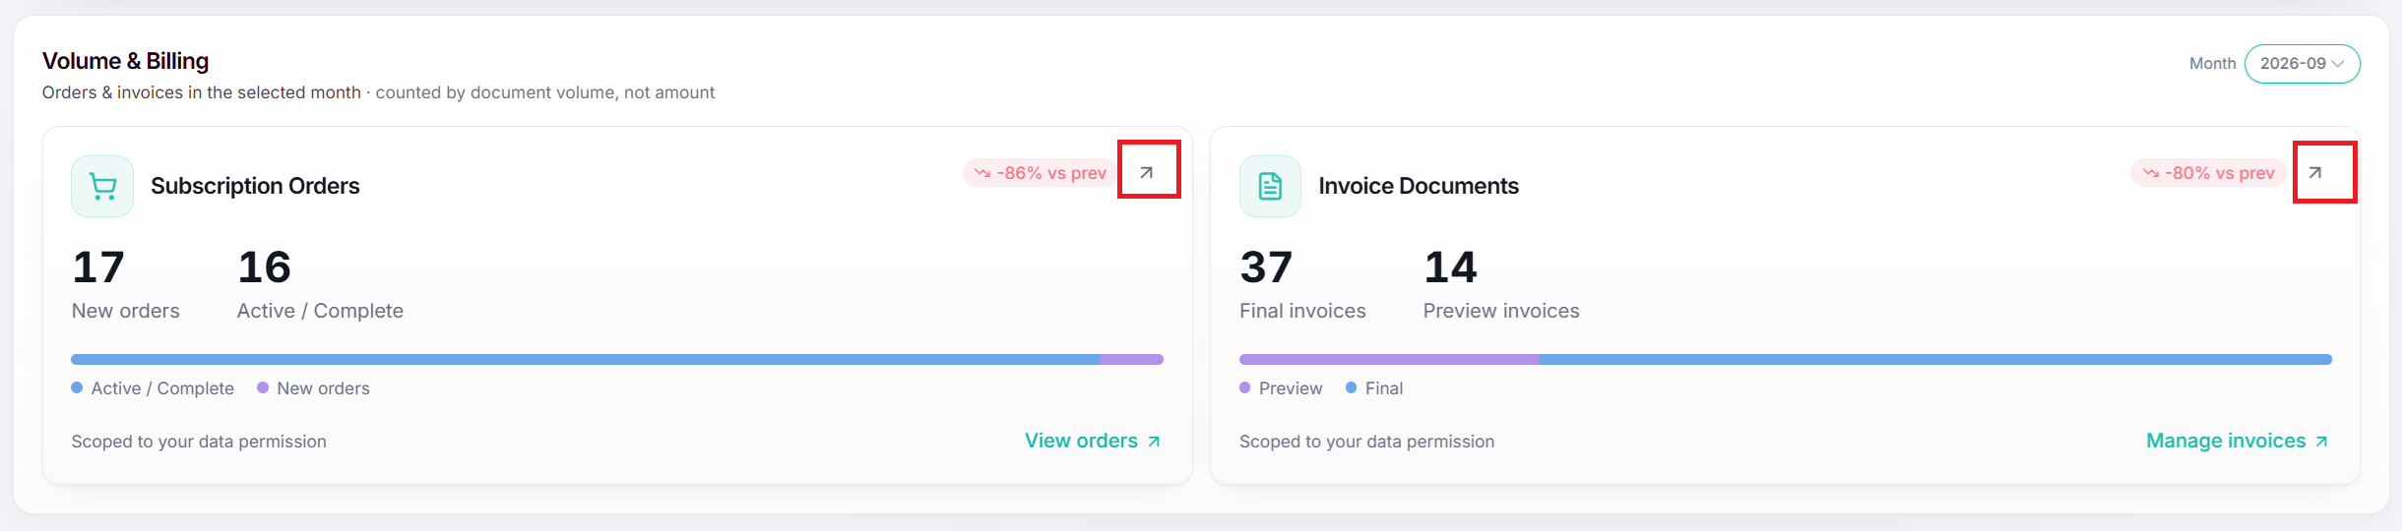
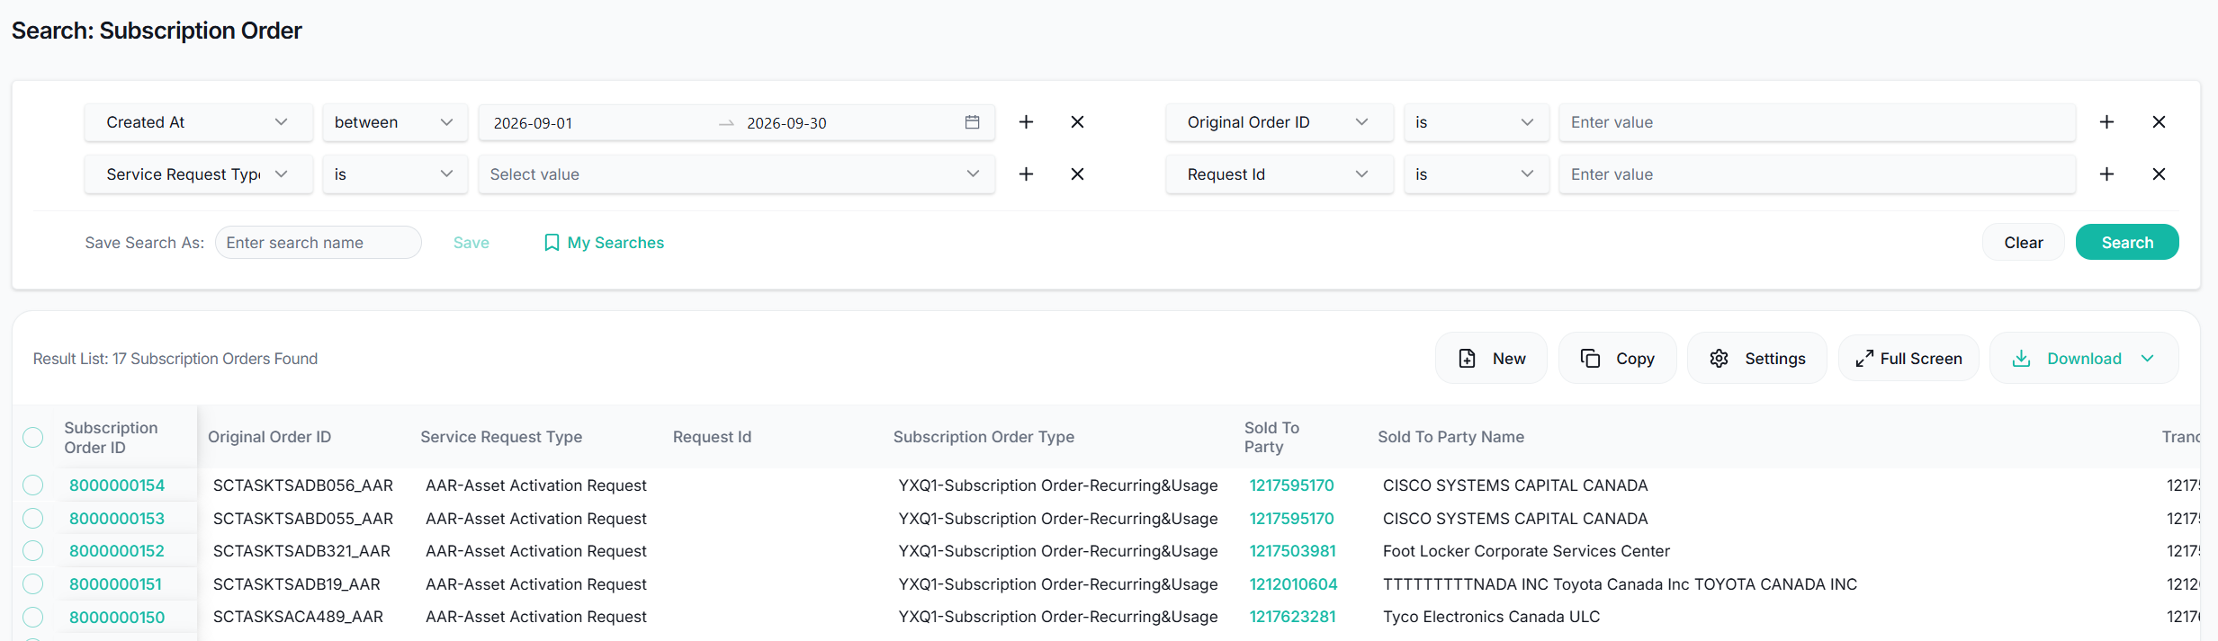
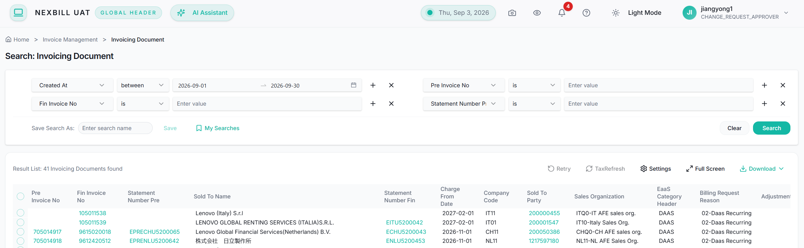
Volume & Billing
The dashboard provides a monthly overview of subscription order and invoice processing activities in NexBill. It helps users monitor business volume, track subscription order and invoice trends, and quickly access detailed transaction information.
1
Volume & Billing
1
The Volume & Billing widget summarizes key subscription order and billing activities for the selected month. The Month filter allows users to view dashboard data for a specific reporting month.
Subscription Orders
Provides an overview of subscription order creation and processing status, including:
New Orders: Number of subscription orders created during the selected month.
Active / Complete: Number of subscription orders that are active or completed.
Users can select the arrow icon (↗) or View Subscription Orders link to navigate directly to the Subscription Order Search page for detailed subscription order review and management.
Invoice Documents
Provides an overview of invoice document generation status, including:
Final Invoices: Number of finalized invoice documents.
Preview Invoices: Number of invoice documents in preview status.
Users can select the arrow icon (↗) or Manage Invoices link to navigate directly to the Invoice Document Search page for detailed invoice review and processing.

Slide 22
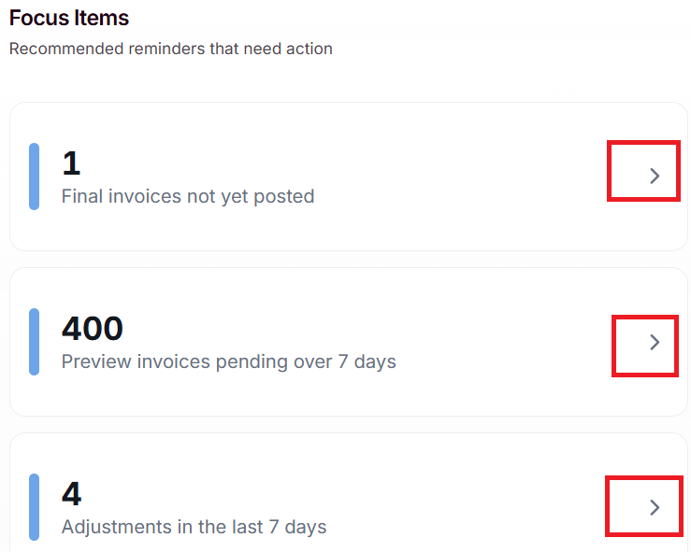
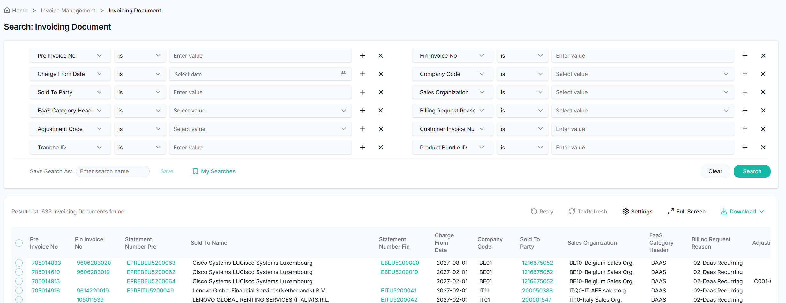
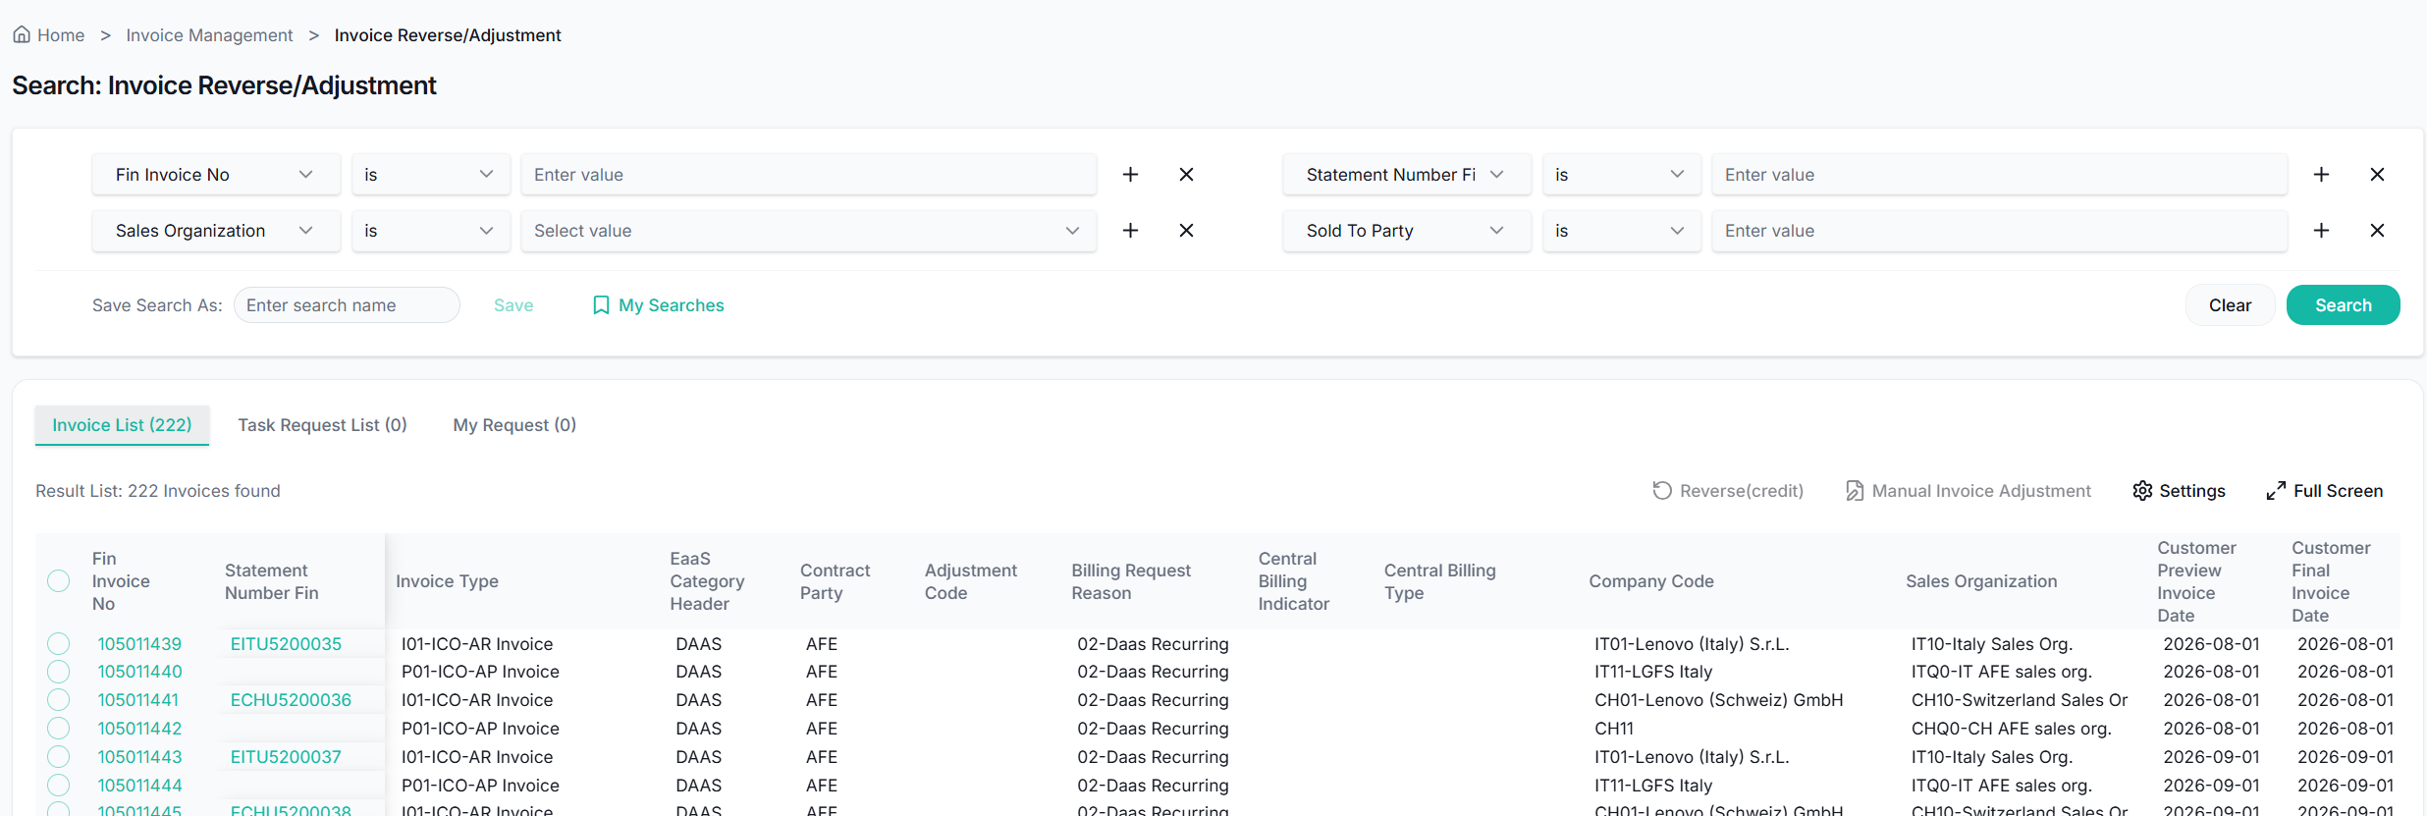
Focus Items
The dashboard highlights important billing and approval activities that require user attention. It provides quick access to pending tasks and exception items, helping users prioritize daily operations and take timely action. Each focus item displays the current volume of records that meet specific business conditions.
1
Final Invoices Not Yet Posted
Displays the number of finalized invoices that have not yet been posted.
Click the arrow icon (>) to open the Invoice Document Search page with the relevant invoice records.
1
2
Preview Invoices Pending Over 7 Days
2
Displays the number of preview invoices that have remained in preview status for more than seven days.
Click the arrow icon (>) to open the Invoice Document Search page with the corresponding invoice records.
3
3
Adjustments in the Last 7 Days
Displays the number of invoice adjustment requests created during the last seven days.
Click the arrow icon (>) to open the Invoice Revision / Adjustment Request page for detailed review and processing.

Slide 23
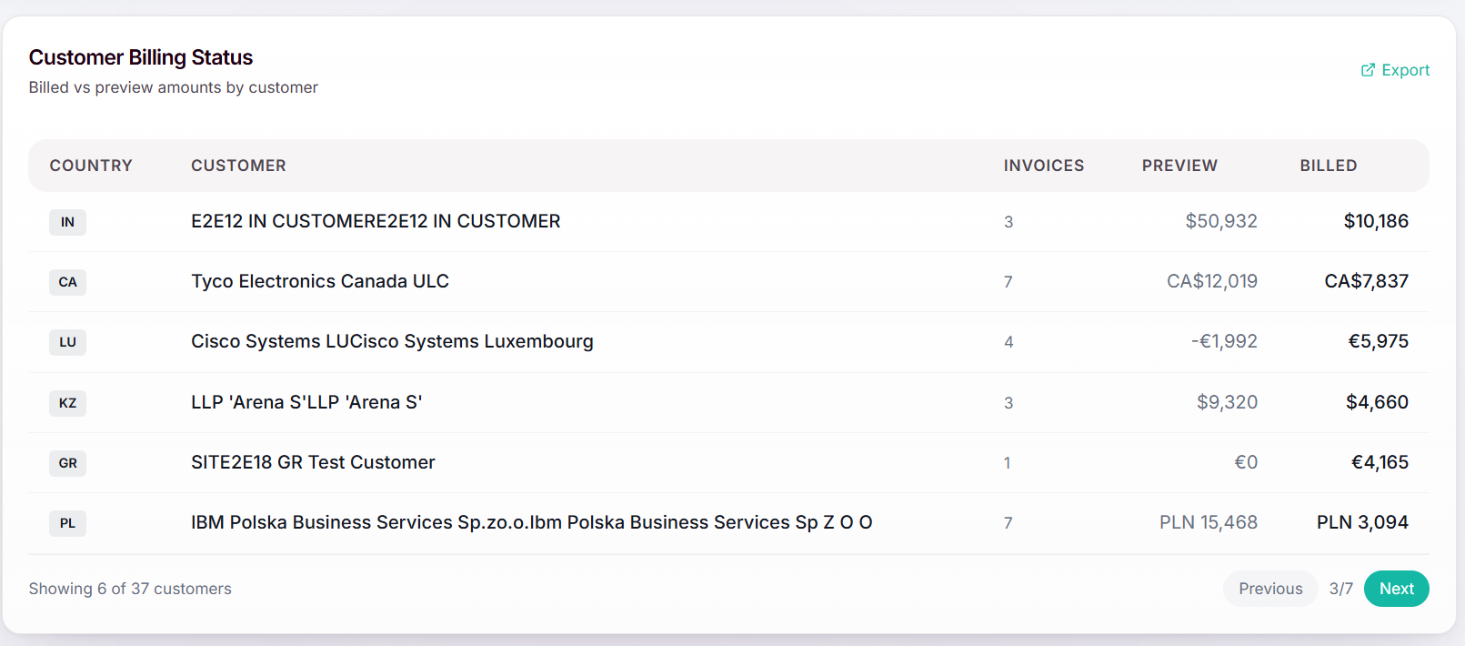
Customer Billing Status
The dashboard provides a customer-level overview of billing activity and invoice generation status. It helps users compare preview invoice amounts with billed amounts, monitor customer billing progress, and identify customers with significant billing volumes.
1
Customer Billing Status
1
The Customer Billing Status widget displays billing information by customer and country.
Country: Displays the customer's country or region.
Customer: Displays the customer name.
Invoices: Displays the total number of invoices associated with the customer.
Preview: Displays the total value of invoices currently in Preview status.
Billed: Displays the total value of invoices that have been finalized and billed.
Users can click anywhere within the Customer Billing Status dashboard to navigate directly to the Invoice Document Search page.
2
2
Export
The Export function allows users to download the dashboard data for offline review, reporting, and analysis.

Slide 24
3. Master Data
Product Master - Joy Jiang
Account Master - Joy Jiang
Duration: 10 Minutes

Slide 25
Master Data — Trust the Data Before You Transact
Your starting point for finding, understanding, and safely maintaining the product and account data used across NexBill.
KEY MESSAGE
Search the right master record, confirm its source and readiness, then follow the governed path when a change is needed.
1 FIND & UNDERSTAND
2 KNOW THE SOURCE
3 ACT WITH CONTROL
• Search Product and Account Master with flexible criteria and saved searches
• Review product classification, sales, plant, tax, bundle and charge-plan details
• Review account identity, address, tax, relationships and invoice profile
• Products: ECC/S4 via LPC; WBD bundles from EPR; SUB* products from PLM
• IaaS usage products need the correct metering type and Charge Plan
• Accounts normally come from Account Service; invoice profiles sync from ServiceNow
• New, Copy and Pull actions support authorized exception handling
• Edit creates a Change Request and requires approval before data becomes effective
• Change Request and Change History provide status visibility and an audit trail
A USER’S MASTER DATA WORKFLOW
SEARCH
Find record
REVIEW
Check details
VERIFY
Confirm source
ACT
Submit change
TRACK
Follow approval
QUICK ACCESS
Filters • Save Search / My Searches • Sort & Reorder • Detail Tabs • Change Request • History
KEY USER RULE | If integrated data is wrong, correct it in the source system; use NexBill maintenance only for authorized exceptions. Edits require approval.

Slide 26
Product Master - What Key Users Need to Know
Understand where products come from, how they are created in NexBill, and what IaaS products require before EPR use.
KEY MESSAGE
Different product types follow different source and preparation flows before they can be used in NexBill.
1 NORMAL ECC / S4 PRODUCT
2 WBD* BUNDLE PRODUCT
3 SUB* PRODUCT
ECC / S4
LPC
EPR Bundle Structure
PLM
NexBill
LPC
EPR inbound triggers product retrieval
WBD bundle detected during EPR inbound
Created before EPR
PLM sends SUB* products to NexBill before the EPR is generated.
NexBill Product Master
NexBill Auto Create
Available for EPR use
Created automatically from LPC when required during EPR processing.
NexBill creates the WBD bundle product from the EPR bundle structure.
IaaS SPECIAL PREPARATION | SUB* + Usage Metering
POWER • HYBCLOUD • BAAS • STAAS • STORAGE • AZURE
PLM sends
SUB* product
NexBill creates and sends
Product Master
LPC creates SUB* product
DT / IT configures
Charge Plan
EPR Inbound
uses product
IaaS billing
ready
IaaS Product without Charge Plan | SUB* + Fix Metering
POWERFIX • FIX
PLM sends
SUB* product
NexBill creates and sends
Product Master
LPC creates SUB* product
EPR Inbound
uses product
IaaS billing
ready
KEY USER RULE | Product exists ≠ IaaS product is ready. A valid Charge Plan must be configured before normal EPR / usage billing processing.

Slide 27
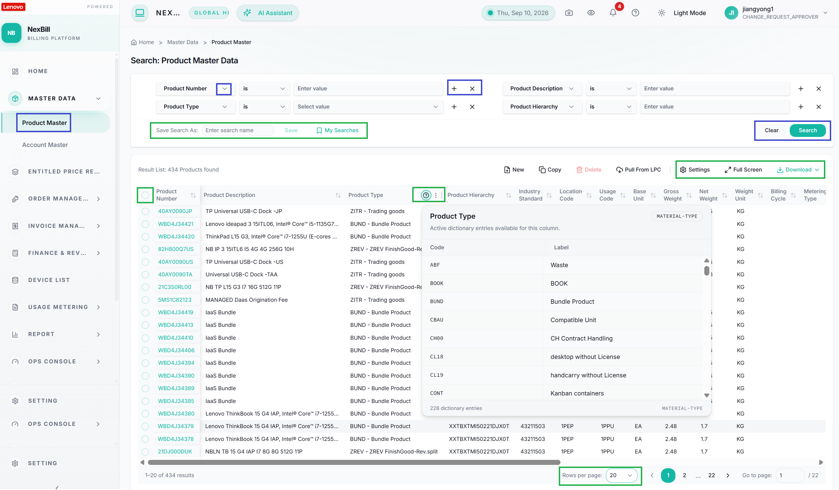
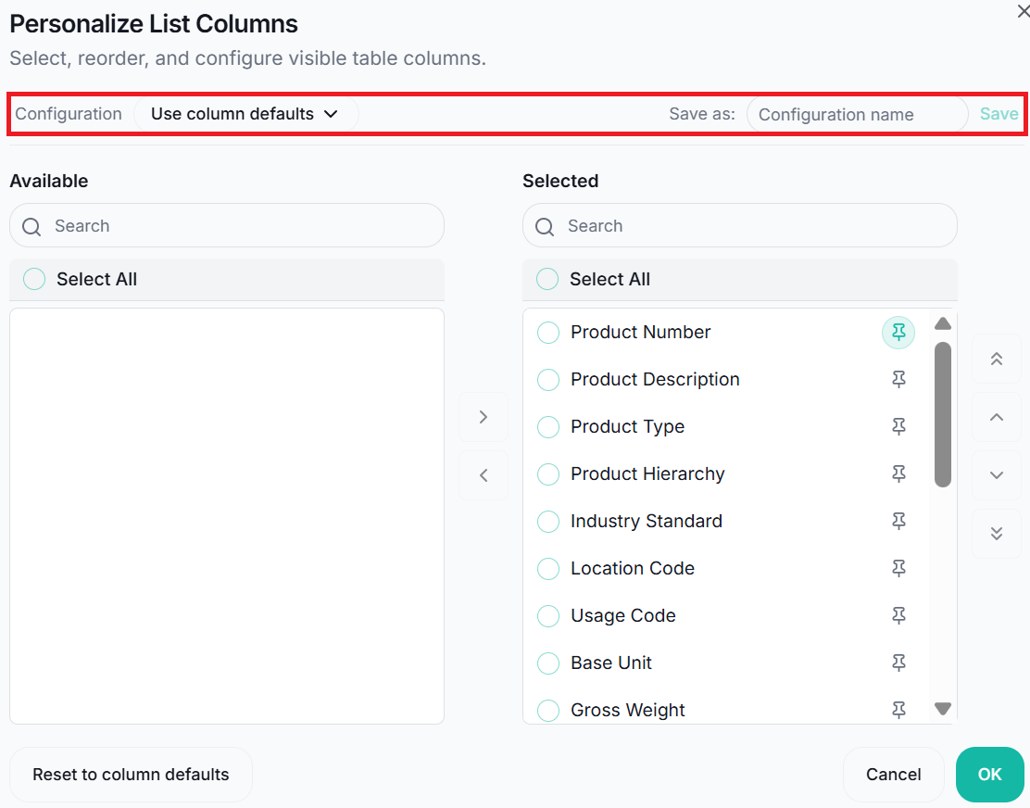
Product Master - Search & Result
The Product Master Search page allows users to search, review, and maintain product master data within NexBill. Users can locate products using flexible search criteria, access product information required for subscription orders and invoicing processes. Navigation: MASTER DATA → Product Master Data
1
Search Product Master Data
Users can search product master records using one or more search criteria.
“+” icon: add additional search conditions.
“×” icon: remove conditions.
Search: retrieve matching product records.
Clear: remove all search criteria and clear the current search results.
Save Search: save frequently used search criteria for future use.
My Searches: quickly reuse previously saved search templates.
1
2
2
Result List
Sorting: sort results by clicking a column header.
Column Resize: resize columns by dragging the column boundary.
Column Reorder: rearrange columns by dragging the column header to a different position.
Data Dictionary: click the (?) icon next to Product Type to view available values and their descriptions.
Record Selection: select records using the row checkbox or use the header checkbox to select all records on the current page.
Record Details Navigation: click the Product Number hyperlink to open the Product Master Detail page.
Pagination: By default, 20 records are displayed per page. Users can navigate between pages using the page controls. Users can change the number of displayed records using the Rows per page selector.
Settings: customize the result list by selecting which fields are displayed. Users can save the layout as a configuration and reuse it in future sessions.
Full Screen: expand the result list for easier review.
Download: exports product master data for offline analysis.
Download All Data: export all records returned by the current search.
Download Selected Data: export only the selected records.

Slide 28
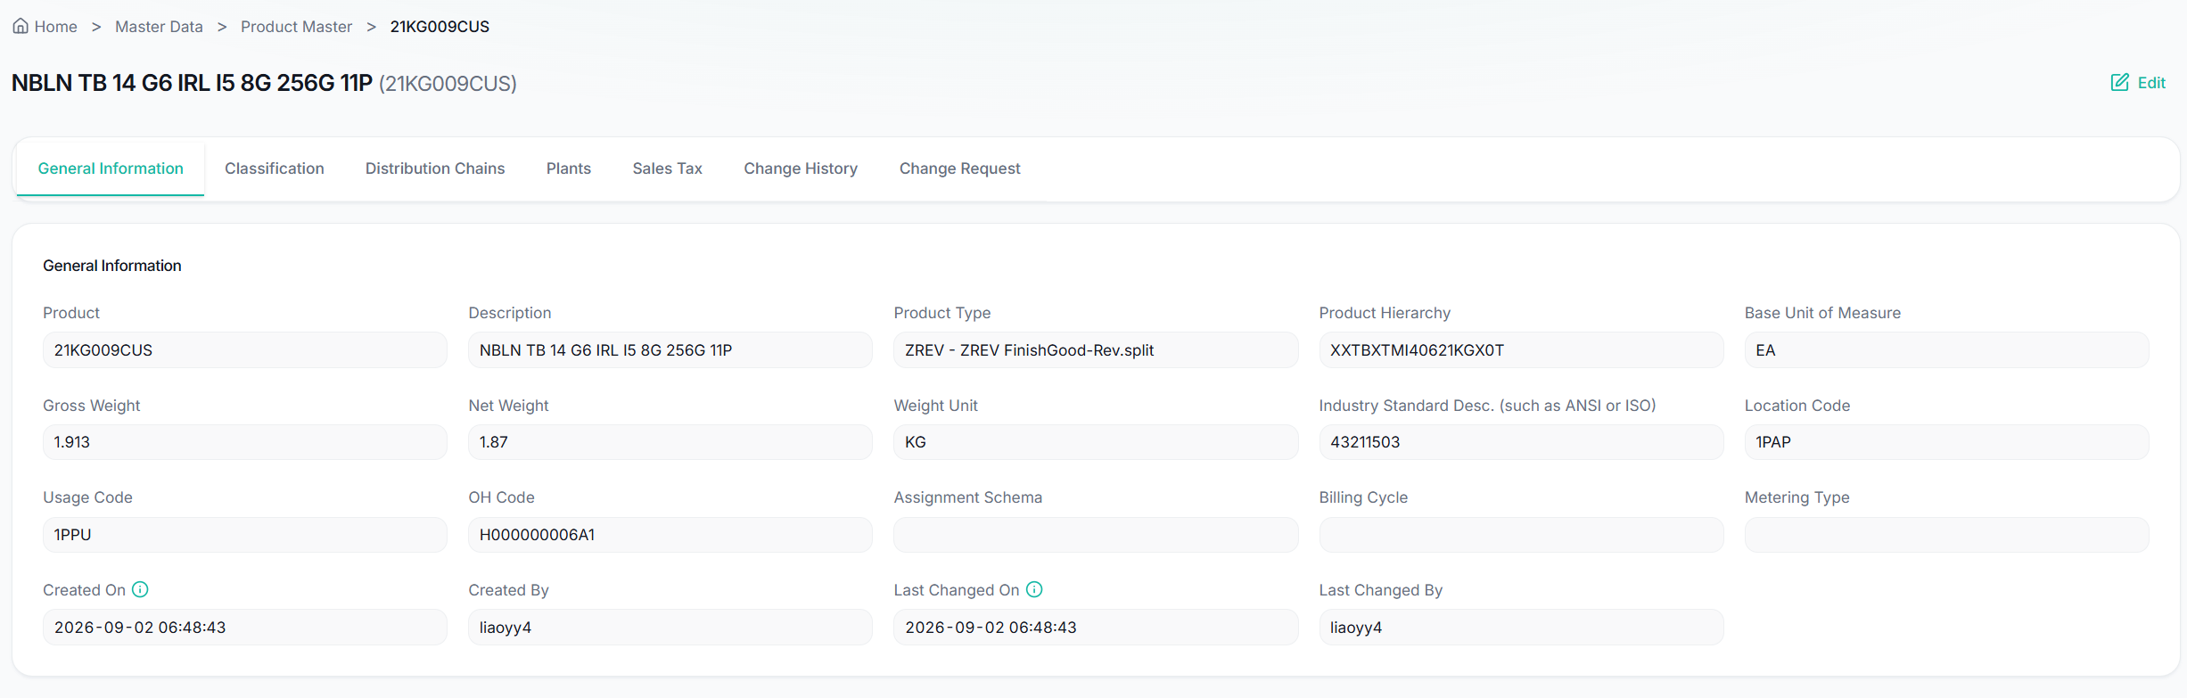
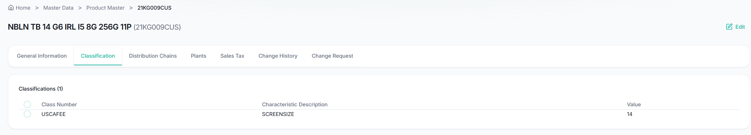
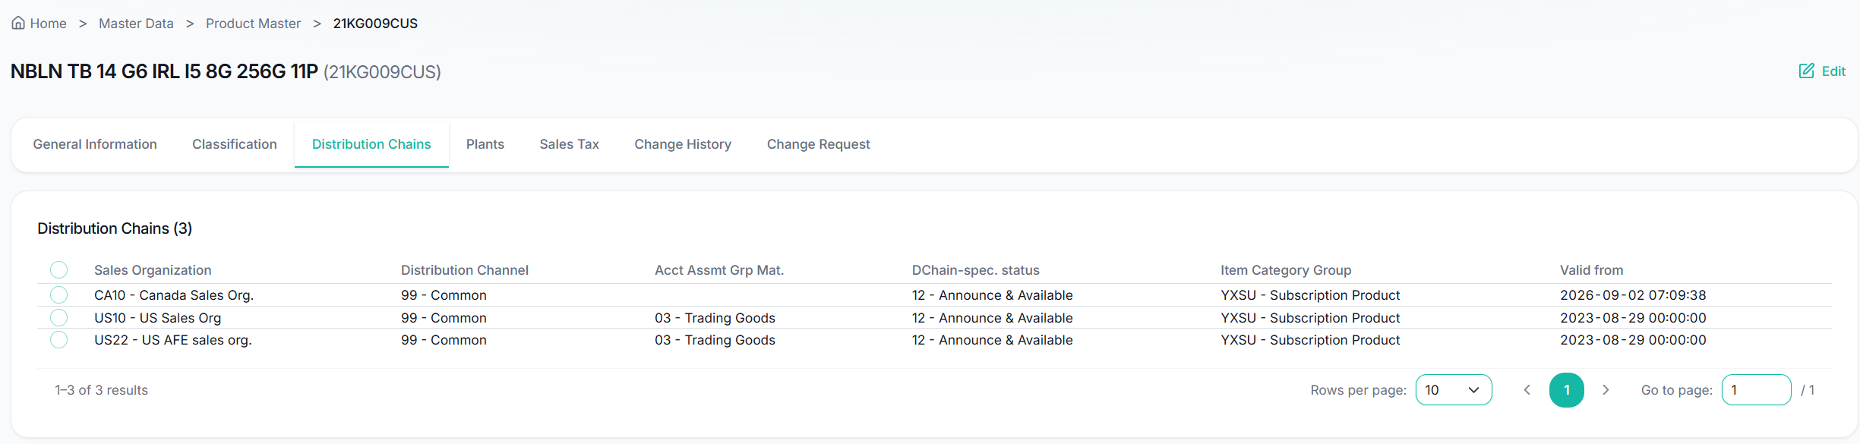
Product Master - Detail
The Product Master Detail page provides comprehensive information about a product master record in NexBill. Users can review product attributes, classifications, sales organization data, plant information, tax settings, bundle structures, change requests, and historical changes associated with the product.
1
General Information
The General Information tab displays the core attributes of the product.
1
2
Classification
The Classification tab displays product classification characteristics and values used for billing and business processing.
For example, SCREENSIZE may be maintained for specific business scenarios such as CA.Rc.Fee calculation and processing.
3
Distribution Chains
The Distribution Chains tab displays sales organization related information for the product.
A product may have multiple distribution chain records.
2
3

Slide 29
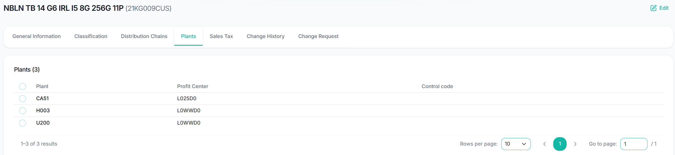
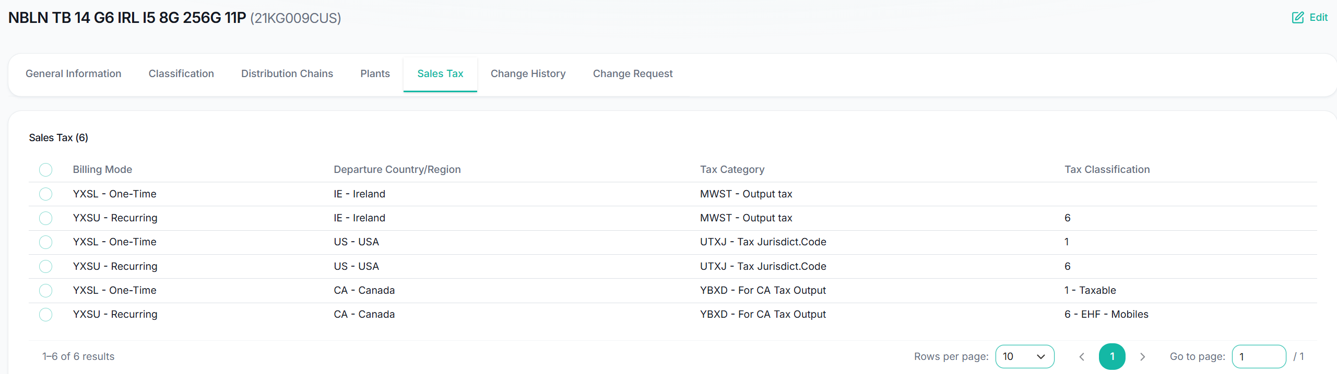
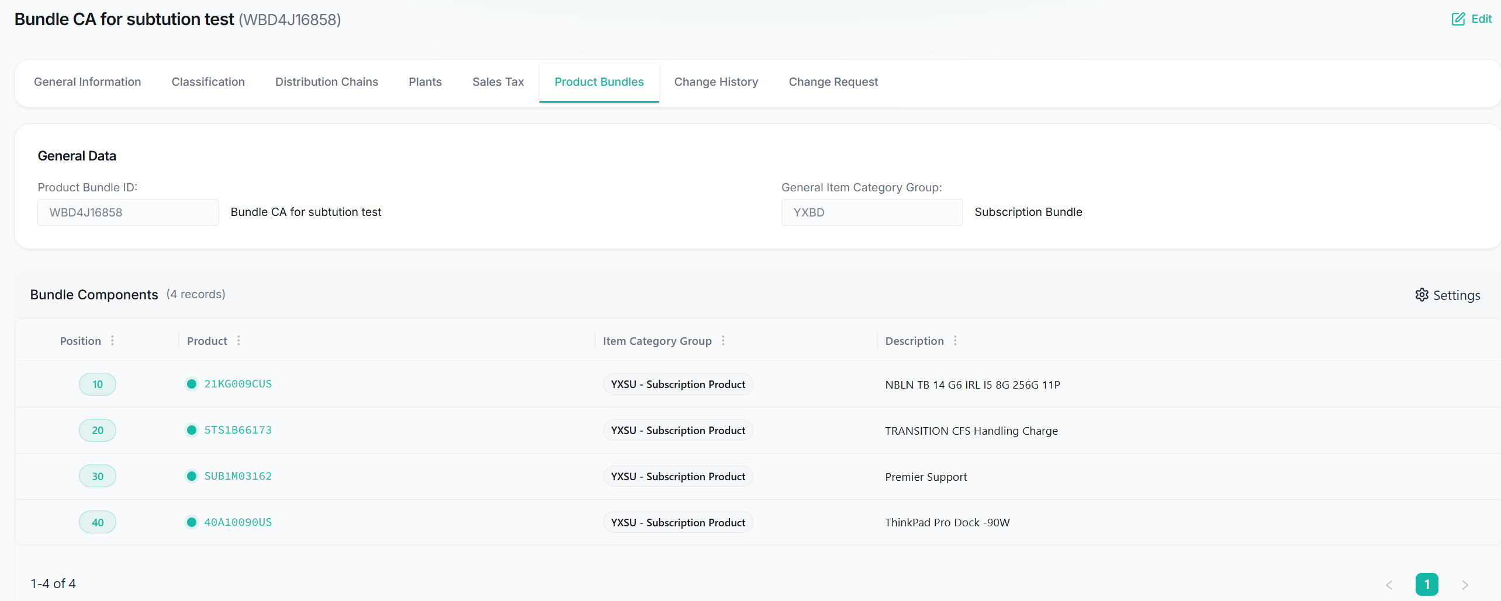
Product Master - Detail
4
Plants
The Plants tab displays plant-specific information associated with the product, includes:
Plant
Profit Center
Control Code
4
5
Sales Tax
The Sales Tax tab displays tax-related settings maintained for the product, includes:
Tax Classification
Tax Determination Attributes
Applicable Tax Settings
5
6
Product Bundles
The Product Bundles tab is available for bundle products.
It displays the bundle structure and associated component products maintained for the selected bundle product.
This information is generated based on the bundle structure received from EPR.
6

Slide 30
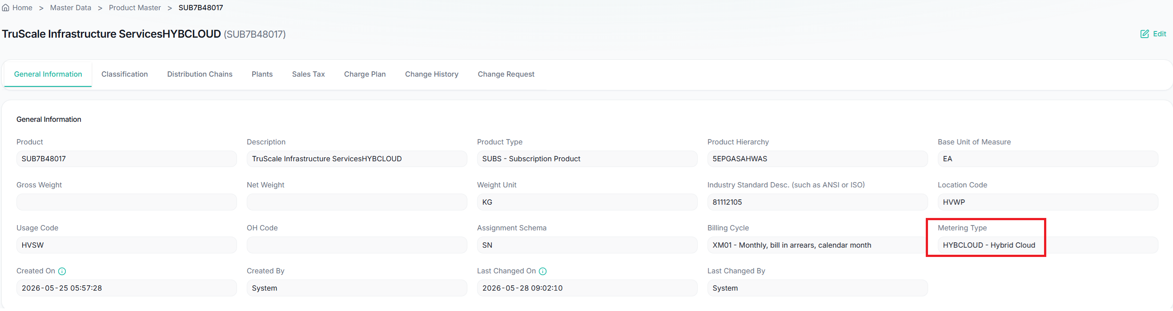
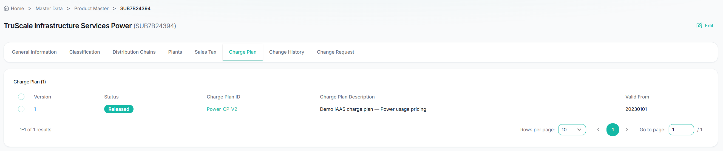
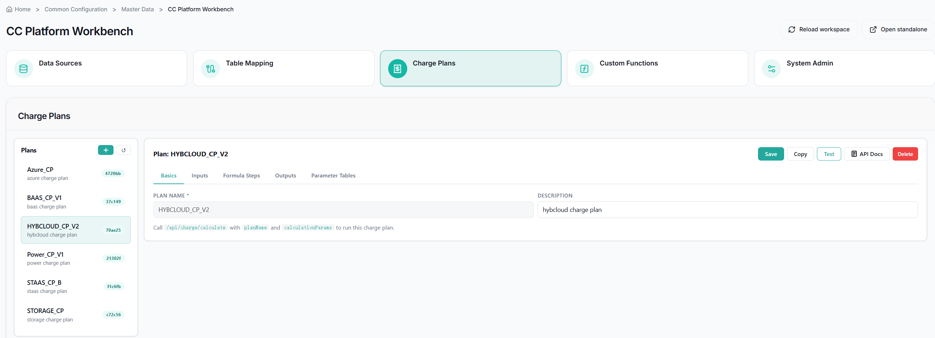
Product Master – Detail - IaaS Specific Information
IaaS usage product can be identified by Metering Type in Product Master.
The Charge Plan tab is available only for IaaS products that have a configured Metering Type. Charge Plan connects an IaaS product to usage-charge calculation.
7
Metering Type & Charge Plan
Metering Type identifies the usage-billing model:
POWER
HYBCLOUD
BAAS
STAAS
STORAGE
AZURE
POWERFIX
FIX
Change Plan: verify a plan exists for the product + metering type. The Charge Plan tab displays:
Version – Charge Plan version number.
Status – Current status of the charge plan (for example, Released).
Charge Plan ID – Unique identifier of the charge plan.
Charge Plan Description – Description of the pricing model.
Valid From – Effective date of the charge plan.
Users can click the Charge Plan ID to open the corresponding Charge Plan Detail page and review the detailed pricing configuration used for usage charge calculation.
Note: The Charge Plan tab is only displayed for products with a Metering Type (exclude POWERFIX and FIX). Products that do not support usage-based billing do not have a Charge Plan tab.
IaaS SUB products must have a valid Released Charge Plan before they can be used successfully in EPR / billing processing.
7

Slide 31
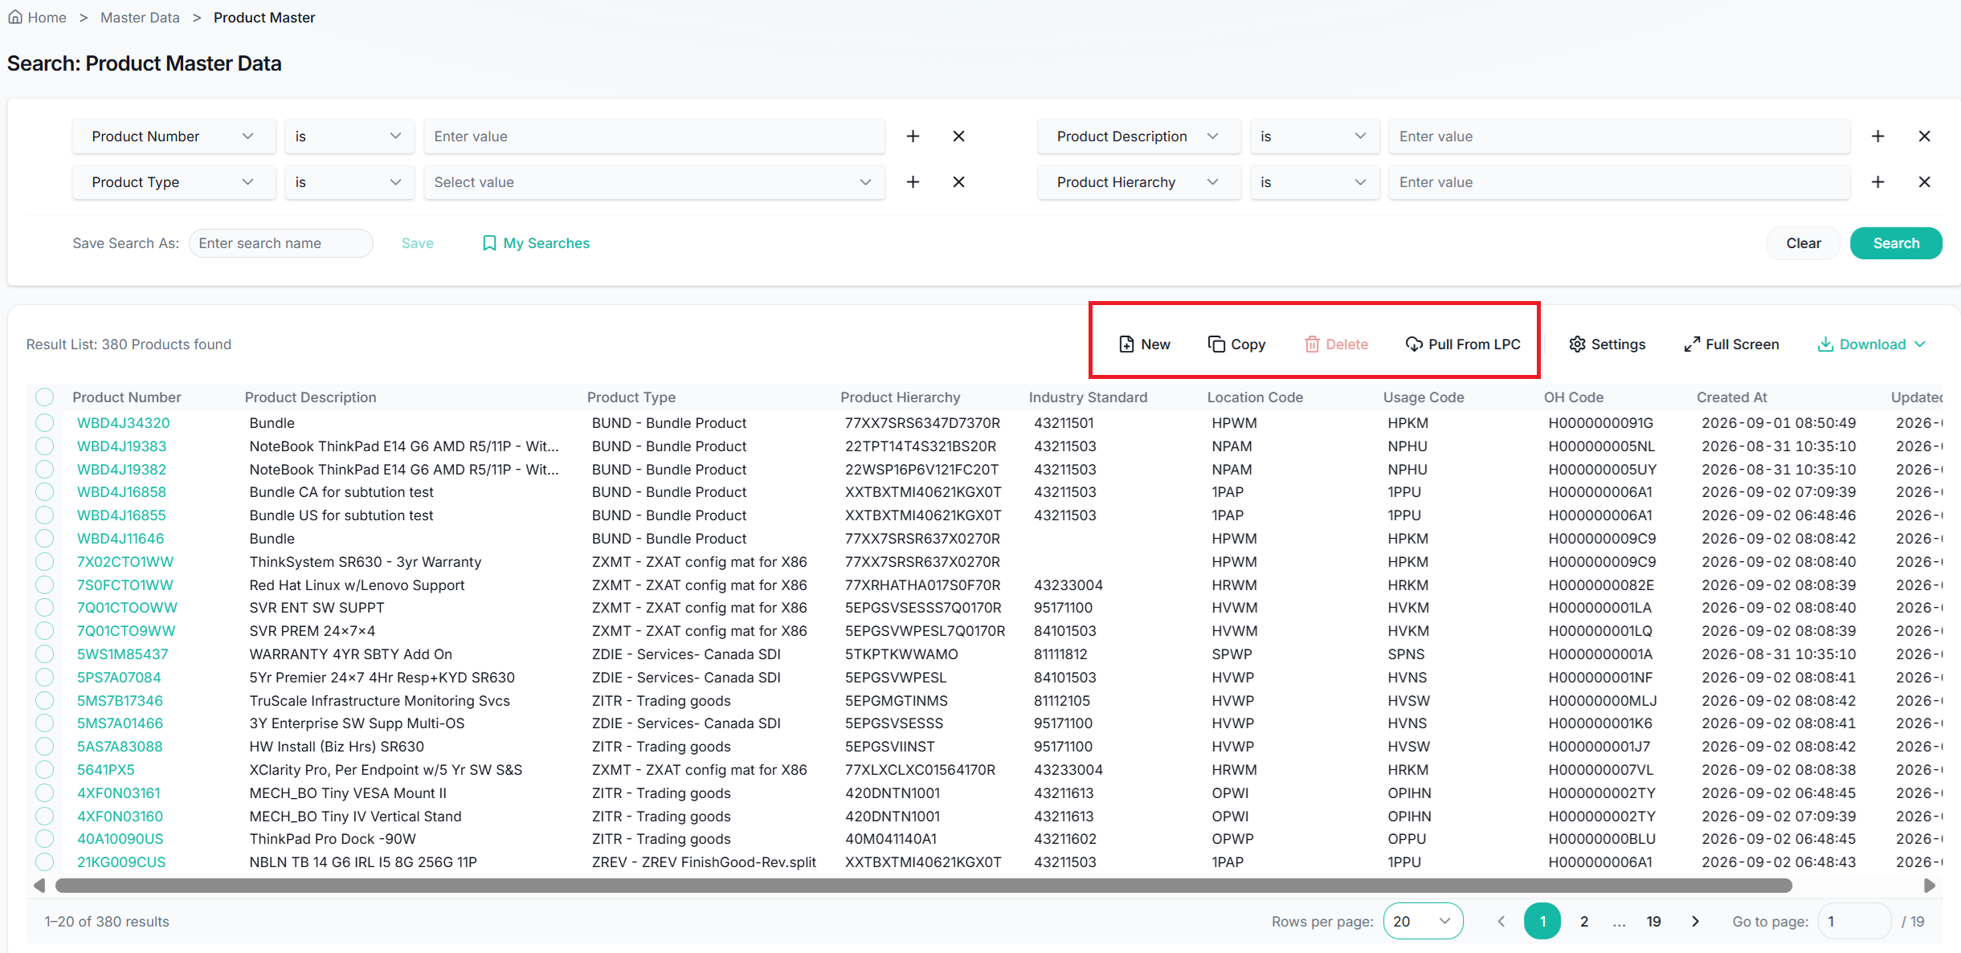
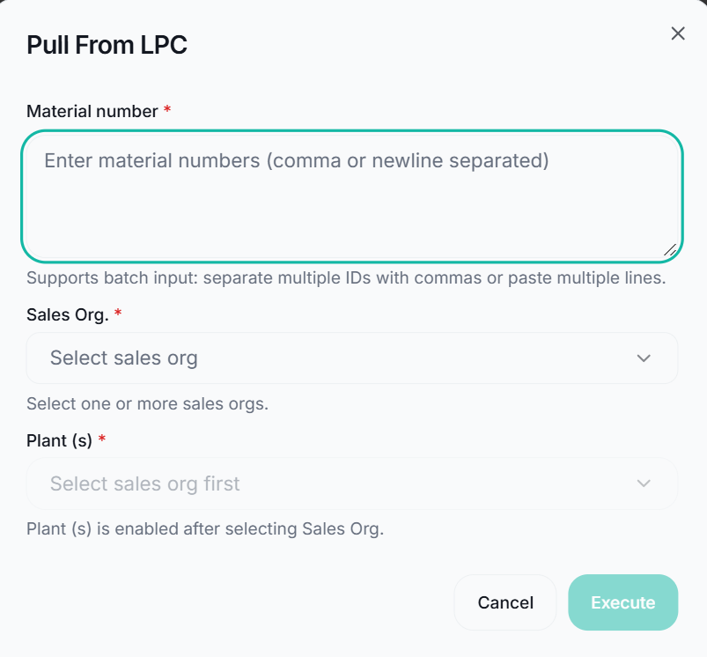
Product Master - Product Actions
The Product Master Search page also provides authorized users with maintenance functions for Product Master records.
Product master records are normally created automatically through system integrations, including EPR inbound processes and source systems such as LPC and PLM.
Manual creation functions, including New, Copy, Delete and Pull From LPC, are provided primarily for exceptional business scenarios and are restricted to authorized users.
1
Action Buttons - Take Effect Immediately
New
Creates a new product master record manually.
Copy
Creates a new product master record by copying an existing product master.
This function helps reduce manual data entry when creating similar products.
Delete
Remove product master records.
Pull From LPC
Retrieve ECC/S4 product information from LPC and create the Product Master in NexBill. Batch processing is supported by entering multiple material numbers separated by commas or line breaks.
1. Enter one or more material numbers.
2. Select the relevant Sales Organization and Plant.
3. Execute the request to retrieve product information from LPC.
Pull From LPC is NOT supported for:
SUB products: sourced from PLM, not LPC.
WBD (Bundle) products: automatically generated by NexBill from EPR bundle structures, not sourced from LPC.
If these products are missing, please verify the corresponding PLM or EPR source data instead of using Pull From LPC.
1

Slide 32
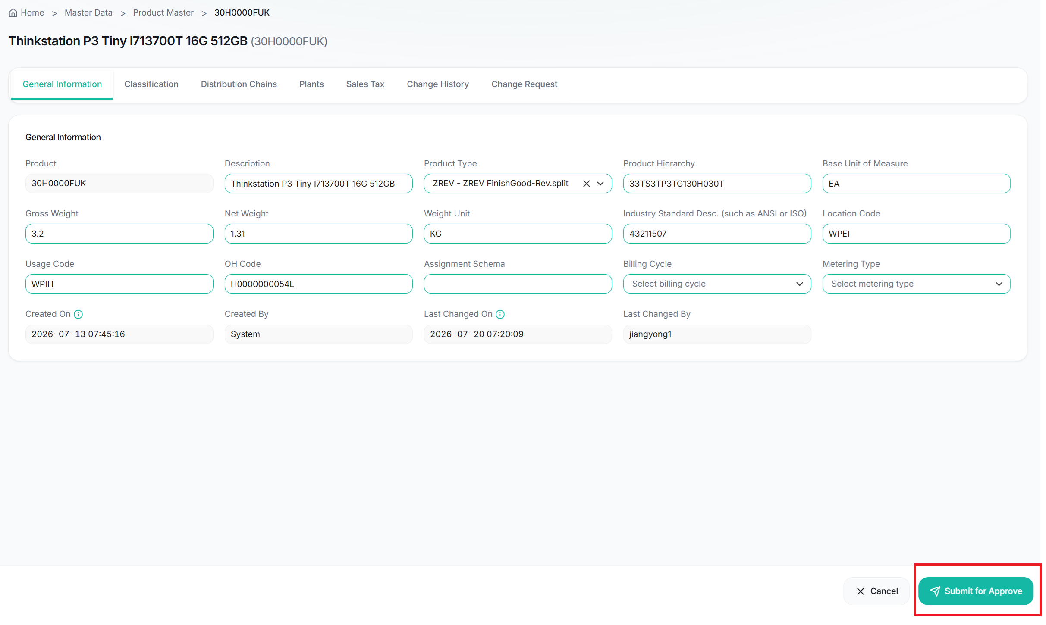
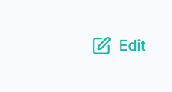
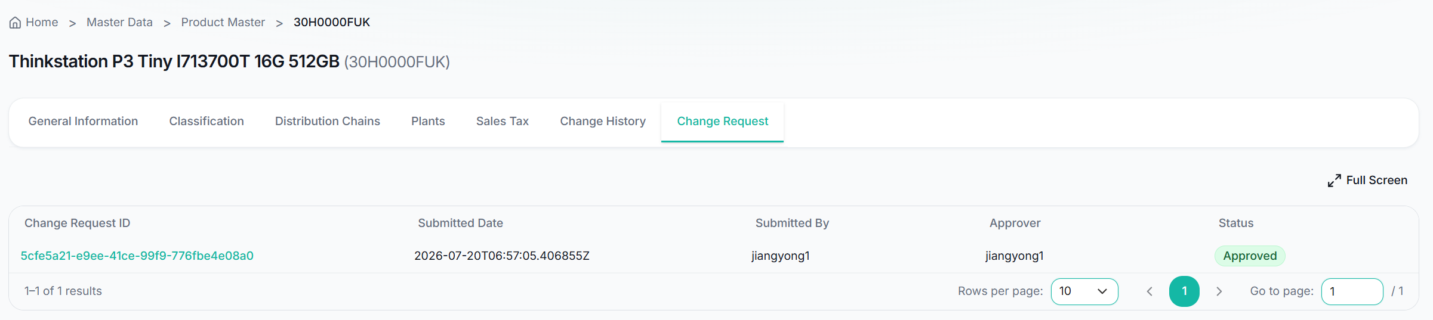
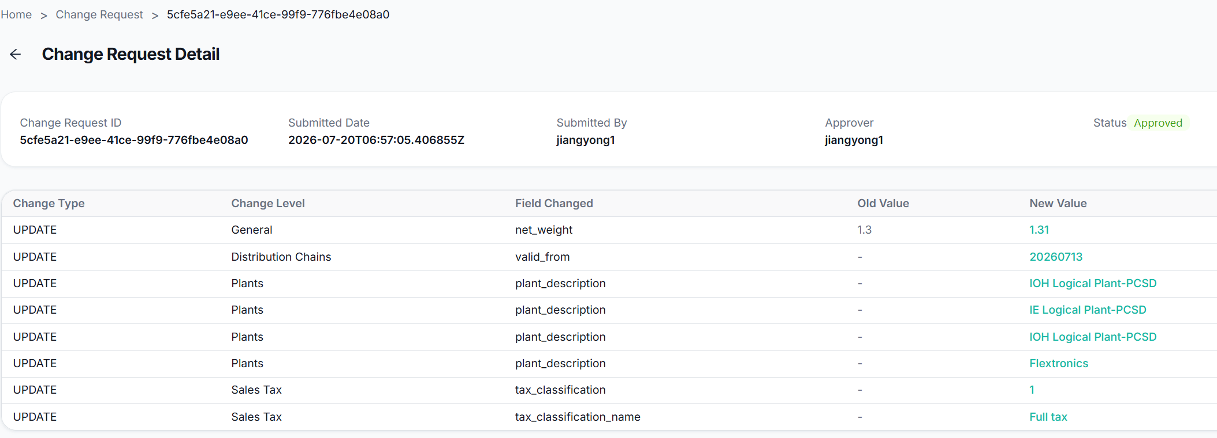
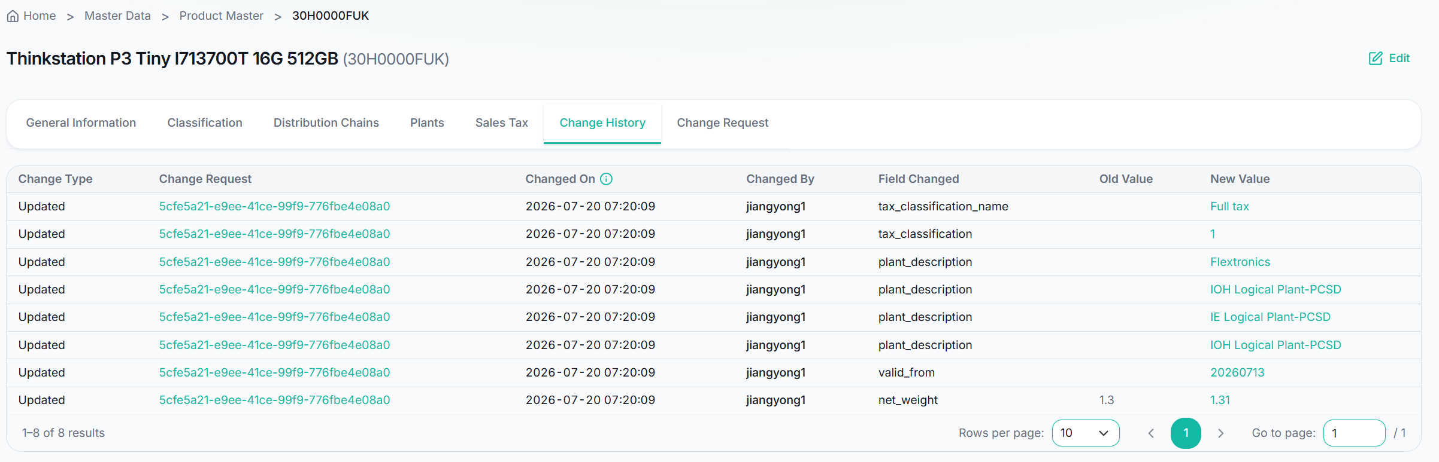
Product Master - Change
Product master records are primarily created and maintained through system integrations. Manual maintenance functions are restricted to authorized users.
All changes must be submitted through a change request and reviewed by authorized approvers before becoming effective.
Only Edit actions require a Change Request and Approval. Operational actions such as New, Copy, Delete and Pull From Source Systems take effect immediately.
1
1
Edit & Change Request - Approval Required
Edit: allows authorized users to submit modifications to product master data. Changes are not applied immediately after editing.
When users submit their modifications:
1. A Change Request is automatically created.
2. The request is routed to the appropriate approver.
3. The approver reviews the request in the Approval Center.
4. The changes become effective only after approval is completed.
This process ensures proper governance and control of master data changes.
Change Request: displays all change requests associated with the product. This provides visibility into pending, approved, and rejected product changes.
Users can click the Change Request ID to open the Change Request Detail page and review the request information.
The Approval Center will be introduced in the following document.
1
2
Change History
The Change History tab maintains a complete audit trail of approved product master updates.
2

Slide 33
Account Master - What Key Users Need to Know
Know where account data comes from, when NexBill creates it, and who maintains it
KEY MESSAGE
Customer & DMU accounts are normally sourced from Account Service and created during EPR inbound; internal customers and vendors are maintained manually by Finance / DT / IT.
1 NORMAL CUSTOMER ACCOUNT
2 INTERNAL CUSTOMER / VENDOR
Account
Service
EPR Inbound
Finance /
DT / IT
Manual
Maintenance
NexBill
NexBill
Account data used for EPR processing
How it works
How it works
Account records are normally created through integration.
Internal Customer (AFE Internal Funder) or Vendor is not sourced through Account Service.
EPR inbound can create / use the required customer account data.
Finance / DT / IT creates and maintains these records manually in NexBill.
Users can search, review and open Account Master details in NexBill.
Manual functions are restricted to authorized users.
STANDARD FLOW
Account Service → NexBill → EPR / Billing
EXCEPTION
Finance-controlled maintenance in NexBill
KEY USER RULE TO REMEMBER
Normal customer → sourced via Account Service / EPR inbound
Internal Customer / Vendor → maintained manually by Finance / DT / IT
Do not use Pull From AS for Internal Customer / Vendor.
Account Master is the place to review the account record — but the source / ownership depends on the account type.

Slide 34
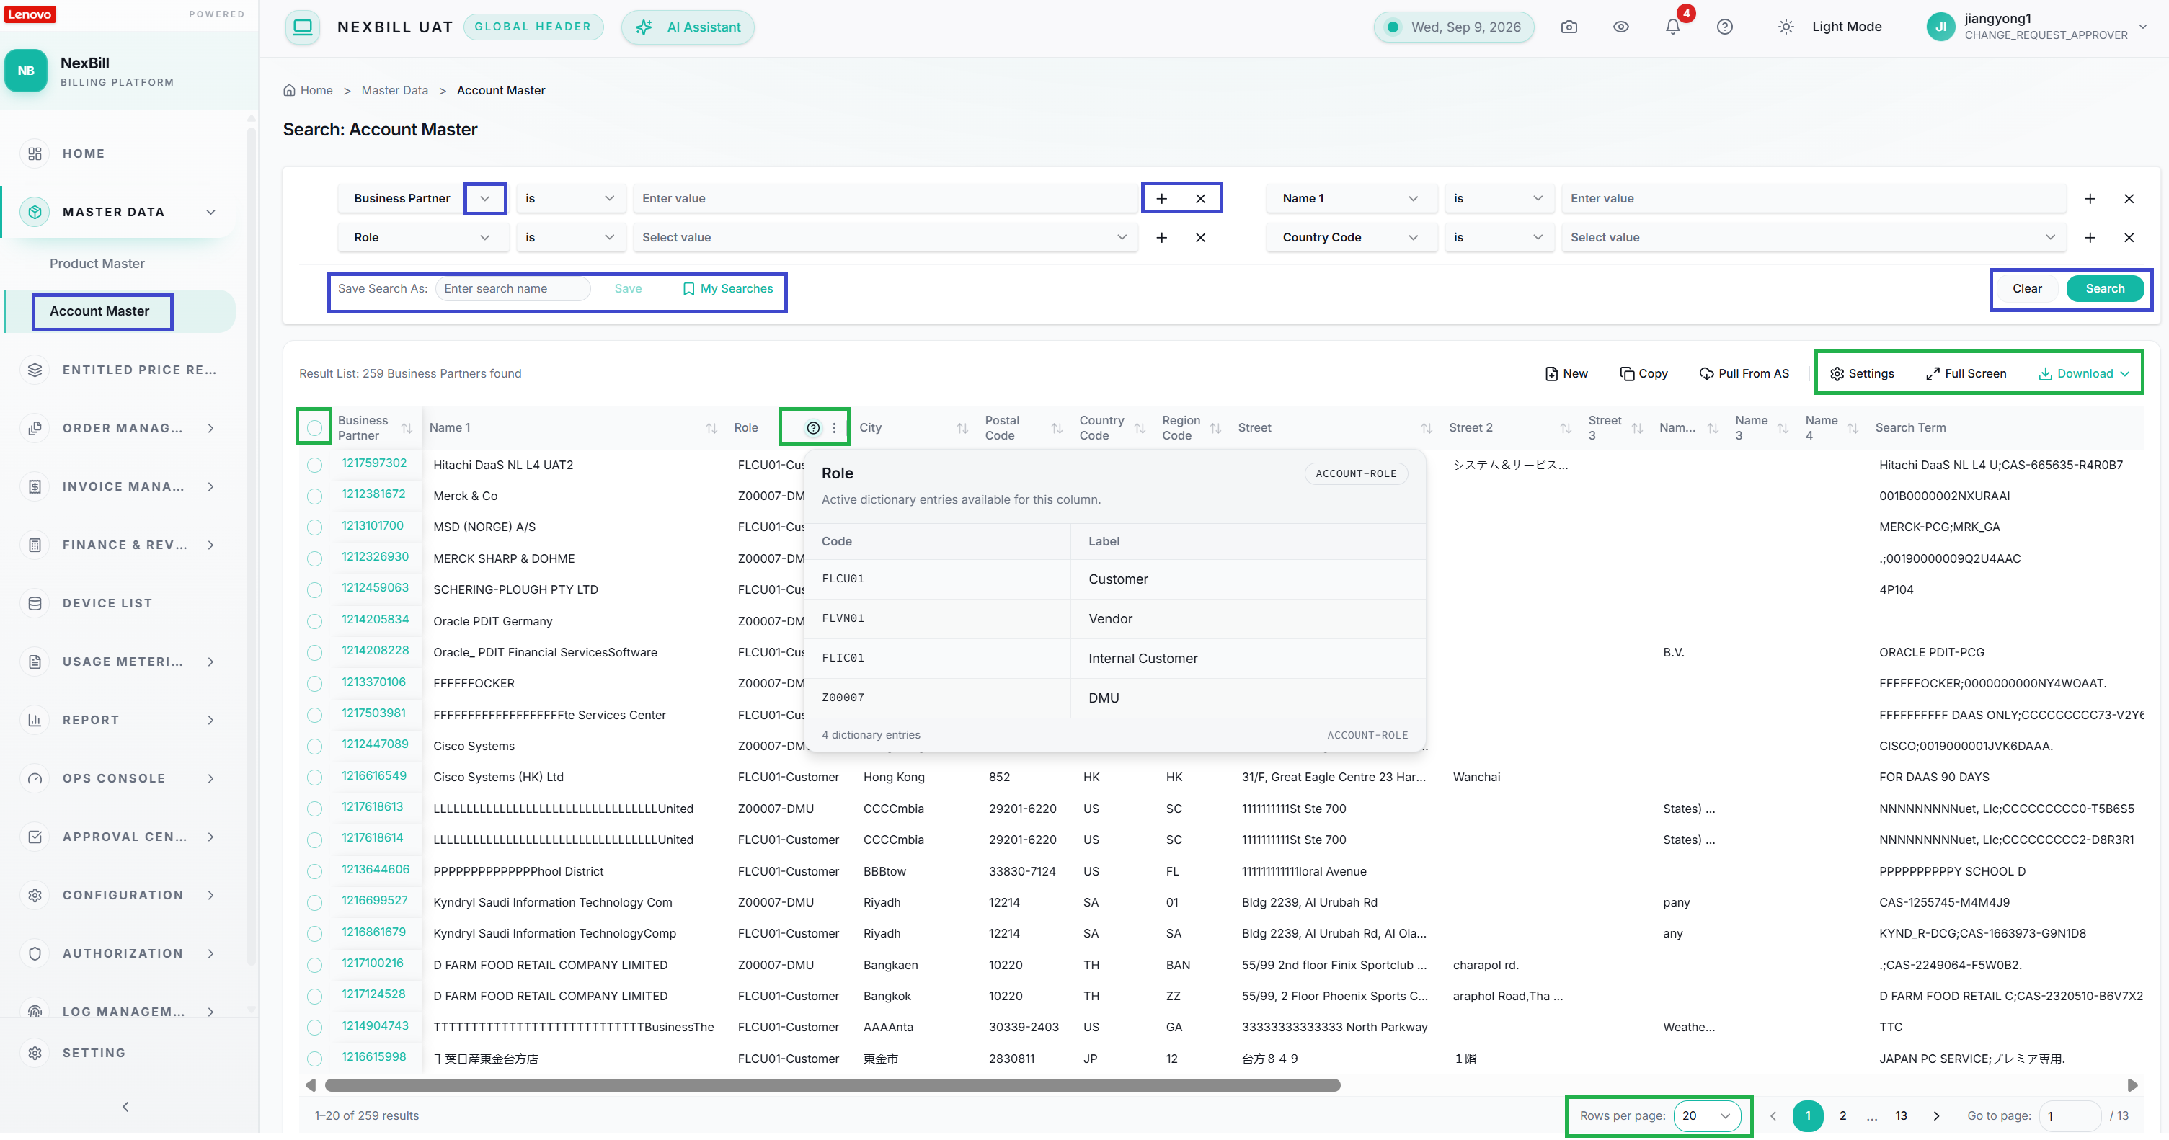
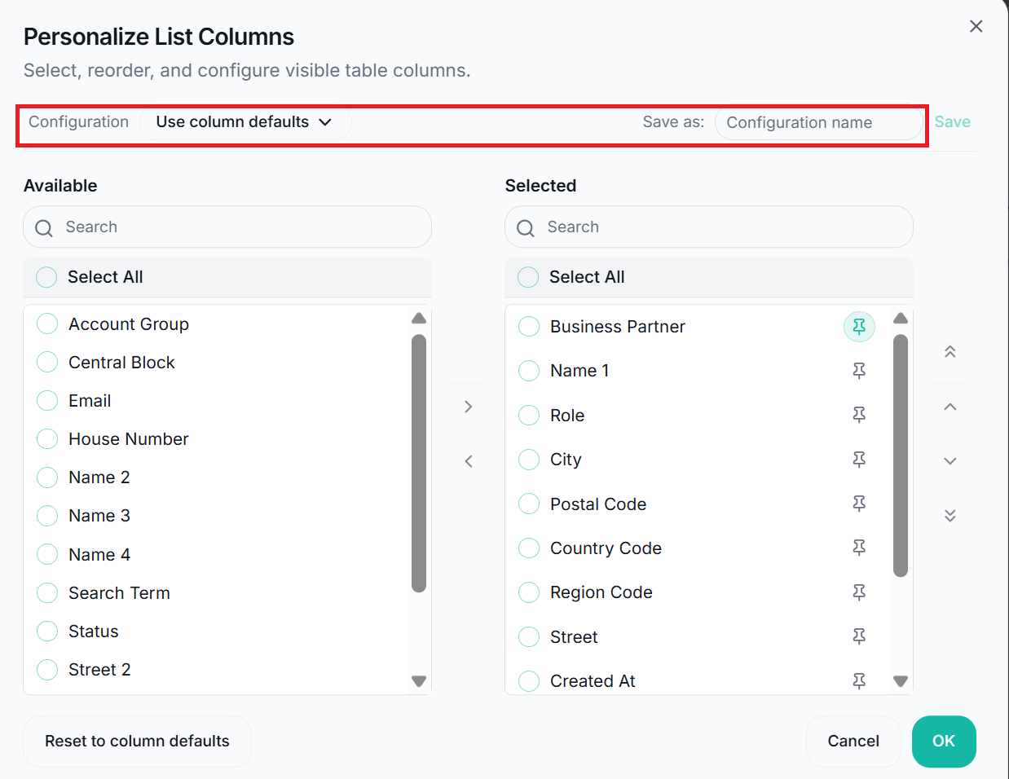
Account Master - Search & Result
The Account Master Search page allows users to search and review customer and business partner master data within NexBill. Users can locate account records using flexible search criteria, review account attributes and address information, and access detailed account information required for subscription and invoicing processes.
1
Search Account Master Data
Users can search account master records using one or more search criteria.
“+” icon: add additional search conditions.
“×” icon: remove conditions.
Search: retrieve matching account records.
Clear: remove all search criteria and clear the current search results.
Save Search: save frequently used search criteria for future use.
My Searches: quickly reuse previously saved search templates.
1
2
2
Result List
Sorting: sort results by clicking a column header.
Column Resize: resize columns by dragging the column boundary.
Column Reorder: rearrange columns by dragging the column header to a different position.
Data Dictionary: click the (?) icon next to Role to view available values and their descriptions.
Record Selection: select records using the row checkbox or use the header checkbox to select all records on the current page.
Record Details Navigation: click the Business Partner hyperlink to open the Account Master Detail page.
Pagination: By default, 20 records are displayed per page. Users can navigate between pages using the page controls. Users can change the number of displayed records using the Rows per page selector.
Settings: customize the result list by selecting which fields are displayed. Users can save the layout as a configuration and reuse it in future sessions.
Full Screen: expand the result list for easier review.
Download: exports account data for offline analysis.
Download All Data: export all records returned by the current search.
Download Selected Data: export only the selected records.

Slide 35
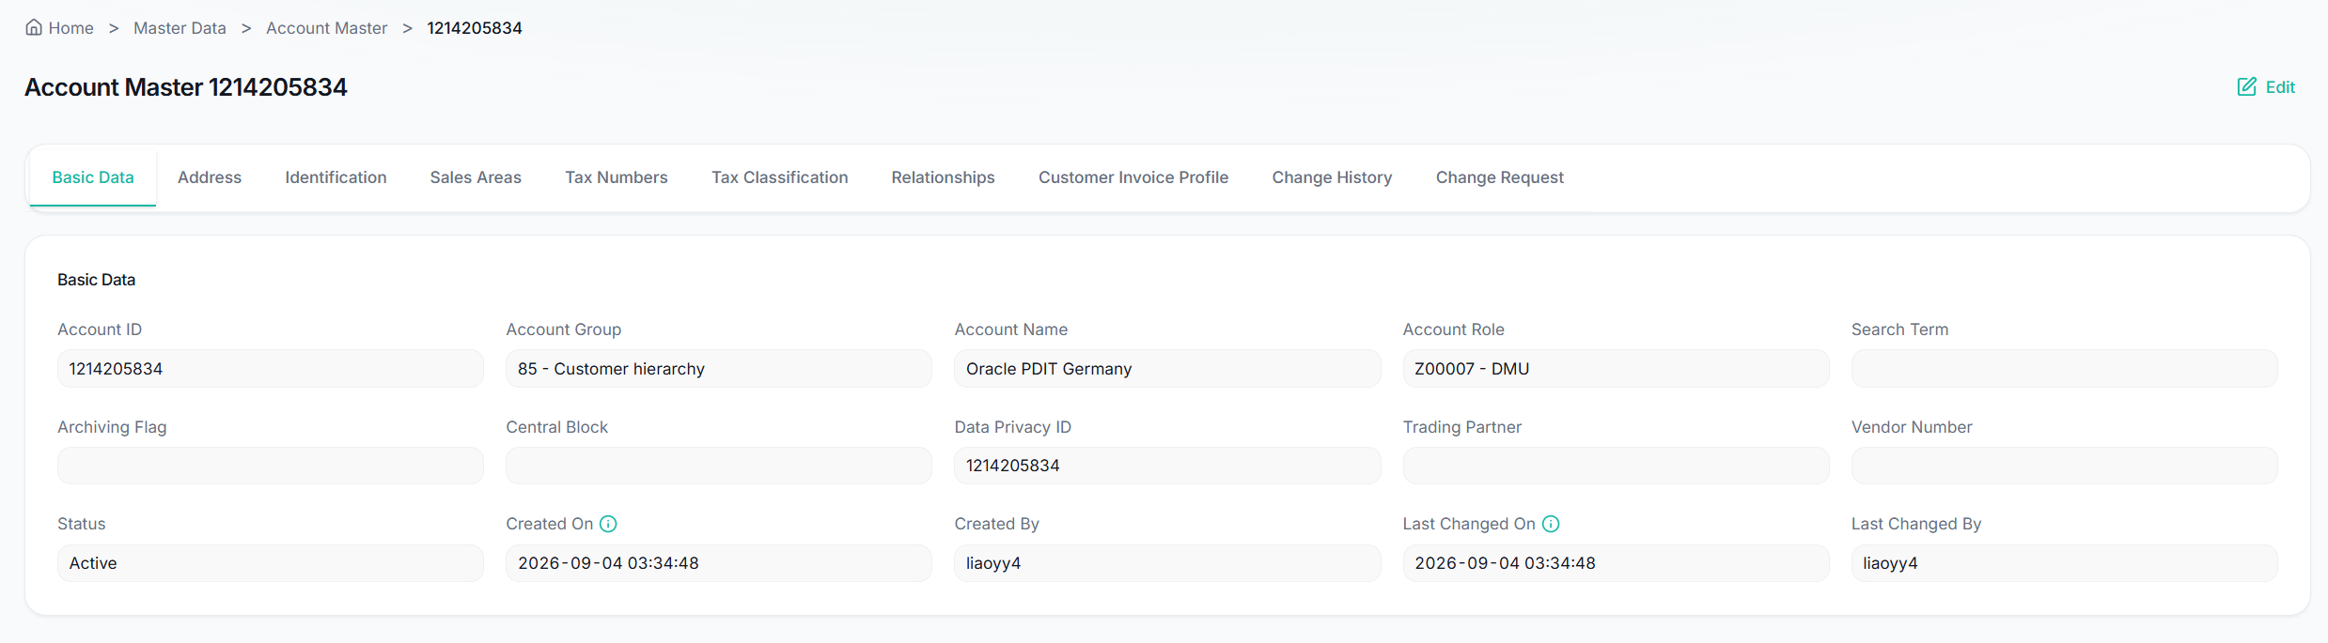
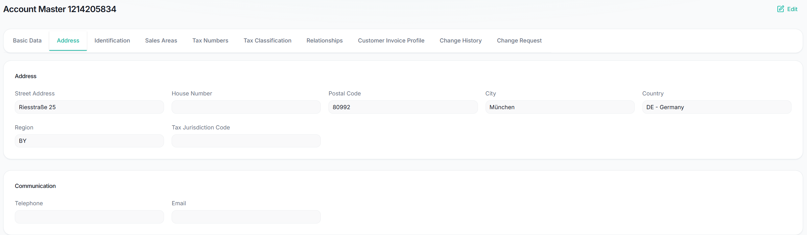
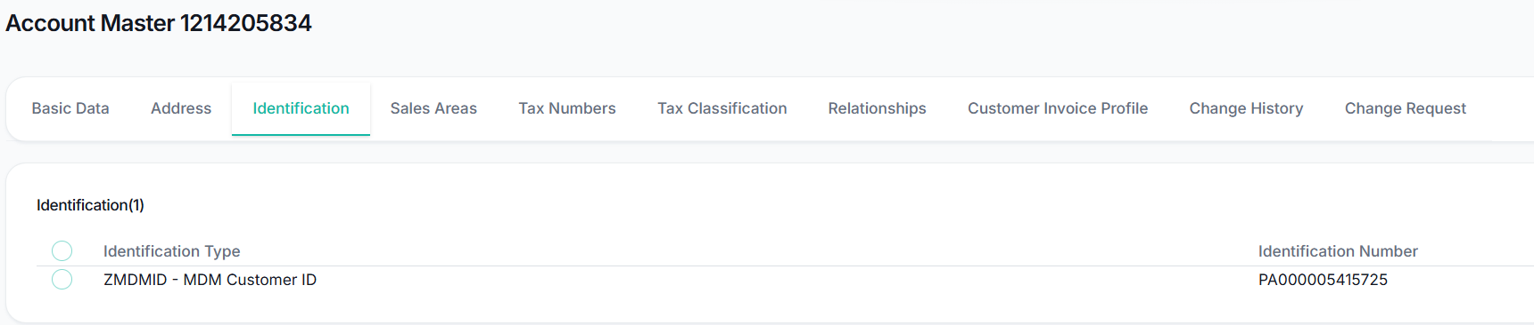
Account Master - Detail
The Account Master Detail page provides comprehensive information about a business partner account maintained in NexBill. Users can review account attributes, address information, identification data, sales area assignments, tax settings, customer invoice profiles, relationships, change requests, and historical changes associated with the account.
1
Basic Data
The Basic Data tab displays the core information of the account.
1
2
Address
The Address tab displays the account's address and communication information.
3
Identification
The Identification tab displays account identification numbers maintained for the business partner.
Examples: MDM ID
2
3

Slide 36
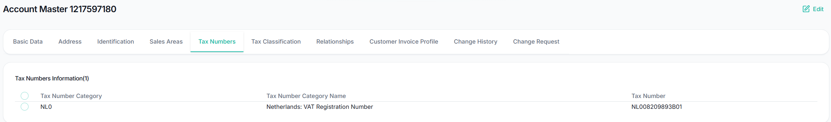


Account Master - Detail
4
Tax Numbers
The Tax Numbers tab displays tax registration information associated with the account.
Examples include:
VAT Registration Number
GST Registration Number
Tax Identification Number
This information is used for tax determination and invoice generation.
4
5
5
Tax Classification
The Tax Classification tab displays tax-related classifications used during billing and tax calculation processes.
6
Relationships
The Relationships tab displays relationships between the current sold-to account and its DMU.
6

Slide 37

Account Master - Detail
7
Customer Invoice Profile
The Customer Invoice Profile tab displays invoice-related preferences and billing configurations assigned to the account.
Examples may include:
Invoice Processing Rules
Approver Email
Customer Email
Customer Invoice Profile data is maintained in ServiceNow (SNOW) and is synchronized to NexBill through system integration.
Note: Customer Invoice Profile data is read-only in NexBill and cannot be created or modified in NexBill.
Any changes to Customer Invoice Profile settings must be performed in SNOW and then transmitted to NexBill through the standard interface process. Once the synchronization is completed, the updated information will be available in NexBill.
7

Slide 38


Account Master - Account Actions
The Account Master Search page also provides integration with the Account Service interface to create new account master records, manual creation capabilities.
Account master records are normally created automatically through system integrations, including EPR inbound processes and source systems such as Account Service.
Manual creation functions, including New, Copy and Pull From AS, are provided primarily for exceptional business scenarios and are restricted to authorized users.
1
Action Buttons - Take Effect Immediately
New
Creates a new account master record manually within NexBill.
Copy
Creates a new account master record by copying an existing account master.
This function helps reduce manual data entry when creating similar accounts.
Pull From AS
Retrieve the account information from account service and create the Account Master in NexBill. Batch processing is supported by entering multiple account numbers separated by commas or line breaks.
1. Enter one or more account numbers.
2. Execute the request to retrieve account information from account service.
Pull From AS is NOT supported for:
Internal Customer (AFE Internal Funders) or Vendor.
These accounts are maintained manually by the Finance team in Nexbill according to the corresponding business process.
1

Slide 39




Account Master - Change
Customer records are normally created and maintained through account service integrations. Manual maintenance functions are restricted to authorized users.
All changes must be submitted through a change request and reviewed by authorized approvers before becoming effective.
Only Edit actions require a Change Request and Approval. Operational actions such as New, Copy, and Pull From Source Systems take effect immediately.
1
1
Edit & Change Request - Approval Required
Edit: allows authorized users to submit modifications to account master data. Changes are not applied immediately after editing.
When users submit their modifications:
1. A Change Request is automatically created.
2. The request is routed to the appropriate approver.
3. The approver reviews the request in the Approval Center.
4. The changes become effective only after approval is completed.
Customer Invoice Profile cannot be modified in NexBill.
Change Request: displays all change requests associated with the account. This provides visibility into pending, approved, and rejected account changes.
Users can click the Change Request ID to open the Change Request Detail page and review the request information.
The Approval Center will be introduced in the following document.
1
2
Change History
The Change History tab maintains a complete audit trail of approved account master updates.
2

Slide 40
4. Entitled Price Record
Entitled Price Record - Joy Jiang
Duration: 10 Minutes

Slide 41
EPR — Use the Right Commercial Record
Use Entitled Price Record when you need to confirm the approved commercial setup behind subscription orders and billing.
KEY MESSAGE
Use NexBill to find, review, and trace EPRs; for standard changes, start in Contract Center and let the approved version flow back.
1 WHEN TO USE EPR
2 WHY IT MATTERS
3 HOW TO USE IT
• Before creating or reviewing a subscription order
• When validating products, parties, pricing, terms or billing model
• When investigating missing, error, inactive or outdated EPR data
• When checking IaaS usage pricing or linked downstream records
• EPR is the approved commercial foundation for order and invoice processing
• Recurring vs. one-time prices are visible at item level
• Links connect users to Account, Product and related Subscription Orders
• Change Request and History provide control and traceability
• Search with flexible filters or saved searches, then open the EPR detail
• Review General, Parties, Items, pricing and related orders
• For normal changes: update in Contract Center, complete approval, then resync
• Use NexBill Edit only when authorized; approval is required
A USER’S EPR WORKFLOW
TRIGGER
Business need
SEARCH
Find EPR
REVIEW
Check setup
DECIDE
Change source
TRACK
Verify result
COMMON SCENARIOS
Order readiness • Pricing review • Billing investigation • IaaS usage pricing • Status / error check • Audit
KEY USER RULE | Need to change EPR? Start with Contract Center—not NexBill—then confirm the approved update has synchronized successfully.

Slide 42
Entitled Price Record - Key Business Boundary
Know where EPR comes from, what NexBill does, and where EPR changes should be made
KEY MESSAGE | Contract Center is the System of Record for EPR
CC
1 SOURCE OF TRUTH
NB
2 NEXBILL ROLE
↺
3 WHEN EPR NEEDS TO CHANGE
Contract Center (LCMP)
NexBill
Default business path
• Creates and maintains EPR
• Owns pricing, terms, products and parties
• Approved EPR is synchronized to NexBill
• Receives and validates inbound EPR
• Displays and uses EPR for downstream processing
• Provides search, detail, related subscription orders and history
1. Change EPR in Contract Center
2. Complete approval / processing there
3. Contract Center resends updated EPR
4. NexBill receives the new version
KEY USER RULE TO REMEMBER
“Need to change EPR?” → Start with Contract Center, not NexBill. Then let the updated EPR flow back to NexBill.
✓

Slide 43


Entitled Price Record - Search & Result
The Entitled Price Record Search page allows users to search, review, and maintain EPR data within NexBill. Users can locate EPR using flexible search criteria, manage EPR records, and access EPR information required for subscription orders and invoicing processes.
1
Search EPR Data
Users can search EPR records using one or more search criteria.
“+” icon: add additional search conditions.
“×” icon: remove conditions.
Search: retrieve matching EPR records.
Clear: remove all search criteria and clear the current search results.
Save Search: save frequently used search criteria for future use.
My Searches: quickly reuse previously saved search templates.
1
2
2
Result List
Sorting: sort results by clicking a column header.
Column Resize: resize columns by dragging the column boundary.
Column Reorder: rearrange columns by dragging the column header to a different position.
Data Dictionary: click the (?) icon next to Header Status to view available values and their descriptions.
Record Selection: select records using the row checkbox or use the header checkbox to select all records on the current page.
Record Details Navigation: click the EPR ID hyperlink to open the EPR Detail page.
Pagination: By default, 20 records are displayed per page. Users can navigate between pages using the page controls. Users can change the number of displayed records using the Rows per page selector.
Settings: customize the result list by selecting which fields are displayed. Users can save the layout as a configuration and reuse it in future sessions.
Full Screen: expand the result list for easier review.
Download: exports EPR data for offline analysis.
Download All Data: export all records returned by the current search.
Download Selected Data: export only the selected records.

Slide 44



Entitled Price Record - Detail
The EPR Detail page provides comprehensive information about an Enterprise Pricing Request (EPR). Users can review contract information, customer and organizational data, EPR items, linked subscription orders, change requests, and historical changes associated with the EPR.
1
General
1
The General tab displays the primary EPR information.
2
Parties Involved
The Parties Involved tab displays business partners associated with the EPR:
Sold-To Party
Authorization Sold-To Party
End Customer DMU
Internal Funder
The Partner Number is displayed as a clickable hyperlink. Users can click it to open the corresponding account master detail page.
3
Related Subscription Orders
The Related Subscription Orders tab displays subscription orders created from the current EPR.
The Subscription Order ID is displayed as a clickable hyperlink. Users can click it to open the corresponding subscription order detail page.
2
3

Slide 45


Entitled Price Record - Detail
4
Items Overview
The Item Overview table displays key item attributes.
The price column displayed in the overview depends on the billing model of the item:
Subscription Price is displayed for recurring subscription items with a Billing Cycle.
One-time Price is displayed for one-time billing items without a Billing Cycle.
This allows users to easily distinguish recurring and one-time billing scenarios.
Settings
The Settings function allows users to personalize the columns displayed in the Item Overview table.
Download
The Download function exports item information for offline analysis and reporting.
4
5
5
Items Detail
Users can click an Item Number to open the corresponding EPR Item Detail page, where additional item attributes and detailed configuration information can be reviewed.
Users can click a Product to open the corresponding product detail page.

Slide 46


Entitled Price Record – Detail - IaaS Specific Information
For IaaS EPRs, certain usage-based products contain additional pricing configurations that are used for usage billing calculations.
5
Usage Pricing Table
NexBill displays the Usage Pricing Table tab in the item detail page for below metering types:
POWER
HYBCLOUD
BAAS
STAAS
STORAGE
AZURE
The pricing table structure displayed varies depending on the product's Metering Type.
Note: The Usage Pricing Table is displayed for reference and review purposes. Only IaaS usage products with a Metering Type have this tab.

Slide 47



Entitled Price Record – EPR Actions
EPR records in NexBill originate from Contract Center (LCMP). The standard integration flow is: LCMP → NexBill.
The EPR Search and EPR Detail pages provide EPR functions, including New, Copy, Pull From LCMP, Delete, Deactivate, and Reactivate.
These functions are provided primarily for exceptional business scenarios and are restricted to authorized users.
1
Action Buttons - Take Effect Immediately
New
Creates a new EPR record manually within NexBill.
Copy
Creates a new EPR record by copying an existing EPR record.
This function helps reduce manual data entry when creating similar EPRs.
Pull From LCMP
Retrieve the EPR information and create the EPR record manually. Batch processing is supported by entering multiple material numbers separated by commas or line breaks, or upload Excel file.
1. Enter one or more EPRs or upload Excel file.
2. Execute the request to retrieve EPR from LCMP.
Delete
Remove EPR records when permitted by business rules.
An EPR can only be deleted when its status is Error.
Deactivate EPR
Deactivate an active EPR.
The EPR status changes to inactive after deactivation.
The EPR can no longer be used for new business processing.
Reactivate EPR
Reactivate a previously deactivated EPR.
The EPR returns to active status after reactivation.
1
1

Slide 48





Entitled Price Record - Change
EPR records are normally created and maintained in Contract Center and then synchronized to NexBill through the integration interface.
Certain EPR change functions may be performed by authorized users in NexBill according to business requirements and assigned permissions.
Submit changes will trigger a Change Request and approval workflow before becoming effective.
1
EPR Change - Approval Required
Edit
The Edit function allows authorized users to modify EPR information. Submitted changes will trigger a Change Request and approval workflow before becoming effective.
1
2
EPR Item Change
Users click the Edit button in the page header to enter Edit Mode.
When the EPR is in Edit Mode, users can maintain EPR items in the Items tab.
Add Item
Users can click New to add a new product item to the EPR.
When adding a new item or updating the Product field, users can click the Search Help (🔍) icon next to the Product field to open the Product Master Search window.
Update Item
Users can modify supported item attributes directly in the Item Overview table or through the Item Detail page.
Delete Item
Users can remove an existing item from the EPR by selecting the Delete icon for the corresponding item.
2
3
Partner Maintenance
When the EPR is in Edit Mode, users can maintain partner assignments in the Parties Involved tab.
Add Authorized Sold-To
Users can click New to add an Authorized Sold-To partner.
Delete Authorized Sold-To
Existing Authorized Sold-To records can be removed.
3

Slide 49



Entitled Price Record - Change
Only Edit actions require a Change Request and Approval. Operational actions such as New, Copy, Delete, Reactivate/Deactivate, and Pull From Source Systems take effect immediately.
4
Change Request
The Change Request tab displays all change requests associated with the EPR.
When users submit their EPR modifications:
1. A Change Request is automatically created.
2. The request is routed to the appropriate approver.
3. The approver reviews the request in the Approval Center.
4. The changes become effective only after approval is completed.
The Change Request ID is displayed as a clickable hyperlink. Users can click the Change Request ID to view the corresponding change request Detail.
The Approval Center will be introduced in the following document.
4
5
Change History
The Change History tab maintains a complete audit trail of EPR changes.
This allows users to track historical modifications and understand how the EPR has evolved over time.
5

Slide 50
5. Order Management
Subscription Order - Joy Jiang
  Recurring Billing Order
  One Time Billing Order
Mass Change - Joy Jiang
  Order Mass Change
  Device Mass Change
Duration: 40 Minutes

Slide 51
Subscription Order - What Key Users Need to Know
From Service Request to Payment Schedule — Understand the business flow and the functions you will use
Subscription Orders are normally created from the standard ServiceNow integration flow. Key Users mainly review, monitor and manage subscription orders; manual creation / copy is reserved for exceptional scenarios.
Future-State Business Flow
1 ServiceNow Request
Inbound / ESOT
(AUTO)
3 Subscription Order (AUTO)
4 Review
Accept
(AUTO)
Payment Schedule
(AUTO)
Service request
created / submitted
›
Approved request
transmitted to NexBill
›
Subscription order created with
relevant details
›
Review subscription order details
›
Trigger payment schedule generation
›
Payment schedule
generation
Key Functions
1 Search & View
2 New / Copy
3 Edit / Change Request
Find subscription orders using business search criteria and open subscription order details.
Create a subscription order manually only for urgent / exceptional scenarios.
Change a single subscription order; changes normally become effective after approval.
4 Accept / Generate Payment Schedule
5 Change Request / History
6 Related Invoice Data
Accept a released subscription order when payment schedule generation is required or needs to be regenerated.
Track what changed, who submitted it and the approval / application status.
Review payment schedule and related invoices from the subscription order.
7 Mass Change
Update multiple subscription orders or selected devices

Slide 52


Subscription Order - Search & Result
The Subscription Order Search page allows users to search, review, and maintain subscription order data within NexBill. Users can locate subscription order using flexible search criteria, manage subscription order records, and access subscription order information required for invoicing processes.
1
Search Subscription Order Data
Users can search subscription orders using one or more search criteria.
“+” icon: add additional search conditions.
“×” icon: remove conditions.
Search: retrieve matching subscription orders.
Clear: remove all search criteria and clear the current search results.
Save Search: save frequently used search criteria for future use.
My Searches: quickly reuse previously saved search templates.
1
1
2
Result List
2
Sorting: sort results by clicking a column header.
Column Resize: resize columns by dragging the column boundary.
Column Reorder: rearrange columns by dragging the column header to a different position.
Data Dictionary: click the (?) icon next to Subscription Order Type to view available values and their descriptions.
Record Selection: select records using the row checkbox or use the header checkbox to select all records on the current page.
Record Details Navigation: click the Subscription Order ID hyperlink to open the Subscription Order Detail page.
Pagination: By default, 20 records are displayed per page. Users can navigate between pages using the page controls. Users can change the number of displayed records using the Rows per page selector.
Settings: customize the result list by selecting which fields are displayed. Users can save the layout as a configuration and reuse it in future sessions.
Full Screen: expand the result list for easier review.
Download: exports subscription order data for offline analysis.
Download All Data: export all records returned by the current search.
Download Selected Data: export only the selected records.

Slide 53


Subscription Order - Detail
The Subscription Order Detail page provides comprehensive information about subscription order. Users can review subscription order information, customer and organizational data, subscription order items, payment schedule, linked final invoices, change events, change requests, and historical changes associated with the subscription order.
1
General
The General tab displays the primary subscription order information.
The Payload button displays the Service Request Task payload received by NexBill.
1
2
Parties Involved
The Parties Involved tab displays business partners associated with the subscription order:
Sold-To Party
Ship-To Party
Bill-To Party
Payer
Internal Funder
The Partner Number is displayed as a clickable hyperlink. Users can click it to open the corresponding account master detail page.
2

Slide 54



Subscription Order - Detail
3
Item Overview
The Item Overview table displays key item attributes.
The price column displayed in the overview depends on the billing model of the item:
Subscription Price is displayed for recurring subscription items with a Billing Cycle.
One-time Price is displayed for one-time billing items without a Billing Cycle.
This allows users to easily distinguish recurring and one-time billing scenarios.
Settings: allows users to personalize the columns displayed in the Item Overview table.
Download: exports item information for offline analysis and reporting.
3
4
4
Items Detail
Users can click an Item Number to open the corresponding Subscription Order Item Detail page, where additional item attributes and detailed configuration information can be reviewed.
Users can click a Product ID to open the corresponding product detail page.
Device Data
For hardware subscription order items, the Device Data tab displays the devices associated with the selected item.

Slide 55




Subscription Order – Detail - IaaS Specific Information
For IaaS subscription orders, certain usage-based products contain additional pricing configurations that are used for usage billing calculations.
NexBill only receives Usage Products and Non-Funded Service Items from ESOT, therefore IaaS Subscription Orders do not contain bundle structures.
5
IaaS Specific Data
IaaS Item Structure
IaaS Subscription Orders contain:
Usage Products
Non-Funded Service Items
Usage Pricing Table
The Usage Pricing Table tab is available only for Usage Products with Metering Type below:
POWER
HYBCLOUD
BAAS
STAAS
STORAGE
AZURE
The pricing table is inherited from the related EPR item and the pricing table structure displayed varies depending on the product's Metering Type.
The Usage Pricing Table is used during usage billing processing.
Device Data
The Device Data tab is available only for IaaS products that are associated with physical or managed devices.
The Device Data tab is NOT displayed for metering types that do not maintain device-level assets:
Azure
Backup as a Service (BaaS)
5

Slide 56


Subscription Order - Detail
6
Scheduled Actions
The Scheduled Actions tab provides visibility into system automatically activities related to the Subscription Order:
Payment Schedule generation
Responses sent from NexBill back to ESOT
Downstream actions sent from NexBill to Magellan.
6
7
Change Event
The Change Events tab displays Subscription Order change event requests received from ESOT.
Change Events integration flow: SNOW → ESOT → NexBill
SNOW Change Events includes:
Early Termination Buyout (ETB)
Early Termination Return (ETR)
Flex Pause (FPS)
Flex Unpause (FNPS)
Flex Down (FDWN)
NexBill automatically generates an EOT (End of Term) Change Event when a Subscription Order reaches its subscription end date.
7

Slide 57

Subscription Order - Detail
8
Payment Schedule
The Payment Schedule tab displays the billing schedule generated for the Subscription Order.
It provides a timeline view of planned billing periods and the corresponding invoice amounts and status throughout the subscription lifecycle.
For recurring subscription orders, NexBill automatically generates payment schedules based on Subscription Start Date, Subscription End Date, Billing Cycle, Subscription Price, Term Duration.
For one-time subscription orders, a single payment schedule is generated.
For usage-based subscription orders, payment schedules are generated according to the contract term, while the actual invoice amount is determined by usage data.
The payment schedule serves as the billing foundation for invoice generation.
8
9
Related Invoices
9
The Related Invoices tab displays all final invoices generated from the current Subscription Order.
The Final Invoice Number is displayed as a clickable hyperlink. Users can click the invoice number to open the corresponding Invoice Document Detail page and review.

Slide 58
Subscription Order – Subscription Order Action
Subscription Orders in NexBill originate from ServiceNow (SNOW). The standard integration flow is: SNOW → ESOT → NexBill.
The Subscription Order Search and Detail pages provide functions, including New, Copy, Cancel, Accept.
These functions are provided primarily for exceptional business scenarios and are restricted to authorized users.
1
Action Buttons - Take Effect Immediately
New
Creates a new subscription order manually within NexBill.
Users can create:
One-Time Subscription Orders
Recurring Subscription Orders
Usage-Based Subscription Orders
Copy
Creates a new subscription order by copying an existing subscription order.
Cancel
The Cancel button is used to cancel the current Subscription Order and its eligible payment schedules (status is 'Pending' or 'Reversed' or 'Lock’).
Payment schedules that have already reached Final status cannot be cancelled.
Accept
The Accept button allows users to regenerate payment schedules when subscription order contains error and payment schedule generation was not completed successfully.
Users can use Accept when:
The Subscription Order has been released without any error.
Payment schedules have not been generated.
1
3

Slide 59
Subscription Order - Change
Subscription Order records are normally created and maintained in SNOW and then synchronized to NexBill through the integration interface.
Certain subscription order change functions may be performed by authorized users in NexBill according to business requirements and assigned permissions.
Submit changes will trigger a Change Request and approval workflow before becoming effective.
1
Subscription Order Change - Approval Required
Edit
The Edit function allows authorized users to modify subscription order information.
Completed and Cancelled Subscription Orders cannot be edited.
1
2
2
Subscription Order Item Change
Click the Edit button in the page header to enter Edit Mode.
When the subscription order is in Edit Mode, users can maintain subscription order items in the Items tab.
Add Item
Users can click New to add a new product item to the subscription order.
When adding a new item or updating the Product field, users can click the Search Help (🔍) icon next to the Product field to open the Product Master Search window.
Update Item
Users can modify supported item attributes directly in the Item Overview table or through the Item Detail page.
Delete Item
Users can remove an existing item from the subscription order by selecting the Delete icon for the corresponding item.
3
3
Partner Maintenance
When the subscription order is in Edit Mode, Ship-To Party, Bill-To Party, and Payer can be changed by deleting the existing partner assignment and adding a new partner record.
Direct replacement of an existing partner is not supported.

Slide 60
Subscription Order - Change
Only Edit actions require a Change Request and Approval. Operational actions such as New, Copy, Cancel, Accept take effect immediately.
4
Change Request
The Change Request tab displays all change requests associated with the subscription order.
When users submit their subscription order modifications:
1. A Change Request is automatically created.
2. The request is routed to the appropriate approver.
3. The approver reviews the request in the Approval Center.
4. The changes become effective only after approval is completed.
The Change Request ID is displayed as a clickable hyperlink. Users can click the Change Request ID to view the corresponding Change Request Detail.
The Approval Center will be introduced in the following document.
4
5
Change History
The Change History tab maintains a complete audit trail of subscription order changes.
This allows users to track historical modifications.
5

Slide 61
One Time Order Creation - Overview
A simple step-by-step guide for manual one-time billing scenarios
WHEN TO USE
CREATE → SUBMIT → BILLING
Special billing scenarios
not handled by the standard integration flow
1
2
3
4
5
6
Choose Order Type
Complete Header
Add Order Items
Review
Submit Order
Verify Result
From Subscription Order Search, click New and select One-Time Order.
Enter required header data and select the Billing Request Reason.
Enter Product, Quantity and One-Time Price.
Enter lease type for selected Billing Request Reasons.
Review auto-derived fields.
Review the complete order information before submission.
Submit the order. NexBill validates the data and creates the order.
Subscription order ID generated.
Payment schedule created.
KEY INPUTS TO REMEMBER
HEADER
ITEM
AUTO-DERIVED
Sold-To Party · Sales Area · Billing Request Reason · Customer PO · Payment Term · EaaS Category · Agreement Type · One-Off Invoice Date
Product · Quantity · One-Time Price · Lease Type
Partners / names / addresses · Sales area attributes · Lease Type · Service Fulfillment Time
KEY USER TIP
The system automatically derives much of the partner and organizational information. Focus on the required business inputs, then Review before Submit.

Slide 62

One-Time Billing Order Creation
The One-Time Billing Order Creation function allows authorized users to manually create a one-time billing order in NexBill for special billing scenarios that cannot be processed through the standard integration flow.
1
Choose Order Type
User chooses a one-time billing order type from the subscription order search page – New button.
Only the following Billing Request Reasons support One-Time Billing Order creation:
01 – On Demand Service
19 – On Demand Service ICO
07 – Damage Charge Request
13 – Manual Monthly Billing
14 – Manual ICO Monthly Billing
15 – Origination Fee
16 – Property Tax
17 – Penalty (Credit)
18 – Penalty ICO (Credit)
1

Slide 63
One Time Order Creation
The One-Time Order Creation function allows authorized users to manually create a one-time billing Subscription Order in NexBill for special billing scenarios that cannot be processed through the standard integration flow. To simplify the user experience and reduce manual effort, NexBill automatically derives and populates information wherever possible. Users only need to enter the required business information and mandatory fields.
2
Input Order Header Information
Minimum required input information includes:
Sold-To Party
Sales Area
Billing Request Reason
Customer PO
Payment Term
EaaS Category Header
Agreement Type
One-Off Invoice Date
Users can either:
Enter a Partner Number directly, or
Click the Search Help (🔍) icon to search and select a partner.
Automatically Derived Data
Ship-To Party, name and address
Bill-To Party, name and address
Payer, name and address
Contract Party, Sales Organization, Distribution Channel, Division, Sales Office, Currency
Users may change the partner or click the ✏ Pencil icon to update Name, Address, City, State / Region, Country, Postal Code
Click Save to apply the changes to the One-Time Order.
Users may change the sale area from dropdown list.
Note: Changes apply only to the current Subscription Order and do not update Account Master data.
2

Slide 64
One Time Order Creation
3
Add Item Information
Minimum required input information includes :
Product
Quantity
One-Time Price
Lease Type
Users can either:
Enter a Product ID directly or
Click the Search Help (🔍) icon to search and select a product.
Users click ‘New’ to add one or more product items.
Automatically Derived Data
Service Fulfillment Time
Lease Type
based on:
Billing Request Reason
EaaS Category Header
For billing request reason below, users must fill lease type OL or FL.
13 – Manual Monthly Billing
14 – Manual ICO Monthly Billing
For billing request reason below, default lease type NA, users can change it to OL or FL.
15 – Origination Fee
16 – Property Tax
17 – Penalty (Credit)
18 – Penalty ICO (Credit)
3

Slide 65
One-Time Billing Order Creation
4
Review and Submit
After all required information is entered, users can:
1. Review the one-time billing order information.
2. Click Submit.
NexBill will validate the order and create a new One-Time Billing Order.
Upon successful creation:
A One-Time Billing Order ID is generated.
Payment Schedule generation is triggered automatically.
Change History is recorded.
The order becomes available for billing processing.
5

Slide 66
Subscription Order Mass Change - Choose the Right Mode
A simple decision path for Key Users: choose the business object first, then apply the appropriate change scope.
KEY USER RULE
Whole Order → Order View | Selected Devices → Devices View
1
What are you changing?
SUBSCRIPTION ORDER VIEW
Change applies to the entire Subscription Order
DEVICE VIEW
Change applies to specific devices within a Subscription Order
WHOLE ORDER
• Bill-To • Ship-To • Ship-To Address
• PO • Payment Term
• Lock / Unlock Payment Schedule
• Cancel Subscription Order
• Bill-To • Ship-To • Ship-To Address
• Cancel Change Event • Change Event Effective Date
• Cancel Device
SELECTED DEVICES
2
If you are changing Devices: what is the scope?
The outcome depends on the action and whether all or only some devices are selected.
DEVICE VIEW — OUTCOME BY ACTION
FULL DEVICES
PARTIAL DEVICES
Change Bill-To / Ship-To / Ship-To Address
No Split
Update existing Order
Split Order
Create new Order for selected Devices
Cancel Device
No Split
Cancel whole Order
No Split
Reduce Order Quantity
Change Event Effective Date
Cancel Event
N/A
Device-level action
N/A
Device-level action
IMPORTANT | Split Order is triggered only for a partial-device partner/address change. Partial Device Cancellation does NOT split the order; it reduces the order quantity.
Submit → Change Request → Approval → Applied
SUBMIT / SAVE
APPROVAL
APPLIED
Then verify affected records + Change History.

Slide 67
Subscription Order Mass Change
The Mass Change function allows authorized users to update multiple Subscription Orders or Devices through a single request. Instead of updating records one by one, users can select multiple records, apply the same change, and submit the request for approval.
The function supports both: Subscription Order View and Device View.
1
Search Subscription Order Data
Users can search subscription order records using one or more search criteria.
Users can add additional search conditions by clicking the "+" icon and remove conditions by clicking the "×" icon.
Save Search & My Searches
Users can enter a search name and click Save.
The current search conditions are saved as a reusable search template.
Users can quickly reload saved search criteria without re-entering conditions by My Searches.
Clear
The Clear button clears all entered filter values and conditions, clears the current search results displayed in the result list.
This function is useful when users want to quickly discard existing search conditions and perform a new search.
After searching, users can select one or multiple records from the result list and perform a mass update.
Users can choose Subscription Order View or Device View

Slide 68
Subscription Order Mass Change
2
Subscription Order View
Used to perform changes at the Subscription Order level.
Change Bill-To
Change Ship-To
Change Ship-To Address
Change PO
Change Payment Term
Lock / Unlock Payment Schedule
Cancel Subscription Order
3
Device View
Used to perform changes on specific devices within a Subscription Order.
Change Bill-To
Change Ship-To
Change Ship-To Address
Cancel Change Event
Change Event Effective Date
Cancel Device

Slide 69

Subscription Order Mass Change – Subscription Order View
2
Subscription Order View
Change Bill-To / Change Ship-To
Allows users to update the Bill-To / Ship-To Partner for selected subscription orders.
Users enter a new Bill-To / Ship-To ID, and NexBill automatically retrieves the corresponding name and address from Account Master. Users may adjust the displayed address information before submitting the request.
Change Ship-To Address
Allows users to update only the Ship-To address information for selected subscription orders, while keeping the existing Ship-To Partner data unchanged.
Change PO
Allows users to replace the Customer PO number for selected Subscription Orders.
Change Payment Term
Allows users to update the Payment Term for selected Subscription Orders.
Lock / Unlock Payment Schedule
Allows users to control future payment schedule generation and billing activities.
Lock: Locks eligible payment schedules (status is 'Pending' or 'Reverse’).
Unlock: Releases previously locked payment schedules and restores them to normal processing.
Cancel Subscription Order
Allows users to cancel selected Subscription Orders. The entire Subscription Order is cancelled after approval. Future payment schedules (status is 'Pending' or 'Reverse' or 'Lock’) are also cancelled.

Slide 70
Subscription Order Mass Change – Device View
3
Device View
Change Bill-To / Change Ship-To / Change Ship-To Address (Device View)
Allows users to update the Bill-To / Ship-To / Ship-To address information for selected devices.
Full Device Selection: If all devices under the Subscription Order are selected, NexBill updates the existing Subscription Order directly after approval.
Partial Device Selection: If only part of the devices under the Subscription Order are selected, NexBill automatically performs a Subscription Order Split after approval:
1. Create a new Subscription Order based on the original Subscription Order, copy header, items, partners, payment schedules, and related attributes.
2. Generate a new Subscription Order ID.
3. Move the selected devices to the new Subscription Order.
4. Adjust quantities on both Subscription Orders.
5. Update the Bill-To / Ship-To / Ship-To address and Payer information on the new Subscription Order.
6. Reassign related records such as payment schedules and change history.
7. Open Change Events linked to those devices are reassigned to the new Subscription Order.
The original Subscription Order remains unchanged and retains only the Change Events associated with the remaining devices.
Cancel Subscription Order (Device View)
Partial Device Cancellation: If only selected devices are cancelled, the Subscription Order remains active and the item quantity is adjusted accordingly.
Full Device Cancellation: If all devices under the Subscription Order are selected, the entire Subscription Order is cancelled, related future payment schedules are cancelled.
Split Order Trigger
Action | Full Device | Partial Device
Change Bill-To | No Split | Split
Change Ship-To | No Split | Split
Change Ship-To Address | No Split | Split
Cancel Device | No Split | No Split

Slide 71
Subscription Order Mass Change
3
Device View
Cancel Change Event
Available in Device View only.
Allows users to cancel open Change Events associated with selected devices. The cancellation becomes effective after approval.
Only Open Change Events are displayed in the result list.
Change Event Effective Date
Available in DeviceView only.
Allows users to update the effective date of open Change Events for selected devices.
Only devices with Open Change Events are displayed in the result list.
The new effective date is applied after approval and execution.
Effective Date cannot be earlier than the billing from date of the most recent final invoice.
Example:
Most Recent Final Invoice Billing From Date: 01-Jan-2026
New Effective Date: 15-Dec-2025 ❌ Not Allowed
New Effective Date: 01-Jan-2026 ✅ Allowed
New Effective Date: 15-Feb-2026 ✅ Allowed
Note: This validation ensures that Change Events cannot modify periods that have already been finalized and invoiced.

Slide 72
Subscription Order Mass Change
4
Generate Change Request
After selecting records and entering the new value:
Click the corresponding action button.
Enter the new value.
Click Submit or Save.
NexBill generates a Change Request.
The request is routed to the configured approver.
No changes are applied until approval is completed.
5
My Request
5
The My Request tab displays all submitted Mass Change requests. Users can monitor change requests and their status.
Possible statuses include:
APPROVED
PENDING_APPROVAL
REJECTED
APPLIED
The Request ID is a hyperlink. Users can click it to view the Change Request details, including affected records and old/new values.
Approval Process
Every Mass Change request must be approved before execution.
After approval, NexBill validates the selected records, executes the requested changes. Records all changes in Change History.

Slide 73
6. Invoice Management
Payment Schedule - Xuezhi Ding
  Manual Invoicing
Invoice Document - Xuezhi Ding
Statement - Xuezhi Ding
Invoice Reverse/Adjustment - Xuezhi Ding
Central Billing Invoice - Xuezhi Ding
Duration: 40 Minutes

Slide 74
Agenda
Payment Schedule
Invoice Document
Statement
Central Billing Invoice
Invoice Reverse/Invoice Adjustment

Slide 75
Business Process View
Billing Function. This ISR focus on---by GSC OF IT team
NexBill-Business Process View
Customer
Interaction
Subscription & Billing – NexBill
AR/AP Handling
…
SPS Sign Off / FGLA
Subscription
Initiation
Payment Schedule
Generation
Billable Item
Invoice Preview & Approval
Customer Invoice Generation
F&A Posting
AR Generation
Taxation
Damage Charge
Customer Collection
Invoice delivery
On Demand Charge
One-off
Subscription
ICO Billing Generation
Flex Pause/Down
Taxation
Early Termination
Subscription
Change
Payment Schedule
Updating
Partner Settlement
Taxation
AP Generation
Termination/
Extension
One-off
Subscription
Invoice Adjustment
Payment
Customer Usage
Metering Data Acquisition
Data Processing

Slide 76
Invoice management: five functions, five user outcomes
Choose the function based on the task you need to complete in the billing cycle.
NO.
FUNCTION
USE IT TO
KEY USER ACTIONS
USER OUTCOME
01
Payment
Schedule
Understand when a customer charge is due and which subscription or order it relates to.
Review charge period, customer, amount and status; identify items ready for invoicing or needing action.
Billing readiness
and clear next steps
02
Invoice
Document
Use the formal billing document generated from billable items.
Review customer, company code, period, amount, tax, currency and references for communication and SAP posting.
Official invoice
and accounting basis
03
Statement
Review consolidated billing for a customer and billing period.
Check statement numbers, amounts, tax, terms and status; approve, reject, unlock, resend or add remarks.
Controlled customer
billing release
04
Central Billing
Invoice
Process central billing and final invoice creation.
Review the original invoice, select AR or AP, generate Central Billing BITs, and monitor Task ID and status.
Traceable Central billing AR/AP
05
Invoice Reverse /
Adjustment
Correct an invoice that was issued incorrectly or now needs a change.
Find the original invoice and start reversal or adjustment; NexBill links the resulting credit or adjustment data.
billing correction

Slide 77
Payment Schedule
Path: NexBill-Invoice Management-Payment Schedule
After the subscription order is created, the Payment Schedule is auto generated. The payment schedule terms are auto calculated based on the subscription order detail information.

Slide 78
Payment Schedule-Search Payment Schedule
Path: NexBill-Invoice Management-Payment Schedule
After the subscription order is created, the Payment Schedule is auto generated. The payment schedule terms are auto calculated based on the subscription order detail information.
1
1
1
Page title: “Search: Payment Schedule and Manual Invoicing”.
3
2
2
Filter conditions — field name, operator, value.
3
+ add a condition field, × removes condition field.
4
5
4
Save Search As / My Searches: store the filter you use daily.
6
7
5
Clear empties results and condition; Search the results list
6
Three tabs: DaaS List, IaaS List, Task Request List.
7
Action buttons.

Slide 79
Payment Schedule-Search Payment Schedule
Path: NexBill-Invoice Management-Payment Schedule
After the subscription order is created, the Payment Schedule is auto generated. The payment schedule terms are auto calculated based on the subscription order detail information.
Click the "+" button, then add the search condition field. And you can choose from the field List.

Slide 80
Payment Schedule-Search Payment Schedule
Path: NexBill-Invoice Management-Payment Schedule
After the subscription order is created, the Payment Schedule is auto generated. The payment schedule terms are auto calculated based on the subscription order detail information.
Field value: For certain fields, click the dropdown arrow to display the list of available values, then select the desired option from the list.

Slide 81
Payment Schedule-Search Payment Schedule
Path: NexBill-Invoice Management-Payment Schedule
After the subscription order is created, the Payment Schedule is auto generated. The payment schedule terms are auto calculated based on the subscription order detail information.
Daas List Tab: display the DAAS/MSAAS/ISGLEASE data;
IAAS List Tab: display the IAAS data.

Slide 82
Payment Schedule- Data List
Path: NexBill-Invoice Management-Payment Schedule
After the subscription order is created, the Payment Schedule is auto generated. The payment schedule terms are auto calculated based on the subscription order detail information.

Slide 83
Payment Schedule-Data List
Path: NexBill-Invoice Management-Payment Schedule
After the subscription order is created, the Payment Schedule is auto generated. The payment schedule terms are auto calculated based on the subscription order detail information.
Payment Schedule Id:
The Payment Schedule ID is generated from the Bundle ID or SA in the Subscription Order.
For every one Bundle ID or every one SA line item, the system will generate one corresponding Payment Schedule Id.
Payment Schedule Item:
The Payment Schedul item equal the current Term.

Slide 84
Payment Schedule-Data List
Path: NexBill-Invoice Management-Payment Schedule
After the subscription order is created, the Payment Schedule is auto generated. The payment schedule terms are auto calculated based on the subscription order detail information.
Code | Status | Action
1 | Pending | When subscription order is generated, then auto generate the payment schedule and the status is 1-pending. or if preview statement Reject+unlock, then set the payment schedule status to 1-pending, Waiting for generate the BIT.
2 | Billable | When job/Manual generate the BIT, then the status is 2-Billable.
3 | Preview Invoice | When job/Manual generate the preview invoice, the status is 3-Preview invoice.
4 | Preview Rejected | The preview invoice was rejected, the status is 4-Preview Rejected.
5 | Final Invoice | The preview invoice was approved and final invoice, the status is 5-Final Invoice.
6 | Reversed | The final invoice was reverse, the status is 6-Reversed, and then you can re-generated the invoice.
7 | Cancel | If the service request type is Flex Down (FDWN) / Early Termination-BuyOut (ETB) / Early Termination-Return (ETR) and the qty reduce to zero OR mass, so the payment schedule status change to 7-Cancel. Or mass change the subscription order to cancel, then will change the payment schedule status to cancel.
8 | Lock | If the service request type is Flex Pause and the qty reduce to zero, so the payment schedule status change to 8-Lock. Or mass change the subscription order to lock, then will change the payment schedule status to lock.

Slide 85
Payment Schedule-Data List
Path: NexBill-Invoice Management-Payment Schedule
After the subscription order is created, the Payment Schedule is auto generated. The payment schedule terms are auto calculated based on the subscription order detail information.
Charge From Date | The system automatically calculates the Charge From Date and Charge To Date for each period using the contract term from the subscription order and the billing cycle.
Charge To Date
Billing Cycle | For recurring invoice, the Billing cycle have the value, like monthly invoice, quarterly invoice, yearly, Semiyearly..etc. But for one-time invoice, the billing cycle is blank.
Currency | The 4 fields is copy from subscription order, and display every period unit price/Qty/amount.
Quantity
Unit Price
Amount
Product ID | Display the bundle ID/SA item and description.
Product Description

Slide 86
Payment Schedule-Data List
Path: NexBill-Invoice Management-Payment Schedule
After the subscription order is created, the Payment Schedule is auto generated. The payment schedule terms are auto calculated based on the subscription order detail information.
Sold To Party
Sold To Name
ERP ID
EPR Item Id
Original order Id
Current Term | The Current Term
Term Duration | The number of total month of the contract
Selling Term | The number of payment times of the contract
Metering Type | For IAAS, show the metering type, like power, Hybrid Cloud….
Usage Data Receive Flag | This field is IAAS only field. It indicates whether the Usage Data has been successfully synchronized from the SOM-CC system. The current-period invoice can be generated if this field is set to X

Slide 87
Payment Schedule-Button
Path: NexBill-Invoice Management-Payment Schedule
After the subscription order is created, the Payment Schedule is auto generated. The payment schedule terms are auto calculated based on the subscription order detail information.
Notes: as below, all the buttons are shared by DAAS and IAAS.
Generate BIT | Select at least one row; If the payment schedule status is 1-pending, you can generate the BIT; The system will automatically generate a task list and run it as a background job. You just need to check the status of the task list;
Manual Invoice | Select at least one row; This applies to advance invoicing scenarios or reverse the original invoice and re-trigger the invoice; If the payment schedule status is 1-pending or 6-reversed, you can generate the BIT; The system will automatically generate a task list and run it as a background job. You just need to check the status of the task list;

Slide 88
Payment Schedule-Button-Manual Invoice
Path: NexBill-Invoice Management-Payment Schedule
After the subscription order is created, the Payment Schedule is auto generated. The payment schedule terms are auto calculated based on the subscription order detail information.
Notes: as below, all the buttons are shared by DAAS and IAAS.
2
1
Select as least one item
2
Click “Manual Invoicing” button
3
Click Confirm button
4
Select Task Request List Tab
1
5
The first task ID is the one you just created. Click the task ID
3
In the task list, the first Task ID is the manual invoice you just created.
4
5

Slide 89
Payment Schedule-Button-Manual Invoice
Path: NexBill-Invoice Management-Payment Schedule
After the subscription order is created, the Payment Schedule is auto generated. The payment schedule terms are auto calculated based on the subscription order detail information.
Notes: as below, all the buttons are shared by DAAS and IAAS.c
6
6
Check the task ID:2095788084976185344
7
Check each step and each step status
8
Display the BIT information
7
9
Display the preview invoice and preview statement
5
8
9

Slide 90
Payment Schedule-Button-Setting
Path: NexBill-Invoice Management-Payment Schedule
After the subscription order is created, the Payment Schedule is auto generated. The payment schedule terms are auto calculated based on the subscription order detail information.
Notes: as below, all the buttons are shared by DAAS and IAAS.
1
Configuration — pick a saved column set, or the defaults.
2
Save as — name the current set so you can reuse it.
1
2
3
Available — fields not currently shown.
3
4
4
Selected — the columns on your list, in order.
6
5
Move fields between the two lists.
6
Pin a column so it stays fixed on the left while scrolling.
5
7
7
Reorder: to top, up, down, to bottom.
8
Reset the column default.
8

Slide 91
Payment Schedule-Button-Full Screen
Path: NexBill-Invoice Management-Payment Schedule
After the subscription order is created, the Payment Schedule is auto generated. The payment schedule terms are auto calculated based on the subscription order detail information.
Notes: as below, all the buttons are shared by DAAS and IAAS.
Expands the table to the whole window and show many columns.

Slide 92
Payment Schedule-Button-Download
Path: NexBill-Invoice Management-Payment Schedule
After the subscription order is created, the Payment Schedule is auto generated. The payment schedule terms are auto calculated based on the subscription order detail information.
Notes: as below, all the buttons are shared by DAAS and IAAS.
Two choices: Download all data, or Download select data for just the rows you selected. Both download file is CSV.

Slide 93
Payment Schedule-Button-Recalculate Usage Data
Path: NexBill-Invoice Management-Payment Schedule
After the subscription order is created, the Payment Schedule is auto generated. The payment schedule terms are auto calculated based on the subscription order detail information.
Notes: The “Recalculate Usage Date” is only for IAAS.cc
If the metering type is AZURE,BAAS, HYBCLOUD, POWER,STAAS,STORAGE. the usage data must receive from SOM-CC, then you can generate the invoice, otherwise, can't generate the invoice;
The received new usage amount = 1473.4 and update into the amount field, and the usage data receive flag = ‘X’;
As below, the payment schedule current term 2, not received from SOM-CC, so the amount is 0 and the usage data receive flag = blank.

Slide 94
Payment Schedule- Button- Recalculate Usage Data
Path: NexBill-Invoice Management-Payment Schedule
After the subscription order is created, the Payment Schedule is auto generated. The payment schedule terms are auto calculated based on the subscription order detail information.
Notes: The “Recalculate Usage Date” is only for IAAS.cc
1
2
If you find the usage amount is incorrect. You can Click the “Recalculate Usage Data” button, and manual receive the usage amount from SOM-CC.
And in screen , you can check the new usage amount whether ok or not. if not yes, continue change the SOM-CC usage data and re-calculate.
3
3

Slide 95
Payment Schedule-Hyperlink
Path: NexBill-Invoice Management-Payment Schedule
After the subscription order is created, the Payment Schedule is auto generated. The payment schedule terms are auto calculated based on the subscription order detail information.
Notes: as below, all the buttons are shared by DAAS and IAAS.
You‘ll notice some fields are highlighted in green. These are actually hyperlinks. If you click on any of them, the system will directly take you to the corresponding function module.

Slide 96
Payment Schedule-Hyperlink
Path: NexBill-Invoice Management-Payment Schedule
After the subscription order is created, the Payment Schedule is auto generated. The payment schedule terms are auto calculated based on the subscription order detail information.
Notes: as below, all the buttons are shared by DAAS and IAAS.
Click the payment schedule No. and then go to payment schedule detail information tab, and display every field and value

Slide 97
Payment Schedule-Hyperlink
Path: NexBill-Invoice Management-Payment Schedule
After the subscription order is created, the Payment Schedule is auto generated. The payment schedule terms are auto calculated based on the subscription order detail information.
Notes: as below, all the buttons are shared by DAAS and IAAS.
Click the payment schedule No. and then go to “Change History” tab. And this tab display the change log of each field.

Slide 98
Payment Schedule-Hyperlink
Path: NexBill-Invoice Management-Payment Schedule
After the subscription order is created, the Payment Schedule is auto generated. The payment schedule terms are auto calculated based on the subscription order detail information.
Notes: as below, all the buttons are shared by DAAS and IAAS.
Click the final invoice No. and then go to invoice document tab. you can check the invoice document detail.

Slide 99
Agenda
Payment Schedule
Invoice Document
Statement
Central Billing Invoice
Invoice Reverse/Invoice Adjustment

Slide 100
Invoice Document - Menu & Path
The Invoice Document Search page serves as a central hub in NexBill for searching, reviewing, and managing invoice documents. It supports flexible search criteria and provides easy access to statement document information needed for approvals.
1
Invoice Document Menu
Right-click the tree structure menu or icon on the left navigator.
Click Invoice Management, then click Invoice Document to access the invoice document search screen.
1
2
Invoice Fields Definition
If user need more information, click the attachment to view the field structure for the invoice header and items.
It includes descriptions of all fields and example values for the most important ones.
2

Slide 101
Invoice Document - Search & Result
The Invoice Document Search page serves as a central hub in NexBill for searching, reviewing, and managing invoice documents. It supports flexible search criteria and provides easy access to statement document information needed for approvals.
1
1
Search Invoice Document
Users can search Invoice Document using one or more search criteria.​
​
Users can add additional search conditions by clicking the "+" icon and remove conditions by clicking the "×" icon.​
​
Save Search & My Searches​
Users can enter a search name and click Save.​
The current search conditions are saved as are usable search template.​
Users can quickly reload saved search criteria without re-entering conditions by My Searches.​
​
Clear​
The Clear button clears all entered filter values and conditions, clears the current search results displayed in the result list. ​
2
2
Retry
After resolving the underlying issues, select one or more invoices and click Retry.
Users can correct errors by clicking the Retry button.
On the result list, the invoice number is displayed as a clickable hyperlink. Click it to open the corresponding invoice detail page.

Slide 102
Invoice Document - Search & Result
The Invoice Document Search page serves as a central hub in NexBill for searching, reviewing, and managing invoice documents. It supports flexible search criteria and provides easy access to statement document information needed for approvals.
3
Buttons
Settings
The Settings function allows users to personalize the result list layout.
Select which fields are displayed in the search results from Available list.
Save the selected field layout as a configuration.
Reuse saved configurations in future sessions without reselecting columns.
This helps users tailor the result view to their business needs.
Pagination
By default, 20 records are displayed per page.
Users can change the number of records displayed per page using the Rows per page selector.
Users can navigate between pages using the page navigation controls.
Full Screen
Expands the result list to full-screen mode for improved visibility and analysis of product master records.
Download
Exports account master search results for offline analysis and reporting. Available Options:
Download All Data: Exports all records returned by the current search criteria.
Download Selected Data: Exports only the records selected in the result list.
3

Slide 103
Invoice Document - Search & Result
The Invoice Document Search page serves as a central hub in NexBill for searching, reviewing, and managing invoice documents. It supports flexible search criteria and provides easy access to statement document information needed for approvals.
4
Status Type
Clicking the question mark icon displays the complete list of codes for the Status Type field, along with their label descriptions.
Status Type
Active dictionary entries available.
Code Label
I In Process
E Error
S Success
W Warning
4

Slide 104
Invoice Document - Detail
The Invoice Document Detail page provides comprehensive information about the invoice document, including invoice details, customer and organizational data, invoice items, BIT, payment schedule, subscription order and linked final invoices, statements, and historical change records.
1
Header
The Header Information tab displays the invoice header details, which include the following sections:
General Information
Including Organization structure, EaaS Category, total amount, Currency, Reversed Flag, etc.
Posting Information
Company Code, Business Place, After FA document created, link to FA document and posted flag. Exchange Rate, Local Total Amount and Local Country Currency.
Invoicing Period
It shows the billing cycle and charge from/to date.
Payment Data
Display the payment term and due date.
Official Document
It shows the official document number generated upon final invoice creation.
Tax Related Data
Display the Call LGTP status and LGTP Number, date and Customer/Seller Vat No information.
Others
Customer/Original Invoice Number, End Client ID/Name and other key information related to this invoice.
Administrative Data
It shows created by and created at.
1

Slide 105
Invoice Document - Detail
The Invoice Document Detail page provides comprehensive information about the invoice document, including invoice details, customer and organizational data, invoice items, BIT, payment schedule, subscription order and linked final invoices, statements, and historical change records.
1
Header – Tax Related Data
LGTP Status
Active dictionary entries available.
Code Label
PS Pre-invoice tax call: Success
PE Pre-invoice tax call: Fail
FS Final-invoice tax call: Success
FE Final-invoice tax call: Fail
1

Slide 106
Invoice Document - Detail
The Invoice Document Detail page provides comprehensive information about the invoice document, including invoice details, customer and organizational data, invoice items, BIT, payment schedule, subscription order and linked final invoices, statements, and historical change records.
2
2
Items
List the Invoicing Document Items. Eaas items and tax items.
User can check the bundle structure, quantity, and amount.
Check the fields Main/Sub account key, Tranche ID, and First Bill Indicator, Profit Center.
Tax item lines can correctly retrieve and display the tax amount and related fields returned by LGTP; multi-level taxes are displayed in the corresponding tax group on tax lines.
3
3
Parties Involved
Detail Sold-to, Ship-to, Payer, Bill-to partners Name, addresse information.
4
4
References
Upon generation of the FA document, its document type and document number is displayed.
The Document Number is displayed as a clickable hyperlink. click it to open the corresponding FA Document detail page.​

Slide 107
Invoice Document - Detail
The Invoice Document Detail page provides comprehensive information about the invoice document, including invoice details, customer and organizational data, invoice items, BIT, payment schedule, subscription order and linked final invoices, statements, and historical change records.
5
5
Billable Items
The Billable Items tab displays all billable items that are linked to or grouped under invoice items.
The displayed information includes the billable item type, quantity and amount, subscription order ID and item, payment schedule ID and item, and EPR ID and item.
6
6
Validation Log
The Validation Log tab provides the error code and corresponding error message, enabling users to diagnose and correct errors effectively.
After correction, the resolution status can be tracked through the Resolved and Resolved By fields.
7
7
Change History
This tab displays the creation and change history of the invoice, including who made the changes and when they were made.
It also lists the changed fields, showing the old value and the new value for each.

Slide 108
Agenda
Payment Schedule
Invoice Document
Statement
Central Billing Invoice
Invoice Reverse/Invoice Adjustment

Slide 109
Statement - Menu & Path
The Statement Search page serves as a central hub in NexBill for searching, reviewing, and managing statement documents. It supports flexible search criteria and provides quick access to essential actions, including linking to statement and download the result list.
1
Statement Menu
Right-click the tree structure menu or icon on the left.
Click Invoice Management, then click Statement to access the statement search screen.
1
2
Statement Fields Definition
If user need more information, click the attachment to view the field structure for the Statement from line number 120 to 133.
It includes descriptions of all fields and example values for the most important ones.
2

Slide 110
Statement - Search & Result
The Statement Search page serves as a central hub in NexBill for searching, reviewing, and managing statement documents. It supports flexible search criteria and provides quick access to essential actions, including linking to statement and download the result list.
1
1
Search Statement Document
Users can search Statement using one or more search criteria.​
​
Users can add additional search conditions by clicking the "+" icon and remove conditions by clicking the "×" icon.​
2
3
On the result list, the Statement number is displayed as a clickable hyperlink. Cinvoiclick it to open the corresponding statement detail page.
2
Full Screen
View the Statement list in full-screen mode.
3
Download
Download selected Statements or all results to local.

Slide 111
Statement - Search & Result
The Statement Search page serves as a central hub in NexBill for searching, reviewing, and managing statement documents. It supports flexible search criteria and provides quick access to essential actions, including linking to statement and download the result list.
4
Latest Send Status
Clicking the question mark icon displays the complete list of codes for the Latest Send Status field, along with their label descriptions.
Latest Send Status
Active dictionary entries available.
Code Label
00 Initial
01 Successfully sent
02 Fail (system)
03 Except (business)
4

Slide 112
Statement - Search & Result
The Statement Search page serves as a central hub in NexBill for searching, reviewing, and managing statement documents. It supports flexible search criteria and provides quick access to essential actions, including linking to statement and download the result list.
5
Approve Status
Clicking the question mark icon displays the complete list of codes for the Approve Status field, along with their label descriptions.
Approve Status
Active dictionary entries available.
Code Label
A Approved
R Rejected
N Rejected and Unlocked
E not complete, need post processing
W Wait for process
5

Slide 113
Statement - Detail
The Statement Detail page provides comprehensive information about the statement, including statement details, approver and customer email lists, and a billing summary. It also offers quick access to essential actions, such as approving, rejecting, unlocking, resending to LIC, and downloading as PDF.
1
Statement
1
The Statement tab displays key general information, such as the statement number, company code, period and date, partner function, payment terms, status, and any remarks.
2
Validation Log
The Validation Log tab provides the error code and corresponding error message, enabling users to diagnose and correct errors effectively.
Clicking the Retry button to correct errors will resolve the issues for all invoices associated with this statement.
After correction, the resolution status can be tracked through the Resolved and Resolved By fields.
2

Slide 114
Statement - Detail
The Statement Detail page provides comprehensive information about the statement, including statement details, approver and customer email lists, and a billing summary. It also offers quick access to essential actions, such as approving, rejecting, unlocking, resending to LIC, and downloading as PDF.
3
3
Approver and Customer Email
Users can view the approver's and customer's email addresses listed here, enabling them to send emails directly to both parties.
5
4
Customer Invoice Profile
Navigate to Master Data > Account Master, then go to the Customer Invoice Profile tab.
From there, users can view both the approver email address and the customer email address, which are synced from ServiceNow.
4
5
Billing Summary
This section displays all invoices grouped under a single statement.
Each invoice number is a clickable hyperlink that opens its corresponding document detail page.

Slide 115
Statement – Add Remark on Statement Level
The Statement Detail page provides comprehensive information about the statement, including statement details, approver and customer email lists, and a billing summary. It also offers quick access to essential actions, such as approving, rejecting, unlocking, resending to LIC, and downloading as PDF.
1
Add Remark on Statement
To add a remark to a statement, navigate to the Statement tab and click the Add Remark button.
In the pop-up window that appears, type your remark and click Save.
Note that the remark will only be saved to the current statement.
The added remark can then be verified on the printed PDF of the statement.
1
1
1

Slide 116
Statement – Add Remark on Invoice Level
The Statement Detail page provides comprehensive information about the statement, including statement details, approver and customer email lists, and a billing summary. It also offers quick access to essential actions, such as approving, rejecting, unlocking, resending to LIC, and downloading as PDF.
2
2
Add Remark on Invoice level
To add a remark to the invoices linked to this statement, follow these steps:
1. Go to the Billing Summary and click the Add Remark button.
2. In the pop-up window, input your remark.
3. Click Apply Selected to save the remark to the selected invoices, or click Apply All to save it to all invoices associated with this statement.
The remark added to the invoice can be verified in the Invoice Header tab.
2
2

Slide 117
Statement – Retry to correct errors
The Statement Detail page provides comprehensive information about the statement, including statement details, approver and customer email lists, and a billing summary. It also offers quick access to essential actions, such as approving, rejecting, unlocking, resending to LIC, and downloading as PDF.
1
1
Retry
Users can correct errors by clicking the Retry button after resolving the underlying issues of this statement.
After resolving the errors using the Retry button, the Validation Logs will show a resolved status of Yes, with Retry listed as the resolver.

Slide 118
Statement - Approve
The Statement Detail page provides comprehensive information about the statement, including statement details, approver and customer email lists, and a billing summary. It also offers quick access to essential actions, such as approving, rejecting, unlocking, resending to LIC, and downloading as PDF.
2
2
Approve
Statement Status Check
The Approve button is disabled if the error log block approve entries.
If the log contains only warning entries (with no block approve entries), the button is enabled, and clicking it triggers a warning message.
Click Approve
Review the statement and click Approve if correct. A pop-up will appear and await your confirmation click on Approve.
RPS Check
The system shall check the customer RPS status. If the check succeeds, execution shall continue. If the check fails, a pop-up shall display the returned message, and no subsequent actions shall be performed.
Update Status
After approving the statement, the status is updated to Approved, and the final invoice and final statement are generated successfully.

Slide 119
Statement – Reject
The Statement Detail page provides comprehensive information about the statement, including statement details, approver and customer email lists, and a billing summary. It also offers quick access to essential actions, such as approving, rejecting, unlocking, resending to LIC, and downloading as PDF.
3
3
Reject
Click Reject
After clicking Reject, a pop-up window will appear, prompting you to enter the rejection reason and remarks.
Update Status
After rejecting the statement, the status is updated to Rejected, and the billable items and payment schedule are updated to Preview Reject accordingly.

Slide 120
Statement - Unlock
The Statement Detail page provides comprehensive information about the statement, including statement details, approver and customer email lists, and a billing summary. It also offers quick access to essential actions, such as approving, rejecting, unlocking, resending to LIC, and downloading as PDF.
4
4
Unlock
Click Unlock
click Unlock. A pop-up will appear and await your confirmation click on unlock.
As a precondition, the related subscription orders must be fully updated before this statement can be unlocked.
Status update
The payment schedule will be updated to Pending, and the statement will be updated to Rejected and Unlocked.

Slide 121
Statement – Resend to LIC and Download
The Statement Detail page provides comprehensive information about the statement, including statement details, approver and customer email lists, and a billing summary. It also offers quick access to essential actions, such as approving, rejecting, unlocking, resending to LIC, and downloading as PDF.
5
6
5
Resend to LIC
Click Resend to LIC. A pop-up will appear, awaiting your confirmation.
Once confirmed, the statement will be sent to LIC, and both the statement and invoice will be generated in LIC.
5
6
Download PDF
Download the statement PDF to your local machine.
In the browser's download section, users can view the download status of the statement, access the downloaded statement in the designated download path, and view the statement in PDF format.
6
6
6

Slide 122
Agenda
Payment Schedule
Invoice Document
Statement
Central Billing Invoice
Invoice Reverse/Invoice Adjustment

Slide 123
Central Billing Invoice
Path: NexBill-Invoice Management-Central Billing Invoice
The central billing invoice is NL11-JP Hitachi customer AR invoice and NL11-AFE AP invoice.

Slide 124
Central Billing Invoice
Path: NexBill-Invoice Management-Central Billing Invoice
The central billing invoice is NL11-JP Hitachi customer AR invoice and NL11-AFE AP invoice.
1
Central Billing Type：Central Billing Invoice type. List: AR/AP
2
BIT Creation Status：default 00-New
1
2
3
4
3
Central Billing Sales Org：default NL11
5
6
4
Central Billing sales office：input every AFE offshore office
5
Original Invoice Number：input the AFE to NL11 final Invoice no
6
Charge From Date：The original invoice number OR charge From Date is required.

Slide 125
Central Billing Invoice
Path: NexBill-Invoice Management-Central Billing Invoice
The central billing invoice is NL11-JP Hitachi customer AR invoice and NL11-AFE AP invoice.
1
Select all List Items
IF Central Billing AR invoice, must check the new unit price is whether calculate with the Local Indirect Charge. And check the new bundle unit price whether is ok.
2
3
4
3
IF everything is ok and Click the “Generate AR BIT” button.
1
2
4
If the new unit price is incorrect, you can change the contract central Local Indirect Charge and re-send to Nexbill and then click the “Recalculate Local Indirect Charge” button to re-calculate the unit price with Local Indirect Charge.
2
5
After Click the “Generate AR BIT’ button, and double confirm, if yes. Click the Confirm button.
5

Slide 126
Central Billing Invoice
Path: NexBill-Invoice Management-Central Billing Invoice
The central billing invoice is NL11-JP Hitachi customer AR invoice and NL11-AFE AP invoice.
6
In the task list, the first Task ID is the Central billing AR/AP Invoice you just created.
7
6
Go to “Task Request List” Tab.
7
The first task ID is the one you just created. Click the task ID
8
Check every step status and Display the
BIT information
8

Slide 127
Central Billing Invoice
Path: NexBill-Invoice Management-Central Billing Invoice
The central billing invoice is NL11-JP Hitachi customer AR invoice and NL11-AFE AP invoice.
The Central Billing AP invoice system process step is Completely same with Central Billing AR invoice；
For Central billing AP Invoice, there is no local indirect charge amount. So the original unit price/original amount is blank.
2
1

Slide 128
Central Billing Invoice
Attention：
In Jan 2027, Nexbill move to Product, but NL11 company not ready in Nexbill, so the central billing second-leg invoice (NL11- JP Hitachi AR invoice and NL11-AFE AP invoice) is not generated in Nexbill, will auto Synchronize to BRIM to generate the AP/AR invoice.
If NL11 company code is ready in Nexbill, and then the central billing AP/AR invoice will generate in Nexbill.

Slide 129
Agenda
Payment Schedule
Invoice Document
Statement
Central Billing Invoice
Invoice Reverse/Invoice Adjustment

Slide 130
Invoice Reverse
Path: NexBill-Invoice Management-Invoice Reverse/Adjustment

Slide 131
Invoice Reverse
Path: NexBill-Invoice Management-Invoice Reverse/Adjustment
The invoice reverse is full CMR, and all items auto generate the BIT items and preview invoice. If the original invoice is central billing invoice, so the 3 invoice will be CMR, include AFE-NL11 invoice, NL11-JP Hitachi AR invoice, NL11-AFE AP Invoice.
1
1
search conditions, like final invoice no, statement no, charge from date, etc.
2
Click the Search button, get the invoice list.
2
3
Select at least one item of data.
4
Click “reverse(Credit) button.
4
3

Slide 132
Invoice Reverse
Path: NexBill-Invoice Management-Invoice Reverse/Adjustment
The invoice reverse is full CMR, and all items auto generate the BIT items and preview invoice. If the original invoice is central billing invoice, so the 3 invoice will be CMR, include AFE-NL11 invoice, NL11-JP Hitachi AR invoice, NL11-AFE AP Invoice.
5
After Click the “Reverse’ button, and double confirm, if yes. Click the Confirm button.
6
Go to the Task Request List Tab
5
7
The first task ID is the one you just created. Click the task ID
6
In the task list, the first Task ID is the Reverse Invoice you just created.
7

Slide 133
Invoice Reverse
Path: NexBill-Invoice Management-Invoice Reverse/Adjustment
The invoice reverse is full CMR, and all items auto generate the BIT items and preview invoice. If the original invoice is central billing invoice, so the 3 invoice will be CMR, include AFE-NL11 invoice, NL11-JP Hitachi AR invoice, NL11-AFE AP Invoice.
8
8
8
Click the first task ID and check every step status and other information. Like generate new BIT, update payment schedule status and new CMR preview invoice/Statement.
8
8

Slide 134
Invoice Reverse
Path: NexBill-Invoice Management-Invoice Reverse/Adjustment
The invoice reverse is full CMR, and all items auto generate the BIT items and preview invoice. If the original invoice is central billing invoice, so the 3 invoice will be CMR, include AFE-NL11 invoice, NL11-JP Hitachi AR invoice, NL11-AFE AP Invoice.
Invoice Type List | Description
T01 | Customer Invoice
TC1 | Customer Credit Invoice
TD1 | Customer Debit Invoice
I01 | ICO-AR Invoice
IC1 | ICO-AR CMR
ID1 | ICO-AR DMR
P01 | ICO-AP Invoice
PC1 | ICO-AP CMR
PD1 | ICO-AP DMR
P02 | Central Billing AP Invoice
PC2 | Central Billing AP CMR
PD2 | Central Billing AP DMR
T02 | Upfront Tax Invoice
TC2 | Upfront Tax CMR Invoice
TD2 | Upfront Tax DMR Invoice

Slide 135
Invoice Reverse
Path: NexBill-Invoice Management-Invoice Reverse/Adjustment
The invoice reverse is full CMR, and all items auto generate the BIT items and preview invoice. If the original invoice is central billing invoice, so the 3 invoice will be CMR, include AFE-NL11 invoice, NL11-JP Hitachi AR invoice, NL11-AFE AP Invoice.
For the original invoice, the Reverse Flag is reversed. And can’t be reverse again.
And for the payment schedule status is 6-reverse. You can Click “manual invoice” button to re-generate the new invoice.

Slide 136
Agenda
Payment Schedule
Invoice Document
Statement
Central Billing Invoice
Invoice Reverse/Invoice Adjustment

Slide 137
Manual Invoice Adjustment
Path: NexBill-Invoice Management-Invoice Reverse/Adjustment
The manual invoice adjustment is partial CMR/DMR. You can change the Qty and unit price. So the partial CMR/DMR need to approve, and after approve, the CMR/DMR request is Available.
1
1
Input search condition and Click search button.
2
Select on invoice. Only one invoice for “Manual invoice Adjustment”.
3
Click “Manual Invoice Adjustment” button.
3
1
2

Slide 138
Manual Invoice Adjustment
Path: NexBill-Invoice Management-Invoice Reverse/Adjustment
The manual invoice adjustment is partial CMR/DMR. You can change the Qty and unit price. So the partial CMR/DMR need to approve, and after approve, the CMR/DRM request is Available.
Select at least one item with Tranch ID+Bundle/Product ID.
And auto bring out each item detail information. Include the qty and unit price. etc
4
5
Input the new CMR/DMR Qty. And the new Qty must less than the original Qty..
5
4
6
Select Credit Memo/Debit Memo
6
Input the new credit/Debit unit price. The Credit unit price is user-definable.The new Credit Amount = Credit unit price multiplie Credit Qty. but the credit amount must less than the original amount.
7
7
8
If everything is ok, then Click the “Process Adjustment” button to next step.
8

Slide 139
Manual Invoice Adjustment
Path: NexBill-Invoice Management-Invoice Reverse/Adjustment
The manual invoice adjustment is partial CMR/DMR. You can change the Qty and unit price. So the partial CMR/DMR need to approve, and after approve, the CMR/DRM request is Available.
9
Go to the “My Request” Tab.
10
Click the first item of request ID.
9
In My request list, the first request ID is the Manual Credit Memo/Debit Memo request.
11
Go to the new request ID and check the CMR/DMR unit price, Qty, and amount
10
11

Slide 140
Manual Invoice Adjustment
Path: NexBill-Invoice Management-Invoice Reverse/Adjustment
The manual invoice adjustment is partial CMR/DMR. You can change the Qty and unit price. So the partial CMR/DMR need to approve, and after approve, the CMR/DRM request is Available.
If some one is the approver, and go to the approve central, and in “My Approval” check box ,fund the original invoice and approve/Reject.
Approve: system Auto generate a CMR/DMR task ID and handle the rest of the steps. Like generate BIT, generate preview invoice.
Reject: Do nothing.

Slide 141
Manual Invoice Adjustment
Path: NexBill-Invoice Management-Invoice Reverse/Adjustment
The manual invoice adjustment is partial CMR/DMR. You can change the Qty and unit price. So the partial CMR/DMR need to approve, and after approve, the CMR/DRM request is Available.
After Approve, in the task request List tab, the first task id is the manual Invoice you just created.

Slide 142
Manual Invoice Adjustment
Path: NexBill-Invoice Management-Invoice Reverse/Adjustment
The manual invoice adjustment is partial CMR/DMR. You can change the Qty and unit price. So the partial CMR/DMR need to approve, and after approve, the CMR/DMR request is Available.
And in the Task ID detail, you can find the new manual CMR/DMR preview invoice/Statement.

Slide 143
Manual Invoice Adjustment
Path: NexBill-Invoice Management-Invoice Reverse/Adjustment
The manual invoice adjustment is partial CMR/DMR. You can change the Qty and unit price. So the partial CMR/DMR need to approve, and after approve, the CMR/DRM request is Available.
If you want to manual DMR adjustment. In the left screen, just only select “Debit Memo” button.
The operating steps for DMR and CMR are exactly the same. So once you know how to do CMR adjustment, you know how to do the adjustment.

Slide 144
7. Finance & Accounting
F&A Scenario recap - Sterling Zeng
Finance Document - Yongcan Li
Duration: 10 + 20 Minutes

Slide 145
NexBill – Typical Business Process View
Customer
Interaction
Subscription & Billing – NexBill
F&A Handling
…
SPS Sign Off / FGLA
Subscription
Initiation
Billing Plan
Generation
Billing Convergence
Invoice Preview & Approval
Customer Invoice Generation
AR Generation
Taxation
Flex Pause/Down
F&A Posting
Customer Collection
Invoice delivery
Early Termination
Billing Plan
Updating
Invoice Adjustment
ICO Billing Generation
SAP GL Posting
Termination/
Extension
Taxation
Customer Usage
Metering Data Acquisition
Data Processing
Partner Settlement
Taxation
AP Generation
On Demand Charge
On demand Billing
Payment
BSR Link:
Next Bill Finance & Accounting BSR - Accounting Comments 0312.pptx
Notes:
外部流程拿到框外面。
Master Contract的价格管理。交叉验证。

Slide 146
Scenario Mapping Table
1.Offering | 2. Business Model | 3.Contract Type | 4.Charge Model | 5. RTM | 6. Lease Type | 7. Billing Type | 8. Funding Model | 9. Product Ctgry | 10. Fulfillment Method | 11. Events | 12. Offering Elements
1.1DaaS | 2.1 AFE | 3.1 MSA | 4.1 Fixed | 5.1 Direct | 6.1 OL | 7.1 Monthly | 8.1 Internal | 9.1 Lenovo | Lenovo | 11.1 Normal Pass | 12.1 HW – funded
1.2 ISG Lease | 2.2 S&D | 3.2 MLA | 4.2 Consumption | 5.2 Indirect | 6.2 FL | 7.2 Quarterly | 8.2 External | 9.2 3rd party | Non-Lenovo | 11.2 EOT | 12.2 SW – funded
1.3 IaaS | 2.3 AFE Hub |  |  |  |  |  |  |  |  | 11.3 Early termination- Device Return | 12.3 SVC - upfront – funded
1.4 Managed Capex (MSAAS) | 2.4 Central Billing |  |  |  |  |  |  |  |  | 11.4 Early termination- Device Lost/Stolen | 12.4 SVC - upfront - not funded (recurring)
1.5 On-demand Service / onetime charge (ODS) |  |  |  |  |  |  |  |  |  | 11.5 Extension auto | 12.5 SVC - on-going – funded
 |  |  |  |  |  |  |  |  |  | 11.6 Extension with (fix/open) | 12.6 SVC - on-going - not funded (recurring)
 |  |  |  |  |  |  |  |  |  | 11.7 Flex pause/un-pause | 12.7 SVC - end of term - not funded (recurring)
 |  |  |  |  |  |  |  |  |  | 11.8 Flex down
 |  |  |  |  |  |  |  |  |  | 11.9 Swap stock
 |  |  |  |  |  |  |  |  |  | 11.10 Damage fund/charge
 |  |  |  |  |  |  |  |  |  | 11.11 SOR with Recourse
 |  |  |  |  |  |  |  |  |  | 11.12 SOR with non-Recourse
 |  |  |  |  |  |  |  |  |  | 11.13 Syndication
 |  |  |  |  |  |  |  |  |  | 11.14 Asset Remarketing
 |  |  |  |  |  |  |  |  |  | 11.15 Manual adjustment – Credit /Debit Memo,Cancellation /Reverse
 |  |  |  |  |  |  |  |  |  | 11.16 Advanced billing (New)
 |  |  |  |  |  |  |  |  |  | 11.17 Interim charge(New)
 |  |  |  |  |  |  |  |  |  | 11.18 structured payment(New)
 |  |  |  |  |  |  |  |  |  | 11.19 mid term rewrite(New)

Slide 147
Nexbill Finance
Nexbill Finance Core Functions
Invoice posting · Defer amortization · ARS Revenue recognition · Posting sync to SAP · Finance reporting
01
02
03
04
05
Invoice posting
Defer amortization
ARS Revenue recognition
Posting sync to SAP
Finance reporting
▸ Invoice type：Customer/Intercompany/upfront tax invoice
▸ Auto posting：Posting be triggered immediately after final invoice approved
▸ Amortization plan：Auto generate amortization plan for Non-monthly Invoice
▸ Execution：Daily background job to generate the amortization posting
▸ ARS collection：ARS revenue collected in customer invoice under defer revenue
▸ ARS revenue transfer：EOT/ET/Flex down trigger ARS Rev transfer to real service revenue
▸ Sync to SAP： Posting auto sync to SAP
▸ Sync report：To check and monitor the sync result
▸ Upfront Tax report
▸ Upfront Service report
▸ IAAS Invoice list report
▸ Amortization report
▸ ARS Transfer Report

Slide 148
Finance Document Types
NexBill finance will generate different types of accounting documents as below,
Source | Nexbill document type | SAP document type | Method
1. Customer billing invoice | YA | EL | Immediately
2. Intercompany AR invoice | YC | RV | Immediately
3. Intercompany AP invoice | YD | KR | Immediately
4. Upfront tax invoice | YT | ET | Immediately
5. Amortization program | YB | EA | Daily BK JOB
6. ARS revenue transfer program | YB | EA | Daily BK JOB

Slide 149
Finance Document – Search Display
The Finance Document page allows users to display FA Posting document created in NexBill.
Users can enter the value directly or select via dropdown list to search the Finance document.
Results are displayed in multiple pages and can be downloaded.
1
Selection Criteria
All FA document fields on the header can be selected as search criteria. Six fields are listed by default, users can add more selection fields by clicking on the + button, or reduce the fields by clicking on X button.
FA documents are displayed and header fields can be scrolled horizontally. Settings button can be used to change the layout.

Slide 150
Finance Document – Search Display
The Finance Document page allows users to save the most often used search selection criteria and values as My Searches, it is user specific. It can apply automatically every time user opens this Finance Document page. Multiple searches can be saved. My search can later be modified or deleted too.
My search can later be modified too. E.g. Rename, click on ✔️ to accept
click on the star to enable the by-default automatic application
If you save as shown Company Code=CA01, YA Document Type=YA, next time you enter Finance Document menu, this search will apply automatically as shown. You can cancel this by click on the star.

Slide 151
Finance Document – Search Display
The Setting button can adjust and control which and how many fields are displayed tin the results list, Users can customize layout preferences to create a more comfortable and productive working environment. All settings are applied immediately and are saved in the user's browser. Users can also restore the default configuration at any time by selecting Reset to Defaults.
Selected tab shows all the UI fields in the sequence of the results list. Fields in Selected tab can be removed to the left Available, or added from Available.
Sequence can be adjusted by clicking on the up or down arrow, also can be pinned by clicking on the pin button.
the most often used settings can be saved as Configuration for specific user.
Click on the FA Document Number, it navigates to the document directly

Slide 152
Finance Document – Overview Display
Overview Tab
The overview page shows the header key fields and all line items. The GL (account type S) posting items are listed firstly, then Tax items and AR Customer/ AP Vendor items.
Settings button can adjust and control which and how many line item fields are displayed and in which sequence.
GL Revenue Posting Line Items
Tax Posting Line Items
Customer /Vendor Posting Line Items

Slide 153
Finance Document – Item Details Display
Click on the View eye button on each posting line item, it displays all the fields on the right screen.

Slide 154
Finance Document – Header Display
Header Tab
Header Tab displays all the detailed information in the FA Posting document header. Fields are organized in several sections.
In Posting Information tab,
FI status : shows FI Posting document creation in downstream SAP system
FI Document Number: SAP FI Posting Document Number
ARS Status: evaluation status of Z4 phase 1 job, Y means relevant for ARS trigger creation,
N means not relevant for ARS,
Empty means not evaluated by Z4 yet.
Defer Status: evaluation status of Z3 phase 1 job, Y means relevant for defer trigger creation,
N means not relevant for defer revenue,
Empty means not evaluated by Z3 yet.

Slide 155
Finance Document – ARS & Defer Trigger Display
ARS Triggers Tab
If a ARS item is included in the posting item and relevant for ARS revenue recognition, ARS Status =Y in the header (Z4 phase 1 job evaluated it as relevant), this tab shows which item and amount is stored for future ARS Transfer when revenue recognition criteria is met (i.e. EOT/ETB/ETR/FDWN change events occur)
1
Defer Triggers Tab
If defer revenue item is included in the posting item and relevant for defer revenue recognition, Defer Status =Y in the header (Z3 phase 1 job evaluated it as relevant, this tab shows which item and amount is stored for defer Transfer when revenue recognition criteria is met (i.e. immediate full amount transfer and monthly periodic transfer)
2

Slide 156
8. Device List
Device List - Joy Jiang
Duration: 5 Minutes

Slide 157
Device List - When Should I Use It?
The Device List displays device information received from SNOW via the Subscription Order Inbound process.
Use Device List when your business question is about a specific asset — not the whole subscription order.
1
I need to FIND / UNDERSTAND a device
2
I need to CHANGE a device
Use Device List for asset-level visibility and investigation.
Use Device List for an asset-level maintenance request.
Search across asset identifiers
Select the affected assets
Subscription Order ID, Serial Number, Material and other criteria.
Choose one or more specific device records from the result list.
Review DaaS / IaaS device data
Edit supported device attributes
Use the relevant device view to understand subscription and asset context.
Update only fields allowed by the system and business rules.
Check status & relationship
Submit for approval
Review validity dates, status, tranche / order linkage and device attributes.
NexBill creates a Change Request; the change is applied only after approval and execution.
Typical question
“Which devices are linked to this Subscription Order, and what is their current status?”
Typical question
“I only need to correct / update these specific assets — do I need to change the whole order?”
QUICK DECISION
Single subscription order
→ Subscription Order
Specific device / asset
→ Device List

Slide 158
Device List - Find Device
The Device List page provides centralized management and visibility of devices associated with Subscription Orders in NexBill. Users can search, review, and maintain device information throughout the device lifecycle. The page supports both DaaS Device Data and IaaS Device Data, allowing users to view device attributes, subscription relationships, contract information, and device status. It also provides device maintenance capabilities through controlled change request and approval workflows.
1
Search Device Data
Users can search device data using one or more search criteria.
“+” icon: add additional search conditions.
“×” icon: remove conditions.
Search: retrieve matching devices.
Clear: remove all search criteria and clear the current search results.
Save Search: save frequently used search criteria for future use.
My Searches: quickly reuse previously saved search templates.
1
2
2
Device Views
3
DaaS Device Data: Displays devices associated with DaaS subscriptions.
IaaS Device Data: Displays devices associated with IaaS subscriptions.
3
Result List
Settings: Customize the result list by selecting which fields are displayed.
Pagination: By default, 20 records are displayed per page. Users can navigate between pages or adjust the number of displayed records.
Full Screen: Expands the result list to full-screen mode
Download: Exports device data for offline analysis.
Download All Data: Export all records returned by the current search.
Download Selected Data: Export only the selected records.

Slide 159
Device List – Change Device
Manual device changes are intended for exceptional business scenarios and are restricted to authorized users.
Device updates are controlled through a change request workflow.
1
Edit - Approval Required
Users can update selected device records:
1. Select one or more device records from the result list.
2. Click Edit to open the device maintenance screen and enter the required changes.
3. Submit the request.
4. NexBill generates a Change Request. The request is routed to the designated approver.
5. Changes become effective only after approval and successful execution.
If no device is selected, the Edit function is disabled and cannot be executed.
Editable Fields
For selected device records, users can update all supported device attributes Except: (system-controlled and cannot be modified)
Subscription Order ID
Subscription Order Item ID
Created By
Created At
Updated At
2
1
2
My Request
Displays device-related change requests submitted by the current user, including approval and processing status.

Slide 160
9. Usage Metering
Price Table - Joy Jiang
Usage Data - Joy Jiang
Charges Data - Joy Jiang
Duration: 10 Minutes

Slide 161
Usage Metering — From Consumption to Billable Charges
Understand how NexBill combines pricing rules and consumption data to calculate, validate, and trace usage-based billing.
KEY MESSAGE
The section explains one end-to-end chain: Pricing Table → Usage Data → Charges Data.
1 PRICING TABLE
2 USAGE DATA
3 CHARGES DATA
Defines how usage is priced
• Originates from EPR and Charge Plan configuration
• Supports different metering types and services
• Lets users review the rules behind charge calculation
Captures how much was consumed
• Upload or review data by Metering Type
• Uses service-specific templates and attributes
• Provides the consumption input for billing calculations
Shows the calculated billing result
• Actual Billing: accepted charges used for invoicing
• Simulated: results used for validation and analysis
• Links charges back to the underlying usage records
THE USAGE-BILLING FLOW
CONFIGURE
Pricing rules
CAPTURE
Usage data
CALCULATE
Charges
VALIDATE
Compare results
BILL
Invoice amount
WHAT USERS CHECK
Is the price correct? • Is usage complete? • Does the charge make sense? • Can the result be traced?
KEY TAKEAWAY | Usage Metering provides a traceable path from commercial pricing and measured consumption to validated billable amounts.

Slide 162
Pricing Table - Search & Result
Pricing Table data originates from EPR and is received from Contract Center when EPR inbound to Nexbill.
The Pricing Table page allows users to search and review usage-based pricing configurations used for IaaS billing in NexBill. Pricing tables are associated with EPR, Subscription Orders and Charge Plans and define how usage charges are calculated for different metering types and services.
1
Search Pricing Tables & Result
Users can search pricing tables using one or more criteria. Multiple search conditions can be combined to narrow the search results.
Search: Click Search to retrieve matching pricing table records.
Clear: Click Clear to remove all search criteria and clear the current search results.
Save Search: Allows users to save frequently used search criteria for future use.
My Searches: Allows users to quickly reuse previously saved search templates.
Sorting: Users can sort results by clicking a column header.
Column Resize: Users can resize columns by dragging the column boundary.
Column Reorder: Users can rearrange columns by dragging the column header to a different position.
Pagination: By default, 20 records are displayed per page. Users can navigate between pages using the page controls. Users can change the number of displayed records using the Rows per page selector.
Settings: allows users to customize the result list by selecting which fields are displayed. Users can save the layout as a configuration and reuse it in future sessions.
Download
Exports pricing table data for offline analysis.
Download All Data: Export all records returned by the current search.
Download Selected Data: Export only the selected records.
The Table ID is displayed as a clickable hyperlink. Users can click the Table ID to open the corresponding Pricing Table Detail page and review detailed pricing configuration information.
1

Slide 163
Pricing Table - Detail
The Pricing Table Detail page displays the detailed pricing configuration associated with the selected pricing table.
Depending on the pricing table type, users can review related pricing data.
2
Pricing Table Detail
The detail page is provided for review and reference purposes to help users understand how usage charges will be calculated during billing.
Settings: Customize the result list by selecting which fields are displayed. Users can save the layout as a configuration and reuse it in future sessions.
Download: Exports pricing data for offline analysis
Note: Pricing Tables are system-generated based on EPR and charge plan configurations.

Slide 164
Usage Data - Search & Result
The Usage Data page allows users to upload, review, and manage metering data used for IaaS usage-based billing in NexBill. The uploaded usage data serves as the basis for usage charge calculation and invoice generation. Because different services use different metering models, NexBill displays different usage attributes and data structures based on the selected Metering Type. This allows users to review and maintain usage data in the format appropriate for each service.
1
Search Usage Data & Result
Users can search usage data using one or more criteria. Multiple search conditions can be combined to narrow the search results.
Search: Click Search to retrieve matching usage records.
Clear: Click Clear to remove all search criteria and clear the current search results.
Save Search: Allows users to save frequently used search criteria for future use.
My Searches: Allows users to quickly reuse previously saved search templates.
Metering Type Tabs: Usage data is organized by Metering Type. Each tab displays different usage fields depending on the selected Metering Type.
Power
Hybrid Cloud
Backup as a Service (BaaS)
Storage as a Service (STaaS)
Azure
Storage
Template Download: allows users to download the upload template for the selected Metering Type. Each Metering Type has its own template structure and required fields.
Template Upload: The Template Upload function allows users to upload metering data into NexBill. Usage data is used as the consumption source for usage-based billing calculations.
Full Screen: expands the result area for easier review and analysis of large usage datasets.
Usage Data Download: download the selected Metering Type.

Slide 165
Charges Data - Search & Result
The Charges Data page allows users to review usage-based charges calculated by NexBill based on uploaded metering data and pricing table configurations. It provides visibility into both Actual Billing charges that are used for invoicing and Simulated charges used for billing validation and analysis. Users can search, review, and compare charge calculation results across different Metering Types to understand how usage consumption is converted into billable amounts.
1
Search Charges Data & Result
Users can search charge records using one or more criteria. Multiple search conditions can be combined to narrow the search results.
Search: Click Search to retrieve matching usage records.
Clear: Click Clear to remove all search criteria and clear the current search results.
Save Search: Allows users to save frequently used search criteria for future use.
My Searches: Allows users to quickly reuse previously saved search templates.
Metering Type Tabs: Charges are organized by Metering Type.
Power
Hybrid Cloud
Backup as a Service (BaaS)
Storage as a Service (STaaS)
Azure
Storage
Actual Billing: Displays charge records that are used in the official billing and invoice generation process. These amounts represent the charges calculated and accepted for customer invoicing.
Simulated: Displays simulated charge calculation results based on the current usage data and pricing configuration.
Charges Data Download: exports charge records for offline analysis and audit purposes.
Full Screen: expands the result area for easier review and analysis of large usage datasets.
Record Navigation: Certain identifier fields in the Charges Data result list are displayed as clickable hyperlinks, allowing users to trace charge records back to the underlying usage data.

Slide 166
10. Report
Subscription Order - Joy Jiang
  Change Events
  Funder log
Invoice - Joy Jiang & Xuezhi Ding
  Invoice Payment Status Tracking
  Invoice Report
Finance & Revenue - Weiwen Chen
  IAAS Invoice list
  ARS Revenue
  Upfront Service
  Upfront Tax
  Defer Revenue Amortization
  Defer Revenue Forecast
  Deferred Revenue Recognition
Duration: 10 + 10 + 20 Minutes

Slide 167
Subscription Order Report - Change Event
The Change Event Report provides visibility into Subscription Order change events processed within NexBill. It allows users to monitor inbound change requests received from upstream systems, track processing status, review effective dates, and investigate subscription lifecycle activities.
1
Search Change Events
Users can search change events using one or more criteria.
Multi-Select Filters: Users can select multiple values by checking multiple options in the dropdown list.
Selected values are displayed as individual tags in the filter field. Users can remove a selected value by clicking the × icon on the corresponding tag.
Apply: Click Apply to execute the search and display matching change events.
Reset: Click Reset to clear all search conditions and restore the default view.
Refresh: Click Refresh to reload the latest report data.
Export: The Export function downloads the current report results for offline analysis and reporting.
The exported file contains all records returned by the current search criteria.
Settings: The Settings function allows users to customize the report layout.
Request ID Navigation: The Request ID is displayed as a clickable hyperlink.
Users can click the Request ID to view the detailed Change Event information associated with the selected request.

Slide 168
Subscription Order Report – Funder Log
The Funder Log Report provides visibility into funder-related messages received from external financing systems and processed by NexBill. The report allows users to monitor inbound funder transactions, review synchronization status, and trace funder information associated with specific tranches.
1
Search Funder Logs
Users can search funder log records using one or more criteria.
Multi-Select Filters: Users can select multiple values by checking multiple options in the dropdown list.
Selected values are displayed as individual tags in the filter field. Users can remove a selected value by clicking the × icon on the corresponding tag.
Apply: Click Apply to execute the search and display matching change events.
Reset: Click Reset to clear all search conditions and restore the default view.
Refresh: Click Refresh to reload the latest report data.
Export: The Export function downloads the current report results for offline analysis and reporting.
The exported file contains all records returned by the current search criteria.
Settings: The Settings function allows users to customize the report layout.
Users can review funder synchronization history directly from the report.

Slide 169
Invoice Report - Invoice Payment Status Tracking
The Invoice Payment Status Tracking report provides a centralized view of customer invoice payment progress within NexBill. The report combines NexBill invoice data and LGAP Accounting Documents to determine whether an invoice has been paid, partially paid, remains unpaid, or is overdue. This report is designed to help users monitor customer payment activities, track outstanding receivables, and gain visibility into invoice payment status without directly accessing accounting systems.
1
Search Invoices
Users can search invoice payment records using one or more criteria
Multi-Select Filters: Users can select multiple values by checking multiple options in the dropdown list.
Selected values are displayed as individual tags in the filter field. Users can remove a selected value by clicking the × icon on the corresponding tag.
Apply: Click Apply to execute the search and display matching change events.
Reset: Click Reset to clear all search conditions and restore the default view.
Refresh: Click Refresh to reload the latest report data.
Export: The Export function downloads the current report results for offline analysis and reporting. The exported file contains all records returned by the current search criteria.
Settings: The Settings function allows users to customize the report layout.
Users can review payment progress directly from the report.
Paid: The invoice has been fully paid.
Partially Paid: The invoice has been partially settled.
Pending Payment: No payment clearing document has been received.
Overdue: The invoice remains unpaid after the due date.

Slide 170
Invoice Report
Customer Level Timeliness & Accuracy
Customer Level Delayed Invoice Aging
LIC Invoice Data report-Header&Item

Slide 171
Invoice Report
1. Customer Level Timeliness & Accuracy
Show Timeliness & Accuracy data in customer level
Enable search by customer、period、service model
Enable data export in excel format
2. Customer Level Delayed Invoice Aging
Show Delayed Invoice Aging data in customer level
Enable search by customer、period、service model
Enable data export in excel format

Slide 172
Invoice Report
3. LIC Invoice Data Report- Header&Item
Invoice report shows all invoices with accurate data; includes filters for date, customer, status;
report is exportable to CSV or PDF

Slide 173
Finance Report – ARS Revenue (1/6)
The ARS Revenue Report allows users to display Deferred ARS Triggers and Reclassify long-term and short term Deferred ARS balance by the end of reporting period. Each tab has its own search criteria (mandatory or optional), Reporting Period is defaulted as current system month. Settings tab can be adjusted.
Five ARS Revenue Tabs,
Deferred ARS Triggers by Reporting Period
Reclass Summary of long-term and short term Deferred ARS balance
Reclass Detail of long-term and short term Deferred ARS balance
Recognition Events (Change Events)
Transfer Audit (Monitor trigger schedule status & Exception)

Slide 174
Finance Report – ARS Revenue (2/6)
Deferred ARS Trigger Tab
This tab allows users to display Deferred ARS Triggers for a specific reporting period.
Company Code is mandatory, multiple values can be entered,
Reporting Period defaulted as current system month 2026-09, select as 2026-08 for more data,
Other selection fields are optional,
Transfer Status can filter

Slide 175
Finance Report – ARS Revenue (3/6)
Reclass Summary Tab
This tab allows users to display long-term and short term Deferred ARS balance by the end of reporting period.

Slide 176
Finance Report – ARS Revenue (4/6)
Reclass Detail Tab
This tab allows users to display details of long-term and short term Deferred ARS balance by the end of reporting period.
Invoice Number & Item Number & FA Document Number are added for further drill-down analysis.

Slide 177
Finance Report – ARS Revenue (5/6)
Recognition Events Tab
This tab allows users to display ARS Relevant Events which triggered the Deferred ARS transfer (Revenue Recognition) in Reporting Period.
This serves for user further drill-down analysis of current month ARS transfer.
Change Effective Date falls under Reporting Period (in this example, 2026-08)

Slide 178
Finance Report – ARS Revenue (6/6)
Transfer Audit Tab
This tab allows users to monitor the ARS transfer (Revenue Recognition) in Reporting Period.
User can further drilldown and analyze how much the transfer amount should be, how of current month ARS transfer.
Change Effective Date falls under Reporting Period (in this example, 2026-08)

Slide 179
Upfront Service Report-Detail
The upfront service Report allows users to display upfront service invoice amount and LT-AR balance by the end of reporting period
1、Display the detail information base on company code, trancheID，master agreement&item, Business partner, product, invoice & FA document ;
2、 LT-AR Balance=total terms* monthly invoice amount - invoice amount*current term;
1
Search upfront service Data
Users can search upfront service records using company code and report date(mandatory) or more search criteria.
Summary&Detail logical keep ASIS
2
Result List
APPLY
After input selection parameter, then using “Apply” to run report.
Settings
The Settings function allows users to personalize the result list layout.
Select which fields are displayed in the search results from Available list.
Export
Using “Export” to download the report to excel to analysis the reporting offline
Reset
User can use Reset button to reset the search criteria and input new paramerter
Refresh
User can use Refresh to update the report data

Slide 180
Upfront Service Report-Summary
The Report allows users to display upfront service LT-AR balance base on , trancheID，master agreement ,BP, product by the end of reporting period
1、Summarize by company code, trancheID，master agreement, Business partner, product
2、 LT-AR Balance=total terms* monthly invoice amount - summarize invoice amount;
1
Search upfront service Data
Users can search upfront service records using company code and report date(mandatory) or more search criteria.
Summary&Detail logical keep ASIS
2
Result List
APPLY
After input selection parameter, then using “Apply” to run report.
Settings
The Settings function allows users to personalize the result list layout.
Select which fields are displayed in the search results from Available list.
Export
Using “Export” to download the report to excel to analysis the reporting offline
Reset
User can use Reset button to reset the search criteria and input new paramerter
Refresh
User can use Refresh to update the report data

Slide 181
Upfront Tax Report-Detail
The Report allows users to display upfront tax invoice amount and LT-AR balance base on invoice by the end of reporting period
1、 Display the detail information for upfront tax base on company code, trancheID，master agreement, Business partner, product ,invoice and FA document.
2、 LT-AR Balance=summary amount by , trancheID
1
Search upfront tax Data
Users can search upfront tax records using company code and report date(mandatory) or more search criteria.
Summary&Detail logical keep ASIS
2
Result List
APPLY
After input selection parameter, then using “Apply” to run report.
Settings
The Settings function allows users to personalize the result list layout.
Select which fields are displayed in the search results from Available list.
Export
Using “Export” to download the report to excel to analysis the reporting offline
Reset
User can use Reset button to reset the search criteria and input new parameters
Refresh
User can use Refresh to update the report data

Slide 182
Upfront Tax Report-Summary
The Report allows users to display upfront tax LT-AR balance base on , trancheID，master agreement ,BP ,product by the end of reporting period
1、Summarize base on company code, trancheID，master agreement, Business partner, product .
2、 LT-AR Balance=summary amount by company code,trancheID， master agreement，Business partner.
1
Search upfront tax Data
Users can search upfront tax records using company code and report date(mandatory) or more search criteria.
Summary&Detail logical keep ASIS
2
Result List
APPLY
After input selection parameter, then using “Apply” to run report.
Settings
The Settings function allows users to personalize the result list layout.
Select which fields are displayed in the search results from Available list.
Export
Using “Export” to download the report to excel to analysis the reporting offline
Reset
User can use Reset button to reset the search criteria and input new parameters
Refresh
User can use Refresh to update the report data

Slide 183
IAAS invoice list(OPP-ID)
The Report allows users to display IAAS invoice detail information by the end of reporting period
1、Display company code, invoice ,FA document , account, PC, contract, product, OPPID, WBS ,
2、Amount, Local amount, Group amount, profit center amount by invoice item
1
Search IAAS invoice Data
Users can search IAAS invoice related with OPPID records using company code and invoice date: from to (mandatory) or more search criteria.
2
Result List
APPLY
After input selection parameter, then using “Apply” to run report.
Settings
The Settings function allows users to personalize the result list layout.
Select which fields are displayed in the search results from Available list.
Export
Using “Export” to download the report to excel to analysis the reporting offline
Reset
User can use Reset button to reset the search criteria and input new parameters
Refresh
User can use Refresh to update the report data

Slide 184
Tax split-posting
The Report allows users to display NL11 tax split detail information and Triggers to create tax split FA document
1、Display company code, account, product, master agreement ,trancheID, WBS, PC, 4 view amount for original invoice ,FA document , account, PC, contract, product
2、Account, product, master agreement ,trancheID, WBS, PC, 4 view amount for split item
1
Search tax split Data
Users can search the data for tax split records using invoice or invoice date: from to
Using split posting date to assign posting date for creating new FA document
2
Result List
Search
After input selection parameter, then using “Search
” to run report.
Execute Selected
Selected the recorder which need posting ,then using this button to post tax split FA document
Export
Using “Export” to download the report to excel to analysis the reporting offline
Clear
User can use clear button to clear the search criteria and input new parameters
Refresh
User can use Refresh to update the report data

Slide 185
Tax split-Display
Display tax split posting log ,include all posting fields and posting FA document number
1
Search IAAS invoice Data
Users can search tax split log records using invoice or invoice date: from to .
2
Result List
Search
After input selection parameter, then using “Search” to run report.
Full Screen
Display the report for full screen.
Export
Using “Export” to download the report to excel to analysis the reporting offline
Refresh
User can use Refresh to update the report data
Clear
User can use clear button to clear the search criteria and input new parameters

Slide 186
Defer Revenue Amortization (1/3)
This report is to show defer revenue amortization document, including totally amount transfer from revenue to defer revenue documents, and defer revenue amortization monthly document.
1
Search amortization document
Users can search amortization document by company code and invoice date: from to (mandatory) or more search criteria.
2
Result List
APPLY
After input selection parameter, then using “Apply” to run report.
Settings
The Settings function allows users to personalize the result list layout.
Select which fields are displayed in the search results from Available list.
Export
Using “Export” to download the report to excel to analysis the reporting offline
Rest
User can use Reset button to reset the search criteria and input new parameters
Refresh
User can use Refresh to update the report data

Slide 187
Defer Revenue Amortization (2/3)
1: The layout fields refer S/4 amortization Report.
2: The amortization result displayed by invoice item level.
1
Search amortization document
Users can search amortization document by company code and invoice date: from to (mandatory) or more search criteria.
2
Result List
APPLY
After input selection parameter, then using “Apply” to run report.
Settings
The Settings function allows users to personalize the result list layout.
Select which fields are displayed in the search results from Available list.
Export
Using “Export” to download the report to excel to analysis the reporting offline
Rest
User can use Reset button to reset the search criteria and input new parameters
Refresh
User can use Refresh to update the report data

Slide 188
Defer Revenue Amortization (3/3)
3:The Monthly Amt is the monthly amortization value.
4:The Accum Amt is the sum amortization amount till current period.
5:The Remain Amt means the amount should be amortized in the remain periods.
1
Search amortization document
Users can search amortization document by company code and invoice date: from to (mandatory) or more search criteria.
2
Result List
APPLY
After input selection parameter, then using “Apply” to run report.
Settings
The Settings function allows users to personalize the result list layout.
Select which fields are displayed in the search results from Available list.
Export
Using “Export” to download the report to excel to analysis the reporting offline
Rest
User can use Reset button to reset the search criteria and input new parameters
Refresh
User can use Refresh to update the report data

Slide 189
Defer Revenue Forecast (1/2)
This Report is to calculate and display the following period amortization amount.
1: The search screen and result list refer the S4 forecast report.
2: We can choose the local currency and group currency to display the forecast amount.
3: For more than 5 years defer revenue we can choose Output M1-M100 to display 100 period forecast amount.
1
Search Forecast document
Users can search forecast amount by company code and invoice date: from to (mandatory) or more search criteria.
2
Result List
APPLY
After input selection parameter, then using “Apply” to run report.
Settings
The Settings function allows users to personalize the result list layout.
Select which fields are displayed in the search results from Available list.
Export
Using “Export” to download the report to excel to analysis the reporting offline
Rest
User can use Reset button to reset the search criteria and input new parameters
Refresh
User can use Refresh to update the report data

Slide 190
Defer Revenue Forecast(2/2)
4: The column Fix rate is the real time exchange rate which is from SAP S4.
5: The column Monthly Amt = forecast amount/terms.
6: The column Accum amt=Monthly Amt x Current month.
7: The column Forecast amt-M1=Monthly Amt, this forecast only for average amount forecast model.
1
Search forecast document
Users can search forecast amount by company code and invoice date: from to (mandatory) or more search criteria.
2
Result List
APPLY
After input selection parameter, then using “Apply” to run report.
Settings
The Settings function allows users to personalize the result list layout.
Select which fields are displayed in the search results from Available list.
Export
Using “Export” to download the report to excel to analysis the reporting offline
Rest
User can use Reset button to reset the search criteria and input new parameters
Refresh
User can use Refresh to update the report data

Slide 191
FA FI Integration report
This Report is to show FA(NexBill finance accounting document) and FI( SAP FI document) relationship, and we can see the document item level mapping.
1
Search FA FI document
Users can search FA FI document item by company code and invoice date: from to (mandatory) or more search criteria.
2
Result List
APPLY
After input selection parameter, then using “Apply” to run report.
Settings
The Settings function allows users to personalize the result list layout.
Select which fields are displayed in the search results from Available list.
Export
Using “Export” to download the report to excel to analysis the reporting offline
Rest
User can use Reset button to reset the search criteria and input new parameters
Refresh
User can use Refresh to update the report data

Slide 192
11. Approval Center
My Request - Joy Jiang
My Approval - Joy Jiang
Approval Configuration - Joy Jiang
Duration: 10 Minutes

Slide 193
Approve Center – What Key Users Need to Know
Know when NexBill creates a Change Request — and when an action executes directly
KEY MESSAGE | Edit / Change existing business data → Change Request → Approval → Effective
1 | APPROVAL REQUIRED
2 | DIRECT ACTIONS — NO APPROVAL
Use Edit / Change when existing business data is modified.
No Change Request / Approval workflow for these actions.
EPR
Edit / Change
Create
Creates a new record
Product Master
Edit / Change
Copy
Creates a new record from an existing record
Account Master
Edit / Change
Delete EPR
Delete error EPR for LCMP resending purpose
Subscription Order
Edit / Change
Deactivate / Reactivate EPR
Changes EPR lifecycle status
Mass Change
Order / Device changes
Cancel Subscription Order
Cancellation from error Subscription Order Detail page for re-generating
Device
Edit / Change
Accept
Generates / regenerates payment schedule
Manual Invoice Adjustment
Edit / Change
Pull From LPC / AS / LCMP
Retrieves source data into NexBill
EDIT / CHANGE → CHANGE REQUEST → APPROVAL → EFFECTIVE
DIRECT ACTION → VALIDATE → EXECUTE → RESULT
IMPORTANT | No Approval does not mean No Control. Direct actions remain subject to authorization, object status and business validations.

Slide 194
Approve Center – Approval Configuration
The Approval Configuration page allows authorized administrators to maintain the approval workflow rules used by NexBill. It defines which approver role is responsible for reviewing and approving different types of change requests across business modules. By configuring approval rules centrally, NexBill ensures that change requests are routed to the correct approvers and that all approval-controlled processes follow consistent governance and audit requirements.
1
Workflow Rules
Access to Approval Configuration is restricted to authorized users.
The Approval Configuration page displays all configured approval rules.
Each rule contains information such as:
Module
Approver Role
Type
EaaS Category
Country
Approval Level
Add Rule
The Add Rule button allows authorized users to create a new approval workflow rule. After saving, the new rule becomes available for future approval requests.
Edit Rule
The Edit function allows users to modify an existing approval workflow rule. After saving, the new rule becomes available for future approval requests.
Delete Rule
The Delete function removes an approval workflow rule from the configuration. Deleted rules will no longer be used for routing newly submitted approval requests.
Approval Level
The Level field identifies the approval stage within the workflow.

Slide 195
Approve Center – My Request
The My Request page allows users to track all requests they have submitted through NexBill approval workflows. It provides visibility into request status, approver information, submission history, and approval results across different business functions. Users can use this page to monitor pending approvals, review completed requests, and track the progress of changes submitted for master data, EPR, devices, mass changes, and other approval-controlled processes.
1
Request Tracking
The My Request page displays all requests submitted by the current user.
This allows users to monitor the lifecycle of their requests from submission through final approval.
The Request ID is displayed as a clickable hyperlink.
Users can click the Request ID to open the corresponding Request Detail page and review.
Possible statuses include:
APPROVED
PENDING APPROVAL
REJECTED
APPLIED

Slide 196
Approve Center – My Approval
The My Approval page allows approvers to review and process requests that are currently awaiting their approval. It provides visibility into request status, approver information, submission history, and approval results across different business functions. Users can use this page to monitor pending approvals, review completed requests, and track the progress of changes submitted for master data, EPR, devices, mass changes, and other approval-controlled processes.
1
Pending Approvals
The Pending Approvals section displays all requests currently awaiting approval by the logged-in approver.
The badge next to Pending Approvals shows the number of requests currently awaiting action.
Request ID: displayed as a clickable hyperlink.
Users can click the Request ID to open the corresponding Approval Detail page and review.
The Approve (✓) button allows the approver to approve the selected request.
After successful approval, the request moves to Approval History and its status is updated accordingly.
The Reject (✕) button allows the approver to reject the selected request.
Rejected requests remain available in the approval history for future reference.
1
2
2
Approval History
The Approval History section displays requests previously reviewed by the approver.
The Transaction ID identifies the business object affected by the request.

Slide 198
End-to-End Document Flow
1
2
3
4
5
Subscription
Order
Payment
Schedule
Billable Item
(BIT)
Invoice
(Pre→Final)
FA Document
→ SAP
Source of
business semantics
Per-period
billing plan
Core billing
unit (180+ fields)
LGTP tax,
approval gate
Z1→Z2 posting
via LGAP

